Slide 1
Covid-19 Safe Physical Education
Dr. John Byl
JOHNBYL50@gmail.com
While we wait, sign up for twice-weekly activity postings on:
Twitter or Instagram
@canadago4sport

Slide 2
Covid-19: PHE Canada

Slide 3
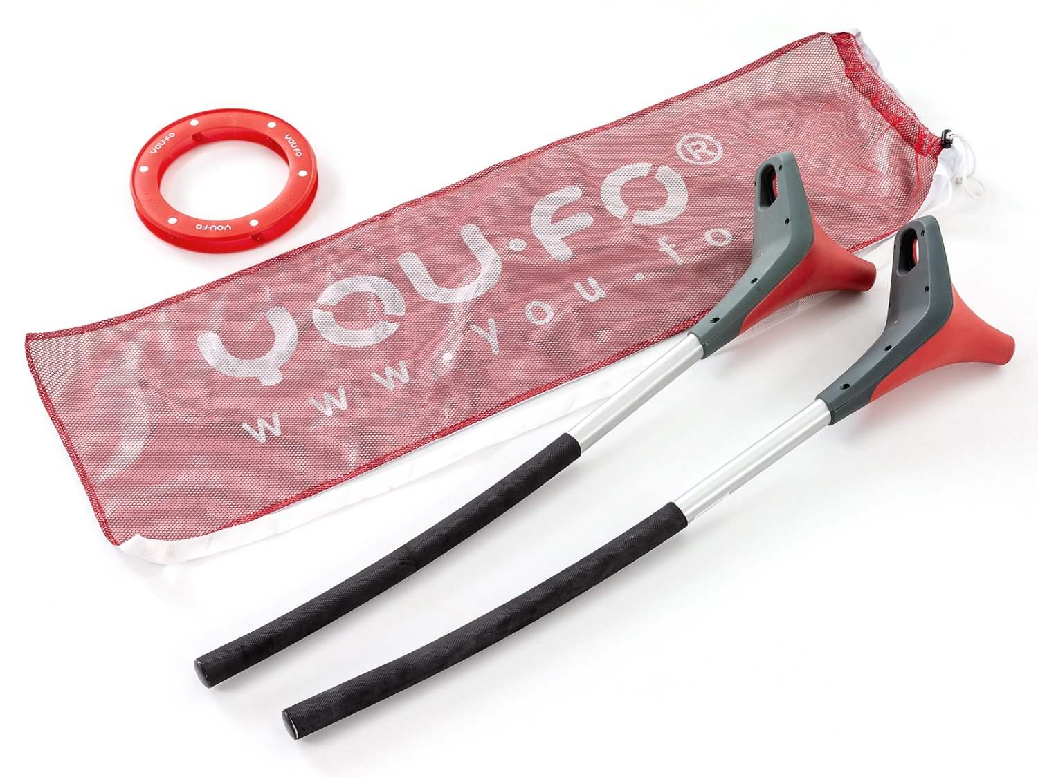
Invasion Games that can Work Well: Though Physical Distancing will need to be Established
Broomball https://www.gophersport.com/sports/broomball?tg=1
Field Hockey https://www.gophersport.com/sports/field-hockey?tg=1
Floor Hockey https://www.gophersport.com/sports/floor-hockey?tg=1
Lacrosse https://www.gophersport.com/sports/lacrosse?tg=1
Scoops https://www.gophersport.com/search-unbxd?q=scoop
Soccer https://www.gophersport.com/search?q=soccer+eqiupment
You Fo https://www.gophersport.com/pe/activities/you-fo-set?item=162696

Slide 4
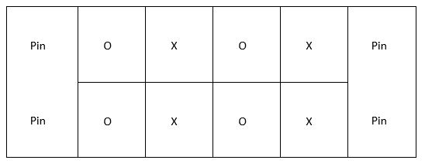
How to Physical Distance in Team Sports
No goalies--use pins
Create grids--players play within
3-5 second pass/shot rule
Add a second ball
Play small sided still, maybe four against four—see diagram below.

Slide 5
Target Games
Target games work well but players should only use their own equipment and keep physical distancing from others.
Students are very capable of developing their own target games—encourage them ☺

Slide 6
Hula Hoop Horseshoe https://www.canadago4sport.com/Target1/Hula-Hoop-Horseshoes

Slide 7
Hula Hoop Horseshoe Race https://www.canadago4sport.com/Target1/Hula-Hoop-Horseshoes-Race

Slide 8
SyncroBall https://www.canadago4sport.com/Target1/SynchroBall

Slide 9
Launch Baseball https://www.canadago4sport.com/strike/Launch-Baseball

Slide 10
Golf https://www.gophersport.com/search-unbxd?&q=Golf%20Equipment&rows=40&view=grid&start=0
Regular Golf

Slide 11
Disc Golf—With Mobile Stands https://www.canadago4sport.com/Target1/Disc-Golf-with-Mobile-Goals

Slide 12
Disc Golf—With Natural Goals https://www.canadago4sport.com/Target1/Disc-Golf-with-Natural-Goals

Slide 13
Kickpar https://www.canadago4sport.com/Target1/Kickpar
No video yet

Slide 14
TripleShot Disc Target https://www.gophersport.com/sports/disc-golf/tripleshot-disc-target-set?item=169024

Slide 15
Net Game Team Launch https://www.canadago4sport.com/Net/Team-Launch-Light

Slide 16
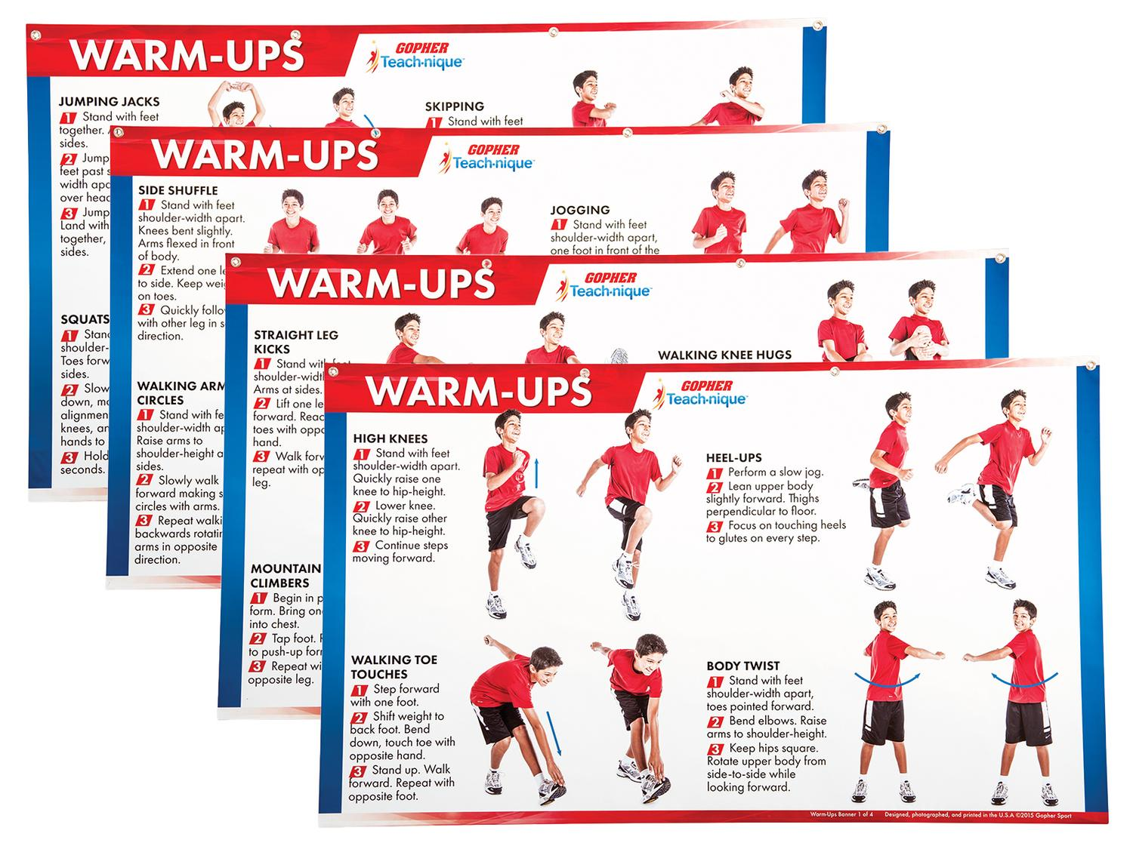
Fitness Activities
Warmup charts without equipment
https://www.gophersport.com/pe/gym-posters/teach-nique-warm-ups-banners?item=9332
F.I.T.T Banners
https://www.gophersport.com/pe/gym-posters/teach-nique-fitt-banners?item=10848

Slide 17
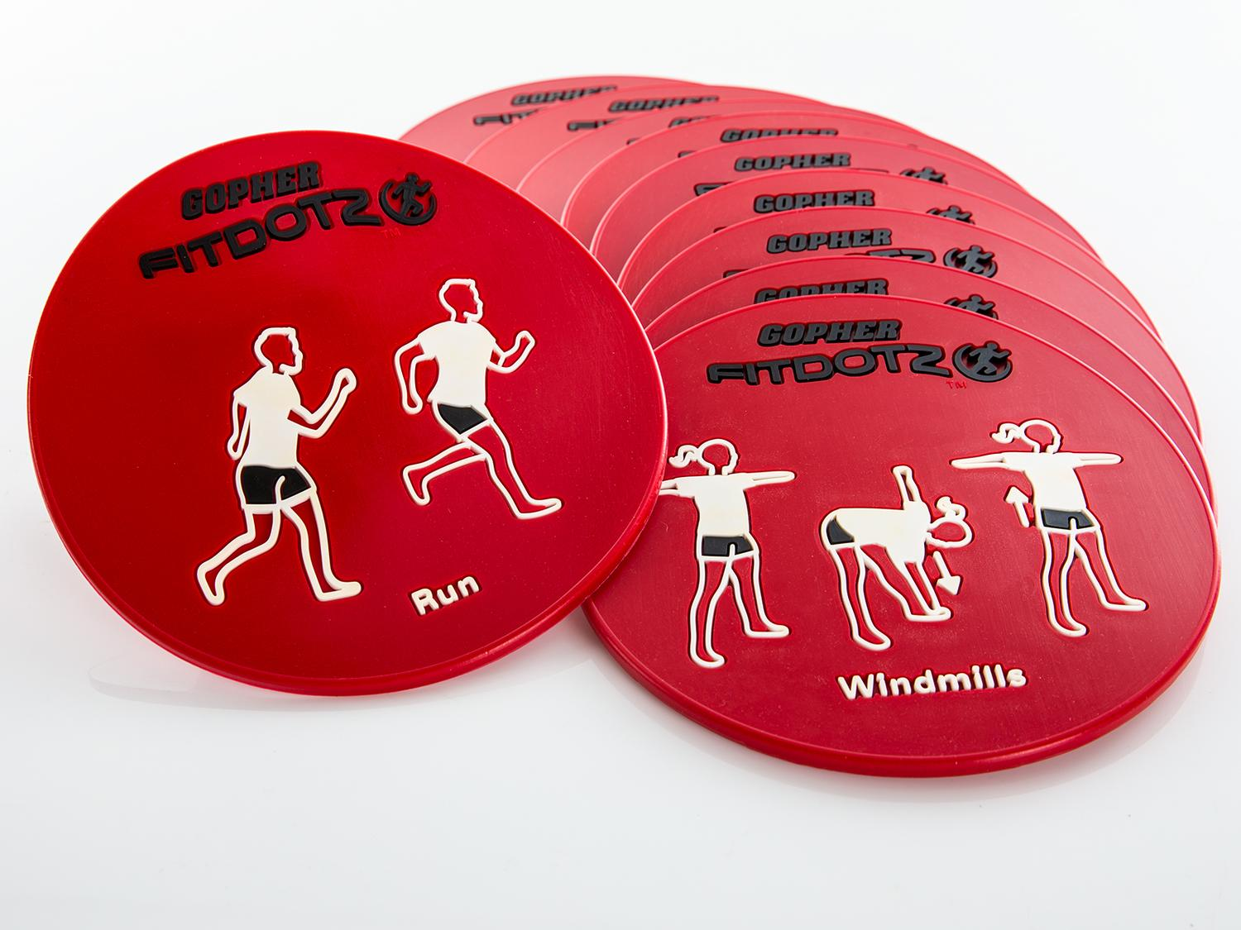
Fitness Activities Con`t Exeropoly https://www.canadago4sport.com/Warmups/Exeropoly

Slide 18
Ladder Activities
Ladder activities—for about 50 different ways https://www.canadago4sport.com/agility-ladders

Slide 19
Ladder Activities Con`t Just with Feet
For example:

Slide 20
In and Out Jumps https://www.canadago4sport.com/Ladders/In-Then-Out-Jumps

Slide 21
180s https://www.canadago4sport.com/Ladders/180s

Slide 22
Ladder Activities Con`t With Feet and Hands
For example:

Slide 23
Sideways Up Up Back Up Up With Feet https://www.canadago4sport.com/Ladders/Ladder-Sideways-Fwd-Fwd-Back-Fwd-Fwd-Back-With-Feet

Slide 24
Sideways with Explosive 3-Point Pushups https://www.canadago4sport.com/Ladders/Ladder-Sideways-Each-Rung-With-Explosive-Three-point-Pushups

Slide 25
Ladder Activities Con`t With Additional Equipment Squat 180 Squat 180 https://www.canadago4sport.com/Ladders/Squat-180

Slide 26
In In Out Out While Dribbling Ball with Racquet https://www.canadago4sport.com/Ladders/Ladder-In-In-Out-Out-While-Dribbling-Ball-With-Racquet

Slide 27
In Out Racquet Rally https://www.canadago4sport.com/Ladders/Ladder-In-In-Out-Out-Racquet-Rally

Slide 28
Lunges with Badminton Bird https://www.canadago4sport.com/Ladders/Lunges-with-badminton-bird

Slide 29
Activity Break followed by Questions
Can be done with standing and squats (can add weights)
Can be done with pushups

Slide 30
Most Tag Games With Cleaned Pool Noodles for Its https://www.gophersport.com/sports/swimming/funoodles-foam-rod-floats?item=-204621

Slide 31
Ice Skating Tag https://www.canadago4sport.com/Locomotor/Ice-Skating-Tag

Slide 32
Sponge Tag https://www.canadago4sport.com/Locomotor/Sponge-Tag

Slide 33
Penguin Lobster Tag https://www.canadago4sport.com/Locomotor/Penguin-Lobster-Tag

Slide 34
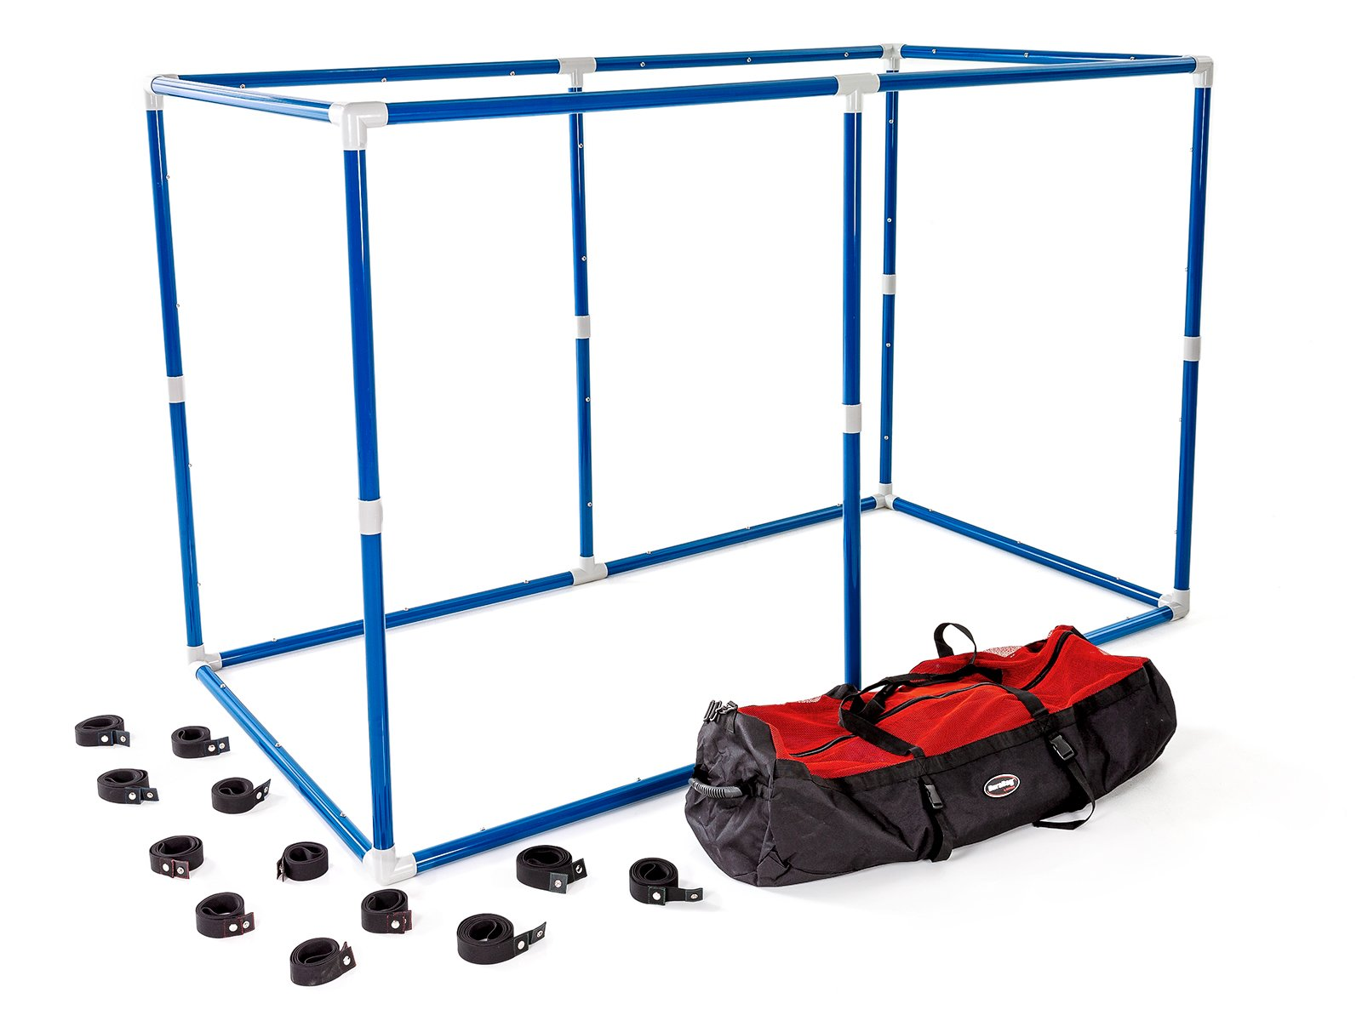
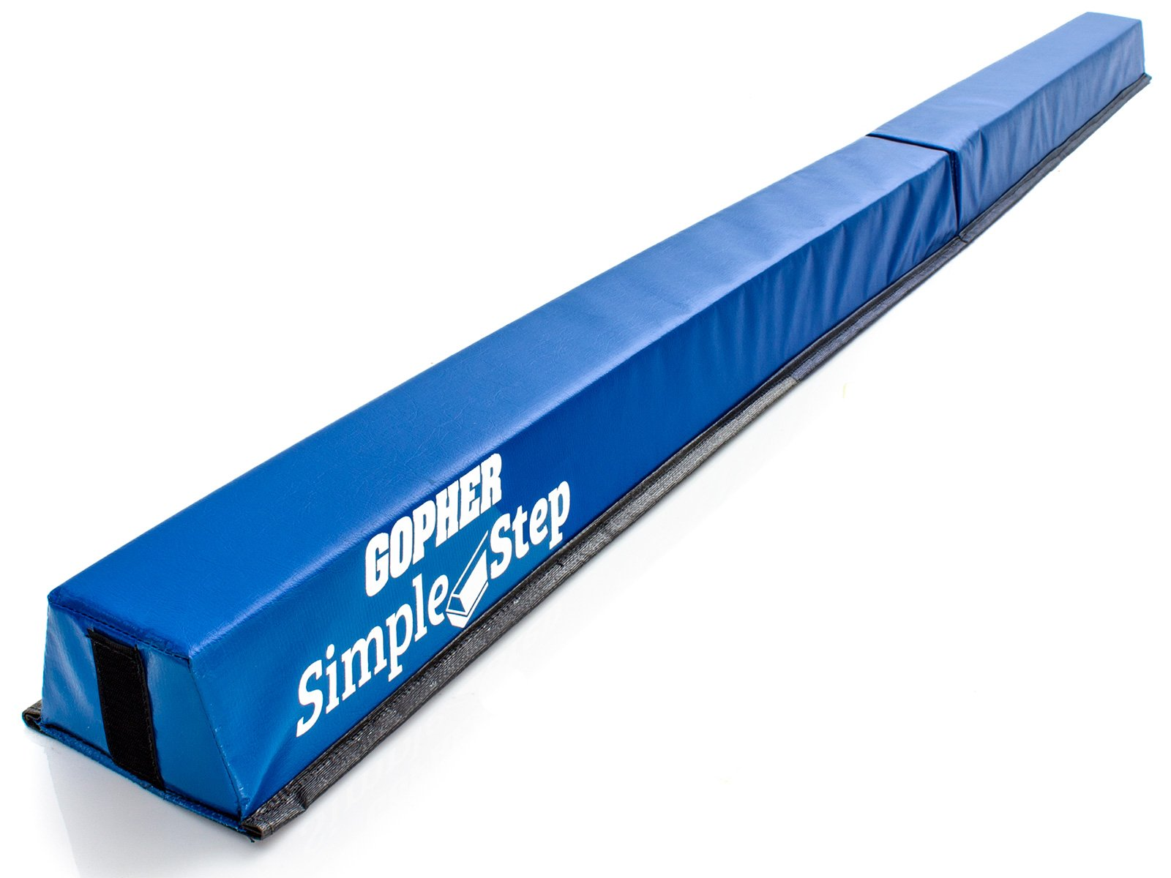
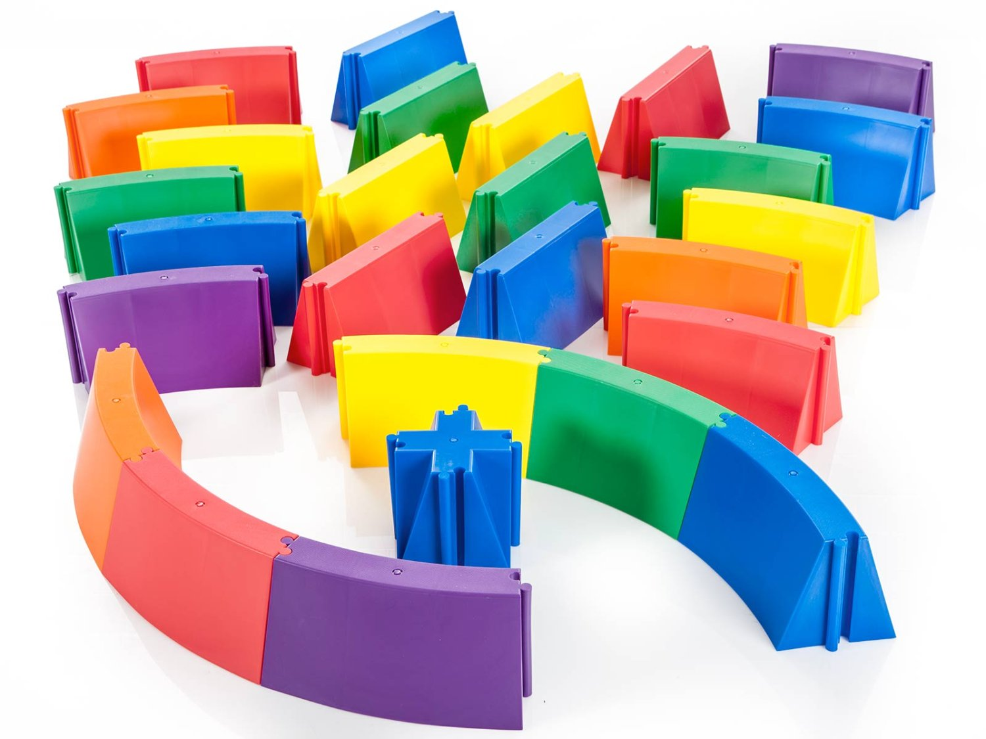
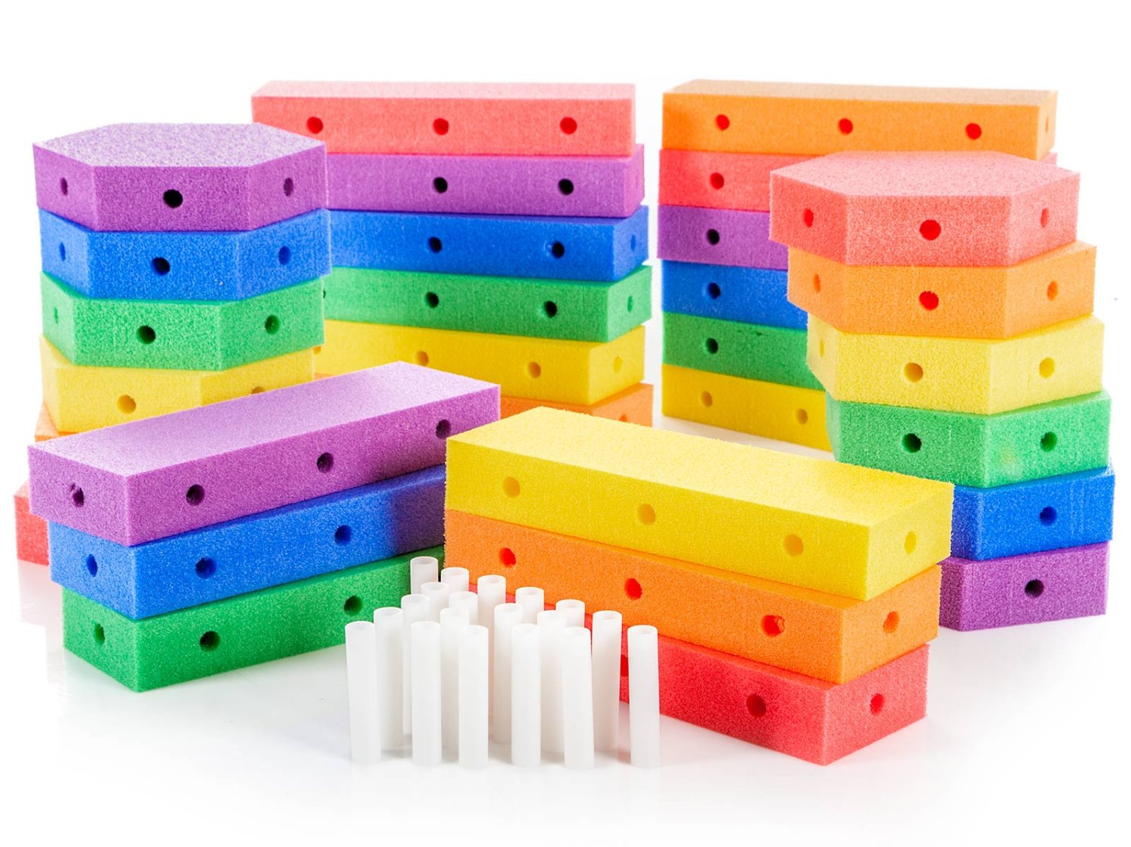
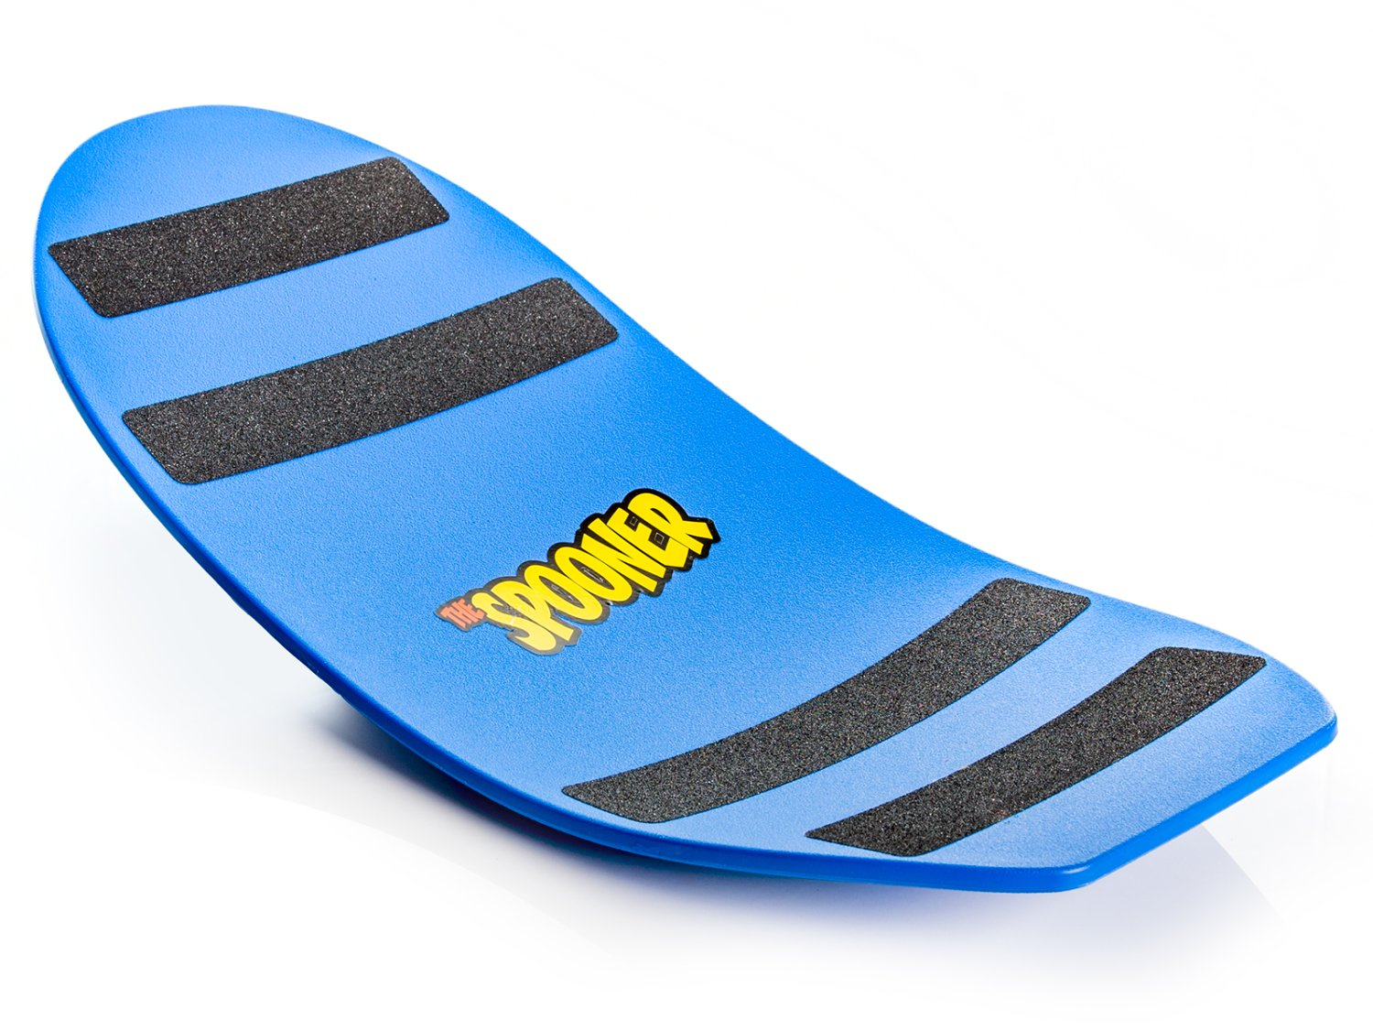
Obstacle Courses
Maneuver Maze https://www.gophersport.com/pe/movement/maneuvermaze-obstacle-course?item=162174
Simple Step https://www.gophersport.com/pe/movement/simplestep-balance-beam?item=154075
Figure 8 https://www.gophersport.com/pe/movement/figure-8-balance-beam?item=5275
Create a Course https://www.gophersport.com/pe/movement/create-a-beam-plus-balance-set?item=9753
Spooner https://www.gophersport.com/pe/movement/the-spooner?item=5584

Slide 35
Sample Obstacle Course https://www.canadago4sport.com/Locomotor/Obstacle-Course

Slide 36
Dance
Resources https://www.gophersport.com/pe/dance?tg=1
Everybody Move https://www.gophersport.com/pe/movement/everybody-move?item=6202
Samples https://www.pinterest.ca/canadago4sport/dance/
Don`t Sit Still Swimming Groove (Body, Brain, & Being)

Slide 37
Daily Physical Activity (DPA)
Everybody Move https://www.gophersport.com/pe/movement/everybody-move?item=6202

Slide 38
Simon Says https://www.canadago4sport.com/Leadership/Simon-Says

Slide 39
Simon Says do Previous https://www.canadago4sport.com/Leadership/Simon-Says-Do-Previous

Slide 40
Simon Says do Opposite https://www.canadago4sport.com/Leadership/Simon-Says-Do-Opposite

Slide 41
Ying Yang You Instructions https://www.canadago4sport.com/Leadership/Ying-Yang-You-Instructions

Slide 42
Ying Yang You Slow https://www.canadago4sport.com/Leadership/Ying-Yang-You-Slow

Slide 43
Ying Yang You Faster https://www.canadago4sport.com/Leadership/Ying-Yang-You-Faster

Slide 44
Ying Yang You Back https://www.canadago4sport.com/Leadership/Ying-Yang-You-Back

Slide 45
Leadership Games

Slide 46
Tip the Bucket https://www.canadago4sport.com/Leadership/Tip-the-Bucket

Slide 47
Carry and Drop the Bean Bag https://www.canadago4sport.com/Leadership/Carry-and-Drop-the-Bean-Bags

Slide 48
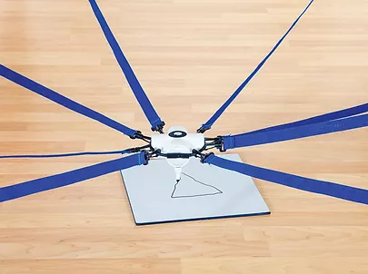
Cooperative Writing https://www.canadago4sport.com/Leadership/Cooperative-Writing
No video yet:

Slide 49
Architect https://www.canadago4sport.com/Leadership/Architect

Slide 50
Numeracy

Slide 51
Even and Odd With Wall Sit and Run https://www.canadago4sport.com/Numeracy/Even-and-Odd-With-Wall-Sit-and-Run

Slide 52
Ready Set Select https://www.canadago4sport.com/Numeracy/Ready-Set-Select-

Slide 53
Odd Even Tag https://www.canadago4sport.com/Numeracy/Odd-Even-Tag

Slide 54
Numeracy--Sequencing
Use ToppleTubes of plastic cups

Slide 55
Tic Tac Double Four in a Row https://www.canadago4sport.com/Numeracy/Tic-Tac-Double-Four-in-a-Row

Slide 56
Connect Four Up https://www.canadago4sport.com/Numeracy/Connect-Four-Up

Slide 57
Active Checkers https://www.canadago4sport.com/Numeracy/Active-Checkers

Slide 58
Topple Three Up https://www.canadago4sport.com/Locomotor/Topple-Three-Up
1,000,00+ views on Pinterest www.pinterest.ca/pin/283515739029933805/

Slide 59
Social Distancing Activities
11 Minute video from CIRA Ontario on Fair & Square at:
https://www.chch.com/distanced-phys-ed/

Slide 60
Web Resources
Canadago4sport:
600+ game docs and 250+ game videos
www.canadago4sport.com
Nearly 50 different ladder activities
https://www.canadago4sport.com/agility-ladders
Gopher Sport:
Order from hundreds of equipment ideas.
https://www.gophersport.com/
Unconditional 100% satisfaction guarantee
Your satisfaction is our #1 concern! If you are not satisfied with any product you buy from us, we'll simply replace it or refund your money. No questions. No hassles. No exclusions. No kidding!

Slide 61
Pinterest and YouTube
Pinterest:
24 boards, and 700+ pins
Follow at https://www.pinterest.ca/canadago4sport/
YouTube:
330+ videos
Subscribe at https://www.youtube.com/c/canadago4sport/

Slide 62
Social Media and Further Questions
Twitter & Instagram:
Tuesday and Thursdays (sometimes other days) posts
Follow at @canadago4sport
Love to hear from you:
JOHNBYL50@gmail.com

Slide 63
With thanks
To all of the wonderful people
who inspire each other
at conferences and other places!
To Gopher Sport
for their innovative products
and high quality equipment!

Slide 64
Download slides at:
www.canadago4sport.com
Workshops
https://www.canadago4sport.com/conferences-and-workshops

Slide 65
Questions and Comments

