Slide 1
Activities and Equipment Kits for More Individualized Physical Health Education at School or at Home K-3 & 4-6
Dr. John Byl
JOHNBYL50@gmail.com
While we wait, sign up for weekly activity postings on:
Twitter or Instagram
@canadago4sport

Slide 2
Key Considerations
Equipment Sharing
Do not share equipment—unless the equipment is kicked (soccer balls for example).
Do not pick up equipment with your hands, and if you do pick up equipment, make sure the equipment has been properly disinfected and not touched by others after disinfection.
Physical Distancing
Try to create playing spaces for each player with the use of poly spots or half-cones…
Masks
Think through wearing of masks in line with safety and school policies…

Slide 3
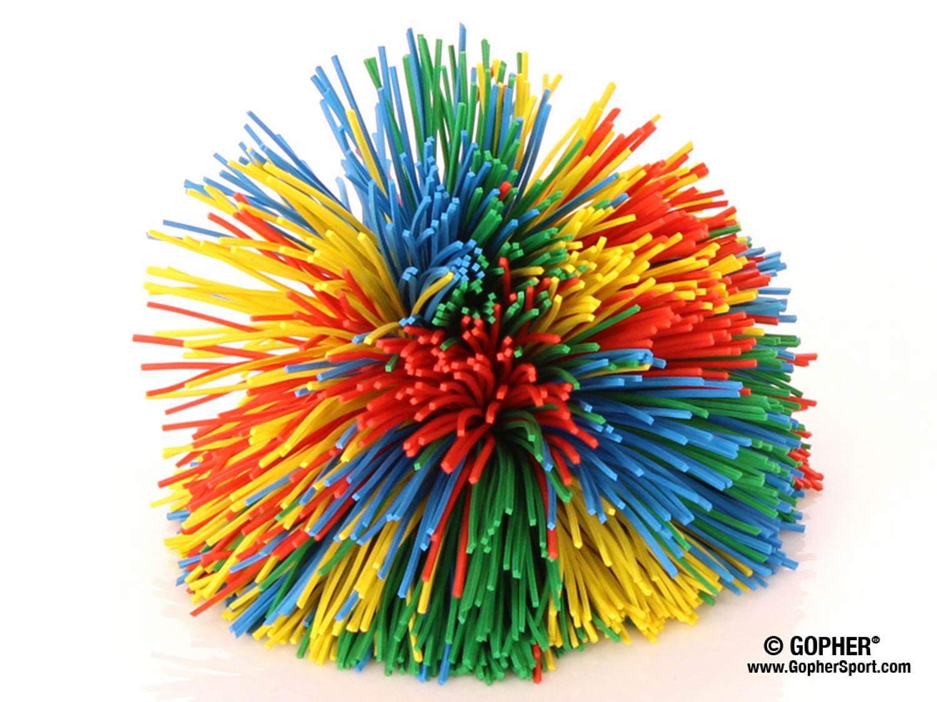
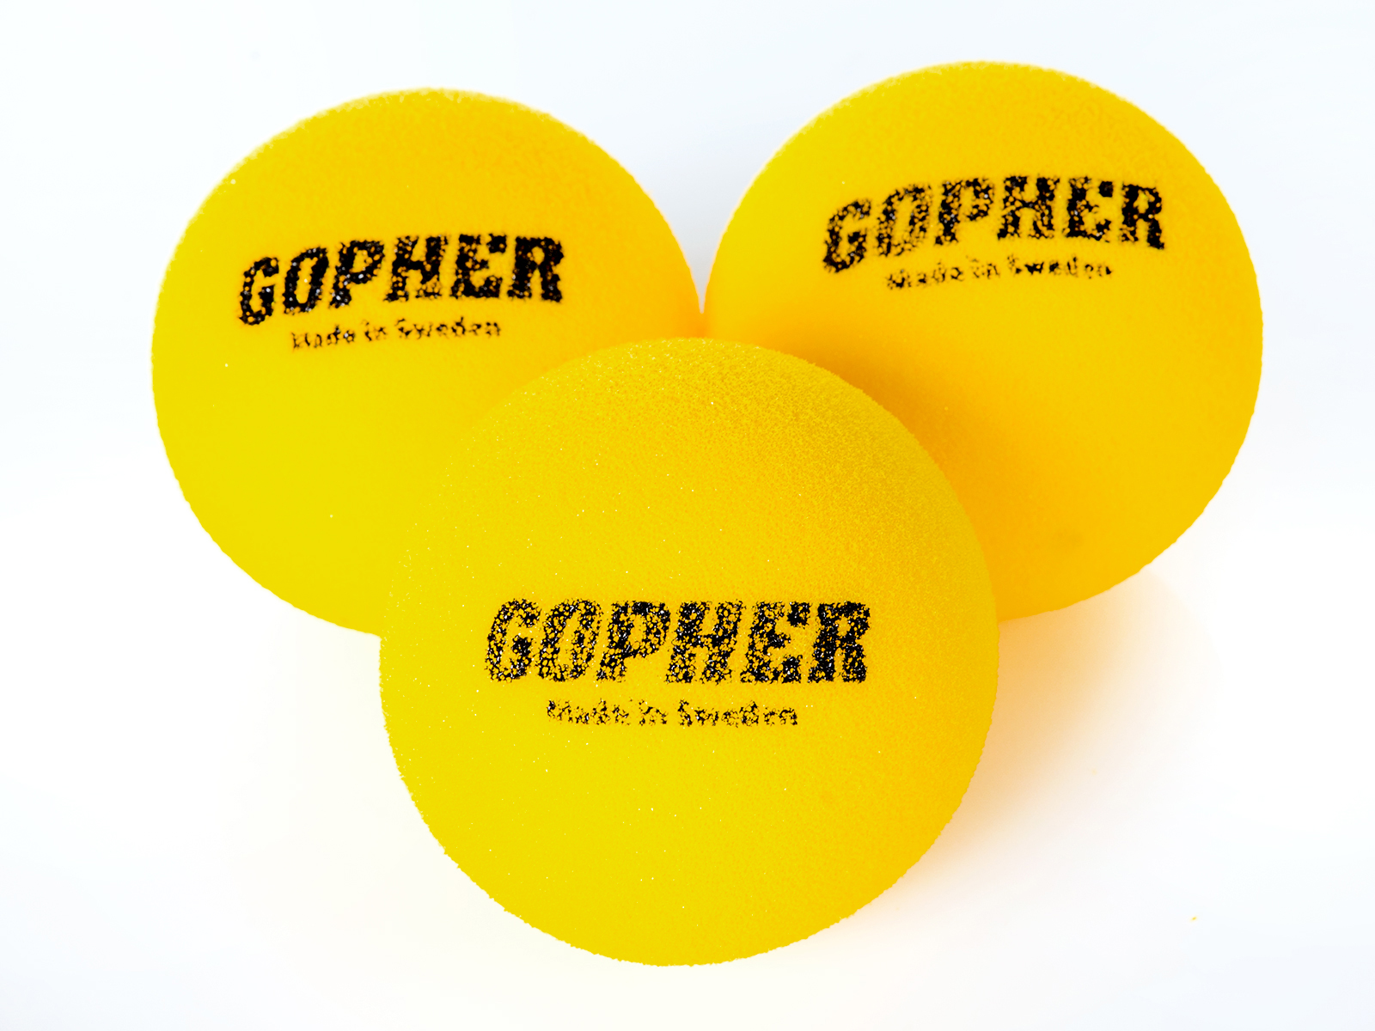
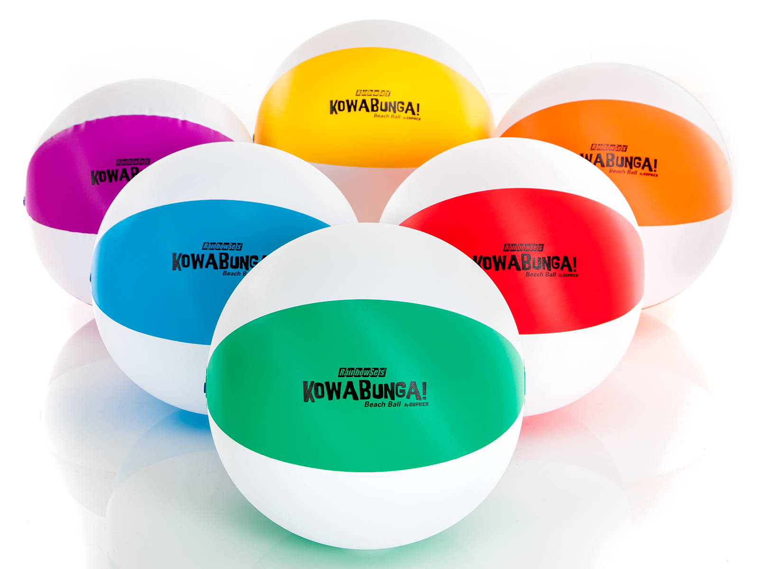
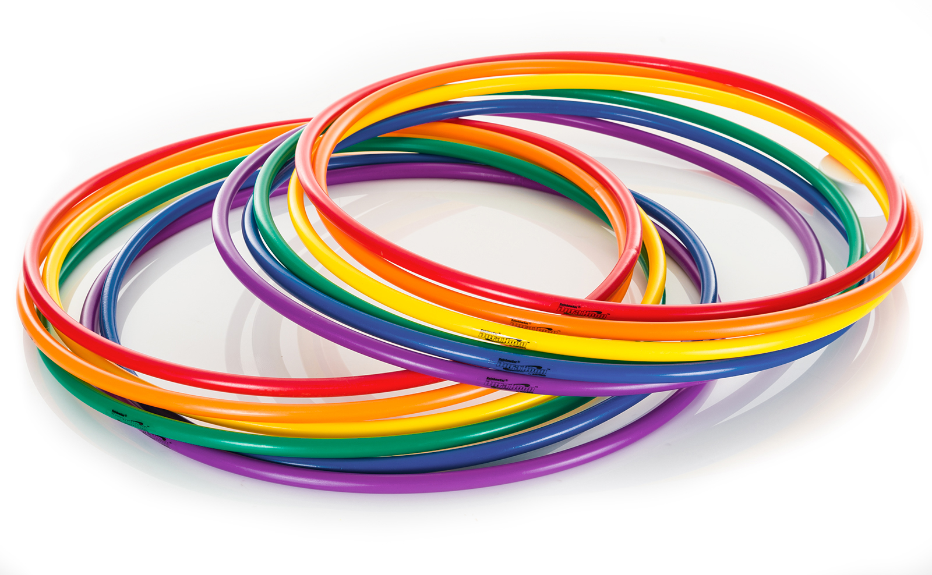
Primary (Grades K-3)
Kit
1 Rubber Band Ball
One bouncy foam ball
Use from home
Water bottles for pins
Tape to mark spaces
Chalk to make hop scotch activities or two square boxes…
Beach ball
2 Hula hoops
Balloons

Slide 4
Locomotor Activities
Design an obstacle course, with chalk, which includes the need to jump, leap, skip, hop, gallop, and dodging—Time how quickly players can complete the course and learn to improve their times by improving their locomotor activity.

Slide 5
Target Activities Hula Hoop Horseshoe https://youtu.be/c-mKFTRXOS8 https://www.canadago4sport.com/Target1/Hula-Hoop-Horseshoes

Slide 6
Hula Hoop Horseshoe Race https://youtu.be/D-lAsMyun3M https://www.canadago4sport.com/Target1/Hula-Hoop-Horseshoes-Race

Slide 7
Net/Wall Activities Two square (use a much lighter ball than a stability ball) https://www.canadago4sport.com/Net/Two-Square-Stability-Ball

Slide 8
Manipulative Retain Balance a Ball https://www.canadago4sport.com/Manipulative-Retain/Balance-Two-Ball

Slide 9
Stork Stand Balloon Keepup https://www.canadago4sport.com/Manipulative-Retain/Stork-Stand-Balloon-Keepup

Slide 10
Balloon Dribble with Hands https://www.canadago4sport.com/Manipulative-Send/Balloon-Dribble-With-Hands

Slide 11
Balloon Dribble with Feet https://www.canadago4sport.com/Manipulative-Send/Balloon-Dribble-with-Feet

Slide 12
Manipulative Send and Receive Noodle Toss Pairs [at home] (but use Rubber Band Ball instead) https://www.canadago4sport.com/Manipulative-Send/Noodle-Toss-Pairs

Slide 13
Circus Catches [at home—unless tossed to self] https://www.canadago4sport.com/Stability-Ball1/Circus-Catches

Slide 14
K-3 Equipment From Gopher
Rubber Band Balls - Individual Multicolored, 2.5" die
Item No: 72-088 (comes in set of 6)
One Rubber Band Ball = $9.00 CDN (US$ amount is lower)
Gopher Oversized Foam Tennis Balls - Gopher Oversized Foam Tennis Balls
Item No: 41-718 (comes in set of 3)
One Oversized Foam Tennis Ball = $6.00 CDN (US$ amount is lower)

Slide 15
K-3 Equipment From Home (or Gopher)
Kowabunga! Beach Balls - 12" dia
Item No: 71-590 (comes in set of 6)
One Beach Ball = $7.33 CDN (US$ amount is lower)
DuraHoop - Set of 12, 30" dia
Item No: 43-505 (comes in set of 12)
One hula hoop is $7.42CDN (US$ amount is lower)

Slide 16
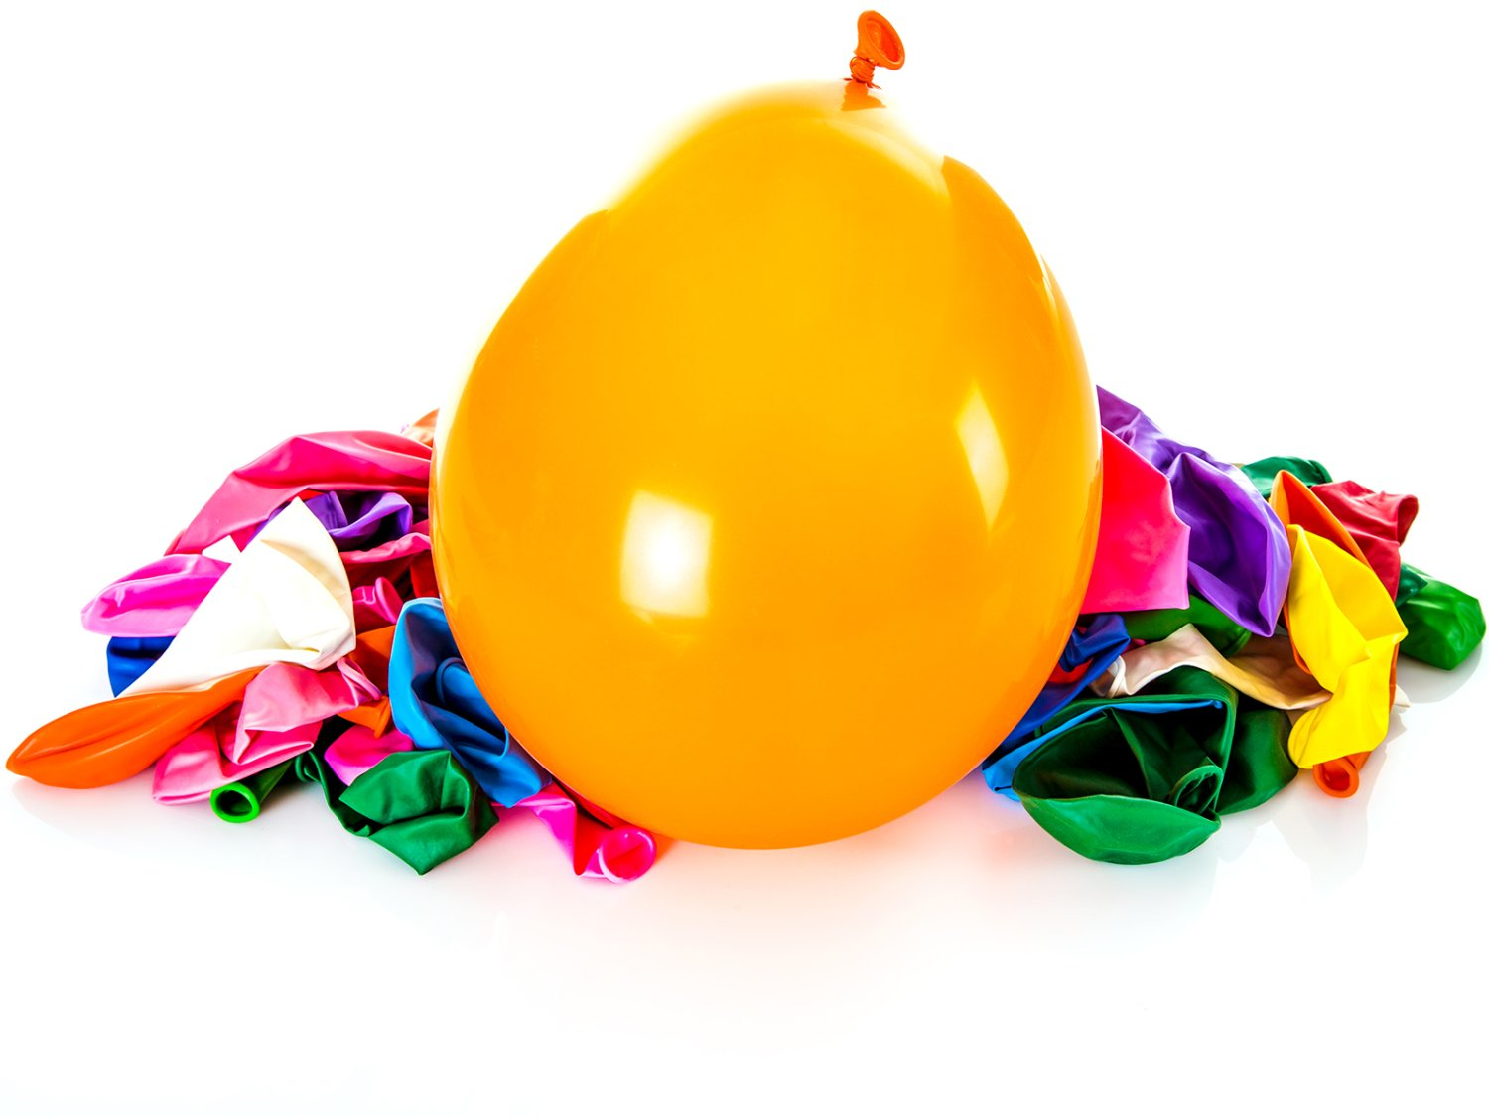
K-3 Equipment From Home (or Gopher) Con’t
Water bottles for pins
Tape to mark spaces
Chalk to make hop scotch activities or two square boxes…
Balloons
Item No: 92-570 (package of 100 12”)
100 Balloons = $13.00CDN (US$ amount is lower)

Slide 17
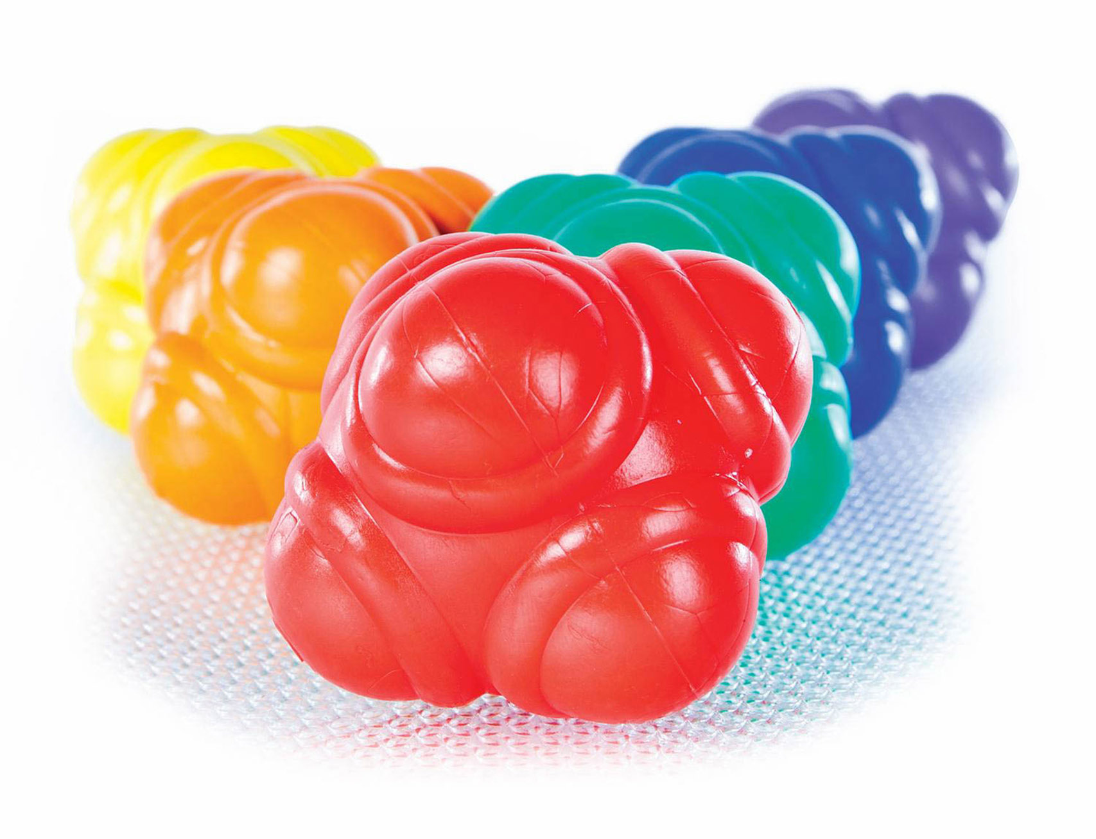
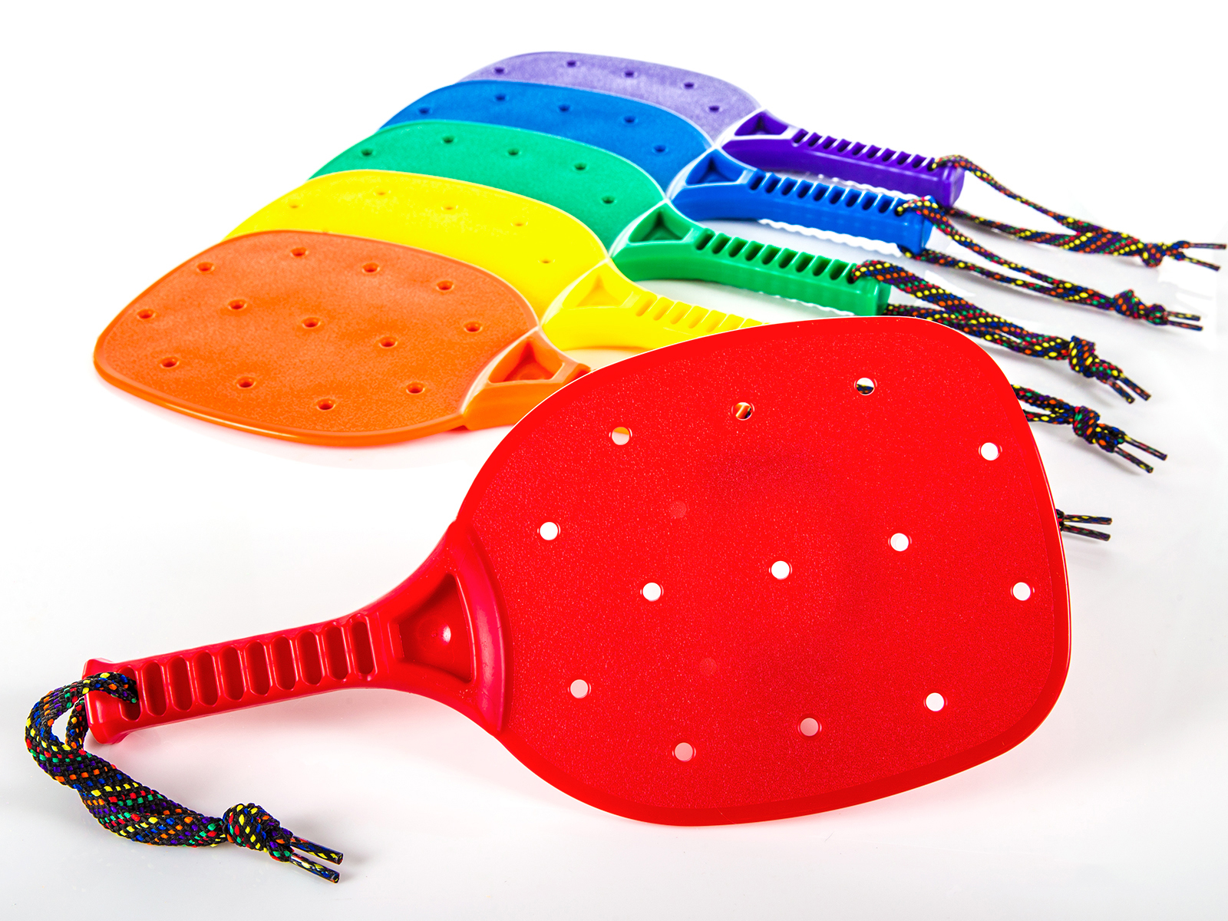
Juniour (Grades 4-6) Kit
1 Reaction ball for quick exercise break
1 Oversized Foam Tennis Balls
1 Paddle

Slide 18
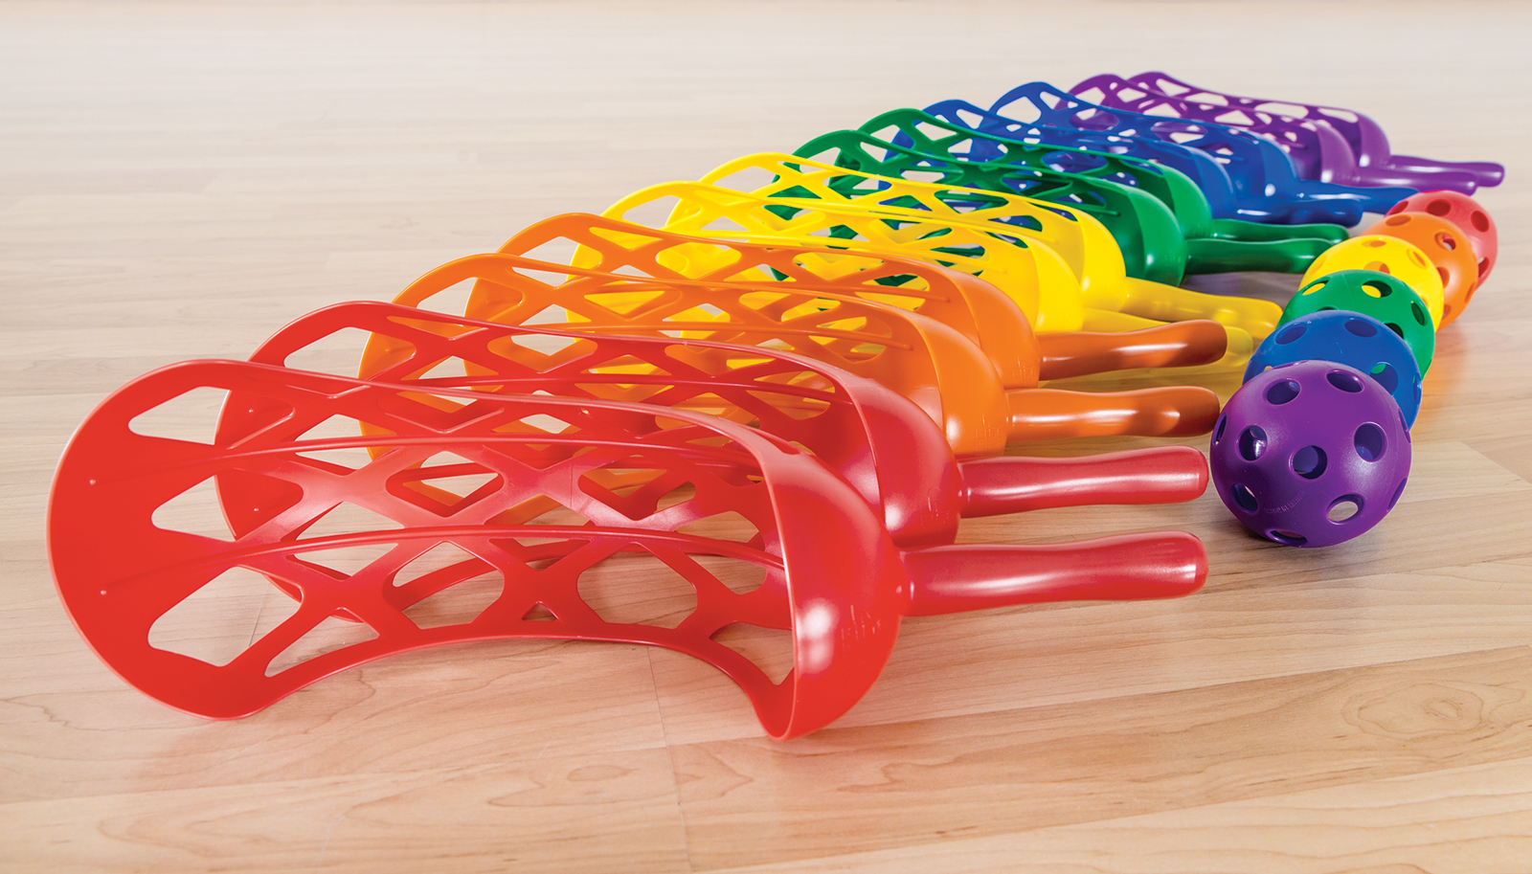
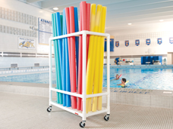
Junior (Grades 4-6) Use from home
Water bottles for pins
Roll of tape
Tape to mark spaces
Chalk to make hop scotch activities or two square boxes…
1 Hula Hoop
1 Soccer Ball
Inflator
Balloons
Popsicle stick or tongue depressor
1 Scoop
1 pool noodle cut in half-length

Slide 19
Target Activities Hula Hoop Horseshoe—Repeat from K-3 https://youtu.be/c-mKFTRXOS8 https://www.canadago4sport.com/Target1/Hula-Hoop-Horseshoes

Slide 20
Hula Hoop Horseshoe Race—Repeat from K-3 https://youtu.be/D-lAsMyun3M https://www.canadago4sport.com/Target1/Hula-Hoop-Horseshoes-Race

Slide 21
Kickpar https://www.canadago4sport.com/Target1/Kickpar

Slide 22
Disc Golf
https://www.canadago4sport.com/Target1/Disc-Golf-with-Natural-Goals
https://www.canadago4sport.com/Target1/Disc-Golf-with-Mobile-Goals

Slide 23
Manipulative Send How Far Can We Roll—Individually https://www.canadago4sport.com/Target1/How-Far-Can-we-Roll

Slide 24
Backwards Partner Bowling [at home] https://www.canadago4sport.com/Target1/Backwards-Partner-Bowling

Slide 25
Tape Roll Rolling https://www.canadago4sport.com/Target1/Tape-Roll-Bowling
No video yet

Slide 26
Net/Wall Activities Two Square With a Target https://www.canadago4sport.com/Target1/Ace-Chase-Two-Square

Slide 27
Width and Depth [at home] https://www.canadago4sport.com/Net/Width-and-Depth

Slide 28
Manipulative Retain Balance a Ball—Repeat from K-3 https://www.canadago4sport.com/Manipulative-Retain/Balance-Two-Ball

Slide 29
Double Dribble https://www.canadago4sport.com/Manipulative-Retain/Double-Dribble

Slide 30
Stork Stand Balloon Keepup Repeat from K-3 https://www.canadago4sport.com/Manipulative-Retain/Stork-Stand-Balloon-Keepup

Slide 31
Balloon Dribble with Hands Repeat from K-3 https://www.canadago4sport.com/Manipulative-Send/Balloon-Dribble-With-Hands

Slide 32
Balloon Dribble with Feet Repeat from K-3 https://www.canadago4sport.com/Manipulative-Send/Balloon-Dribble-with-Feet

Slide 33
Manipulative Send and Receive Noodle Toss Pairs [at home] (but use Rubber Band Ball instead) Repeat from K-3 https://www.canadago4sport.com/Manipulative-Send/Noodle-Toss-Pairs

Slide 34
Scoops with a partner or solo against a wall https://www.canadago4sport.com/Manipulative-Send/Scoop-to-Wall

Slide 35
Throw to a Wall Timed Race https://www.canadago4sport.com/Manipulative-Send/Throw-to-a-Wall-Relay https://www.canadago4sport.com/Manipulative-Send/Toss-and-Catch-to-Wall
But make an individual or team (2-3 players) race of it.

Slide 36
Bird/Ball Juggle https://www.canadago4sport.com/Manipulative-Send/-Bird%2FBall-Juggle

Slide 37
Circus Catches [at home—unless tossed to self] Repeat from K-3 https://www.canadago4sport.com/Stability-Ball1/Circus-Catches

Slide 38
Fitness
Ladder activities—for over 60 different activites, download the Ladder workshops at
https://www.canadago4sport.com/conferences-and-workshops

Slide 39
Two Players Sharing Equipment?
The PHE Canada document does not encourage the sharing of any equipment. For those teachers in other countries, you may wish to consider the following thoughts.
On May 19, 2020 the United States’ Centers for Disease Control and Prevention (CDC) changed its guidelines to state https://www.cdc.gov/coronavirus/2019-ncov/prevent-getting-sick/how-covid-spreads.html:
The virus that causes COVID-19 is spreading very easily and sustainably between people. Information from the ongoing COVID-19 pandemic suggest that this virus is spreading more efficiently than influenza, but not as efficiently as measles, which is highly contagious.
The virus does not spread easily in other ways

Slide 40
Two Players Sharing Equipment? Con’t
COVID-19 is a new disease and we are still learning about how it spreads. It may be possible for COVID-19 to spread in other ways, but these are not thought to be the main ways the virus spreads.
From touching surfaces or objects. It may be possible that a person can get COVID-19 by touching a surface or object that has the virus on it and then touching their own mouth, nose, or possibly their eyes. This is not thought to be the main way the virus spreads, but we are still learning more about this virus.
Based on the CDC guidelines, a school and instructor’s wisdom, you may decide to engage students where there is limited sharing of equipment. How might we do that? Permit a couple of examples if you can still reduce equipment contact if you decide it is wise to go in this direction.

Slide 41
Two Players Sharing Equipment? Con’t
Net Games
Have players share a bird, table tennis ball, or tennis ball.
Playing other two-player games:
Width and Depth https://www.canadago4sport.com/Net/Width-and-Depth
Two Square https://www.canadago4sport.com/Net/Two-Square-Stability-Ball
Striking
Use a different ball for each baseball/cricket inning and for each new pitcher.
There is no unnecessary passing of the ball (tossing the ball around the bases after a strike out…)—but I would rarely (never?) do a full-sized baseball/softball game in a Physical Education class.

Slide 42
Even and Odd With Wall Sit and Run https://www.canadago4sport.com/Numeracy/Even-and-Odd-With-Wall-Sit-and-Run

Slide 43
Ready Set Shoot https://www.canadago4sport.com/Numeracy/Ready-Set-Select-

Slide 44
Topple Three Up https://www.canadago4sport.com/Locomotor/Topple-Three-Up

Slide 45
Shuffle (use playing cards instead of spots) One players per team https://www.canadago4sport.com/Numeracy/Tic-Tac-Toe-Shuffle

Slide 46
Planks till Odd Use own dice and beanbag https://www.canadago4sport.com/Numeracy/Planks-till-odd

Slide 47
Off Balance https://www.canadago4sport.com/Combative/Off-Balance

Slide 48
Popsicle Stick Pull https://www.canadago4sport.com/Combative/Popsicle-Stick-Pull

Slide 49
Push up Hockey in Pairs
https://www.canadago4sport.com/Warmups/Push-Up-Hockey-in-Pairs
https://www.canadago4sport.com/Manipulative-Receive/Feet-to-Feet-Hockey

Slide 50
Round the One Minute Clock Seated https://www.canadago4sport.com/Stability-Ball1/Round-the-One-Minute-Clock

Slide 51
Round the One Minute Clock Standing https://www.canadago4sport.com/Stability-Ball1/Round-the-One-Minute-Clock-Standing

Slide 52
Juniour (Grades 4-6) Kit
1 Reaction ball for quick exercise break
Item No. 69-492 (comes in set of 6)
Price $2.83 CDN (US$ amount is lower)
1 Oversized Foam Tennis Balls
Item No: 41-718 (comes in set of 3)
One Oversized Foam Tennis Ball = $6.00 CDN (US$ amount is lower)
1 Paddle
Item No: 53-406 (comes in set of 6)
One Paddle = $11.50CDN (US$ amount is lower)

Slide 53
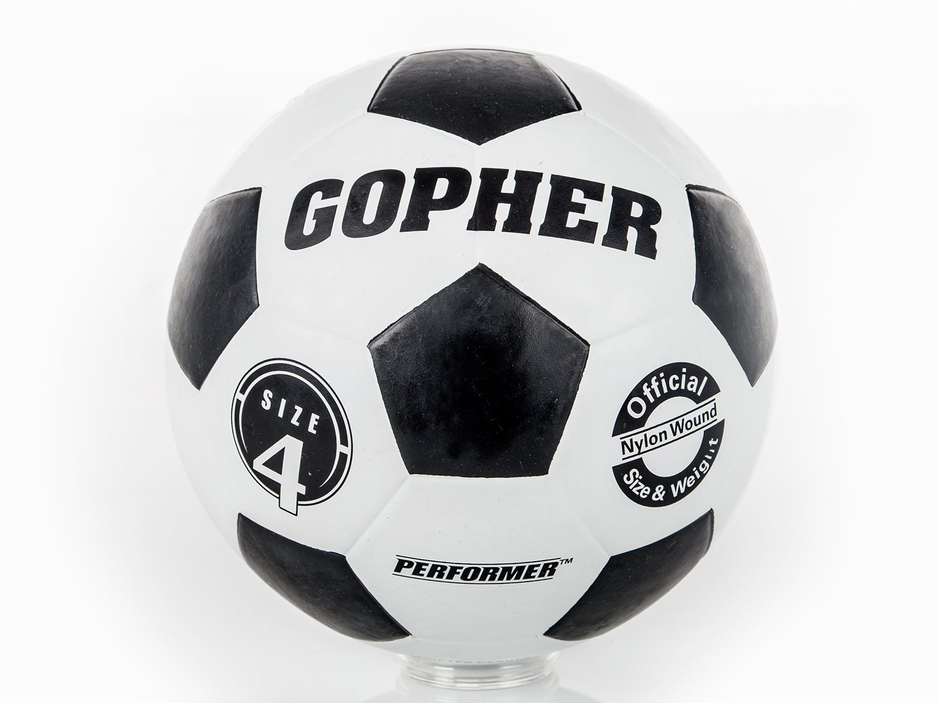
Junior (Grades 4-6) Use from home
Water bottles for pins
Roll of tape
Tape to mark spaces
Chalk to make hop scotch activities or two square boxes…
1 Hula Hoop
Item No: 43-505 (comes in set of 12)
One hula hoop is $7.42CDN (US$ amount is lower)
1 Soccer Ball
Item No: 61-841
One soccer ball is $15.00CDN (US$ amount is lower)

Slide 54
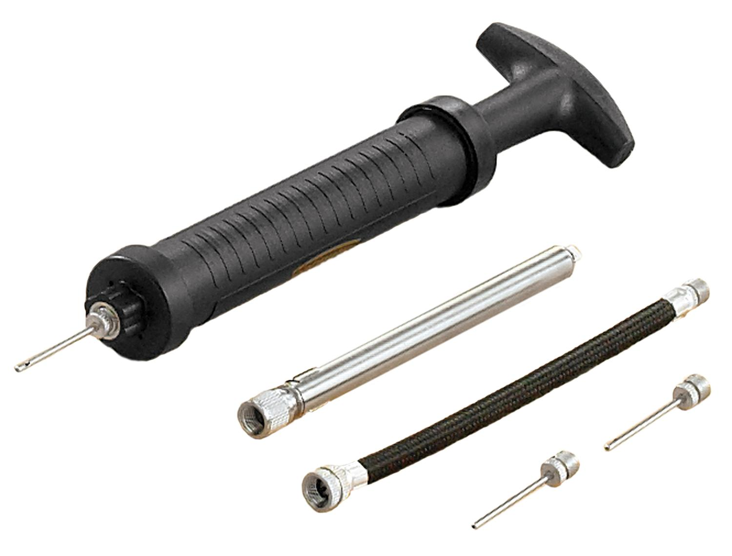
Junior (Grades 4-6) Use from home Con’t
Inflator
Item No: 66-672
1 Inflator = $15CDN (US$ amount is lower)
Balloons
Item No: 92-570 (package of 100 12”)
100 Balloons = $13.00CDN (US$ amount is lower)
Popsicle stick or tongue depressor
1 Scoop
Item No: 58-481 (package of 6)
1 Scoop & Ball = $11.50CDN (US$ amount is lower)
1 pool noodle cut in half-length
Item No: 86-637 (32 Full-length)
1 half-length noodle = $1.95CDN (US$ amount is lower)

Slide 55
Web Resources
Canadago4sport:
600+ game docs and 250+ game videos
www.canadago4sport.com
Nearly 50 different ladder activities
https://www.canadago4sport.com/agility-ladders
Gopher Sport:
Order from over 12 different ladders
https://www.gophersport.com/fitness/saq?tag=agility
Order from hundreds of equipment ideas.
https://www.gophersport.com/
Unconditional 100% satisfaction guarantee
Your satisfaction is our #1 concern! If you are not satisfied with any product you buy from us, we'll simply replace it or refund your money. No questions. No hassles. No exclusions. No kidding!

Slide 56
Pinterest and YouTube
Pinterest:
23 boards, and 600+ pins
Follow at https://www.pinterest.ca/canadago4sport/
YouTube:
330+ videos
Subscribe at https://www.youtube.com/c/canadago4sport/

Slide 57
Social Media and Further Questions
Twitter & Instagram:
Tuesday (sometimes other days) posts
Follow at @canadago4sport
Love to hear from you:
JOHNBYL50@gmail.com

Slide 58
With thanks
To all of the wonderful people
who inspire each other
at conferences and other places!
To Gopher Sport
for their innovative products
and high quality equipment!

Slide 59
Download slides at:
https://www.canadago4sport.com/conferences-and-workshops

