Slide 1
COVID-19 Safe/Individualized Physical Literacy Activities
Dr. John Byl
JOHNBYL50@gmail.com
While we wait, sign up for Tuesday & Thursday activity postings on:
Twitter or Instagram
@canadago4sport
Download slides at:
https://www.canadago4sport.com/conferences-and-workshops

Slide 2

COVID-19: PHE Canada

Slide 3
Physical Education (PE): Key Points (PHE Canada)
How do we engage our students in meaningful learning to help them connect what they are learning at school to their personal lives?
Include more individual pursuits than traditional team activities such as dance, alternative environment and land-based activities, exercises without equipment, fitness, mindfulness, gymnastics, and target games.

Slide 4
In-School Learning (PHE Canada)
Respect the physical distance of 2 metres always
For small sided games, use visual guides to define space and ensure physical distancing is maintained
Incorporate proper hand washing and personal hygiene routines
If possible, create a hand washing station
Use outdoor spaces and parks as much as possible

Slide 5
Equipment & Gear (PHE Canada)
Equipment Sharing
Minimize shared equipment—unless the equipment is kicked (soccer balls for example).
Physical Distancing
Try to create playing spaces for each player with the use of poly spots or half-cones…
Masks
Think through wearing of masks in line with safety and institution policies…

Slide 6
Two Players Sharing Equipment?
The PHE Canada document does not encourage the sharing of any equipment.
Canadian Government:
COVID-19 spreads from an infected person to others through respiratory droplets and aerosols (smaller droplets) created when an infected person:
talks
sings
shouts
coughs
sneezes
COVID-19 can also spread by touching something that has the virus on it, then touching your mouth, nose or eyes with unwashed hands. You can transmit COVID-19 before you start showing symptoms or without ever developing symptoms.

Slide 7
Physical Literacy Skills
"Physical literacy is the motivation, confidence, physical competence, knowledge, and understanding to value and take responsibility for engagement in physical activities for life." - The International Physical Literacy Association, May 2014

Slide 8

https://sportforlife.ca/physical-literacy/

Slide 9
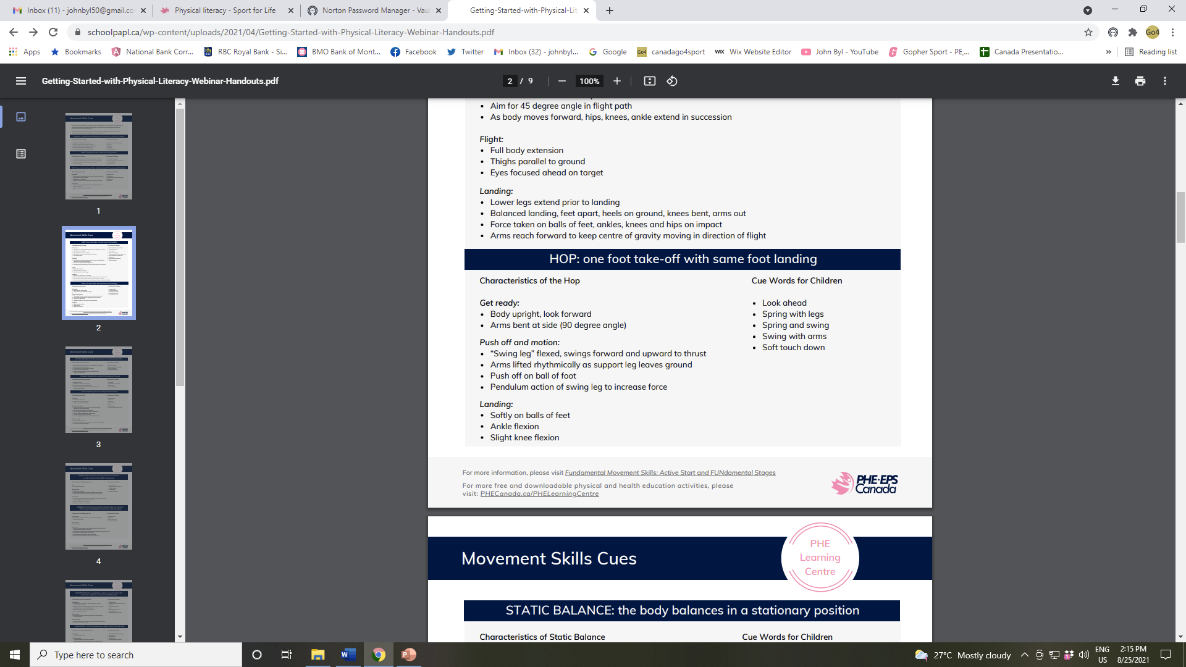
Movement Skills https://schoolpapl.ca/wp-content/uploads/2021/04/Getting-Started-with-Physical-Literacy-Webinar-Handouts.pdf

Slide 10
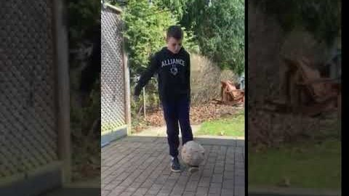
Manipulative Retain Balance a Ball https://www.canadago4sport.com/Manipulative-Retain/Balance-Two-Ball

Slide 11
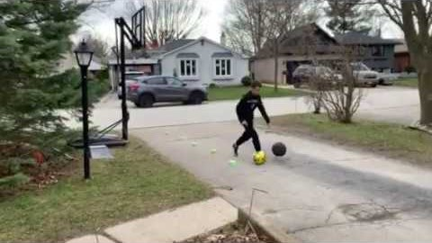
Double Dribble https://www.canadago4sport.com/Manipulative-Retain/Double-Dribble

Slide 12
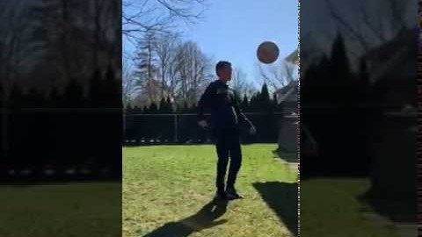
Soccer Juggle with 360 https://www.canadago4sport.com/Manipulative-Retain/Soccer-Juggle-with-360

Slide 13
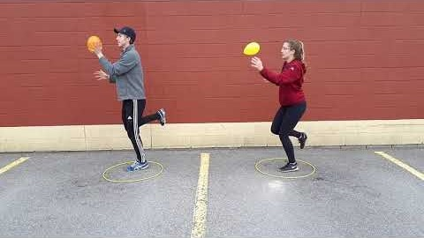
Stork Stand Balloon Keepup https://www.canadago4sport.com/Manipulative-Retain/Stork-Stand-Balloon-Keepup

Slide 14
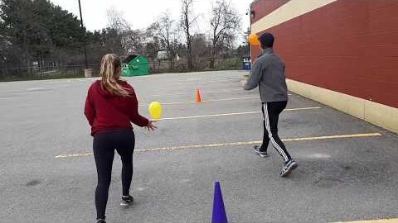
Balloon Dribble with Hands https://www.canadago4sport.com/Manipulative-Send/Balloon-Dribble-With-Hands

Slide 15
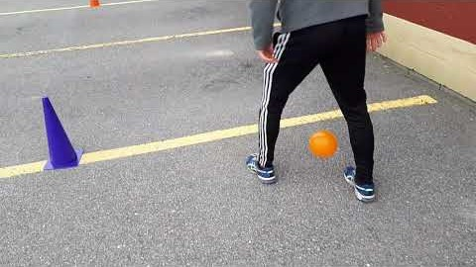
Balloon Dribble with Feet https://www.canadago4sport.com/Manipulative-Send/Balloon-Dribble-with-Feet

Slide 16
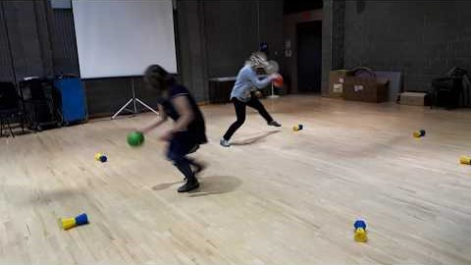
Topple Four Up Dribble (or use feet to right Toppletube) https://www.canadago4sport.com/Numeracy/Topple-Four-Up

Slide 17
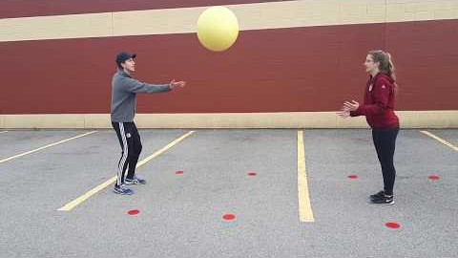
Manipulative Receive Circus Catches [with partner or tossed to self] https://www.canadago4sport.com/Stability-Ball1/Circus-Catches

Slide 18
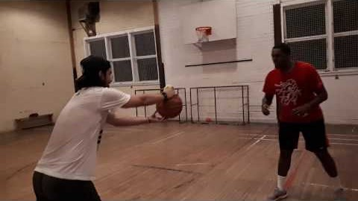
Kaboom: use a larger ball (basketball or soccer ball) and a smaller ball (tennis) or bean bag [do solo or with safe partner] https://www.canadago4sport.com/Manipulative-Receive/Kaboom

Slide 19
Manipulative Send Tape Roll Rolling or Disc Rolling for Distance https://www.canadago4sport.com/Target1/Tape-Roll-Bowling
No videos yet

Slide 20
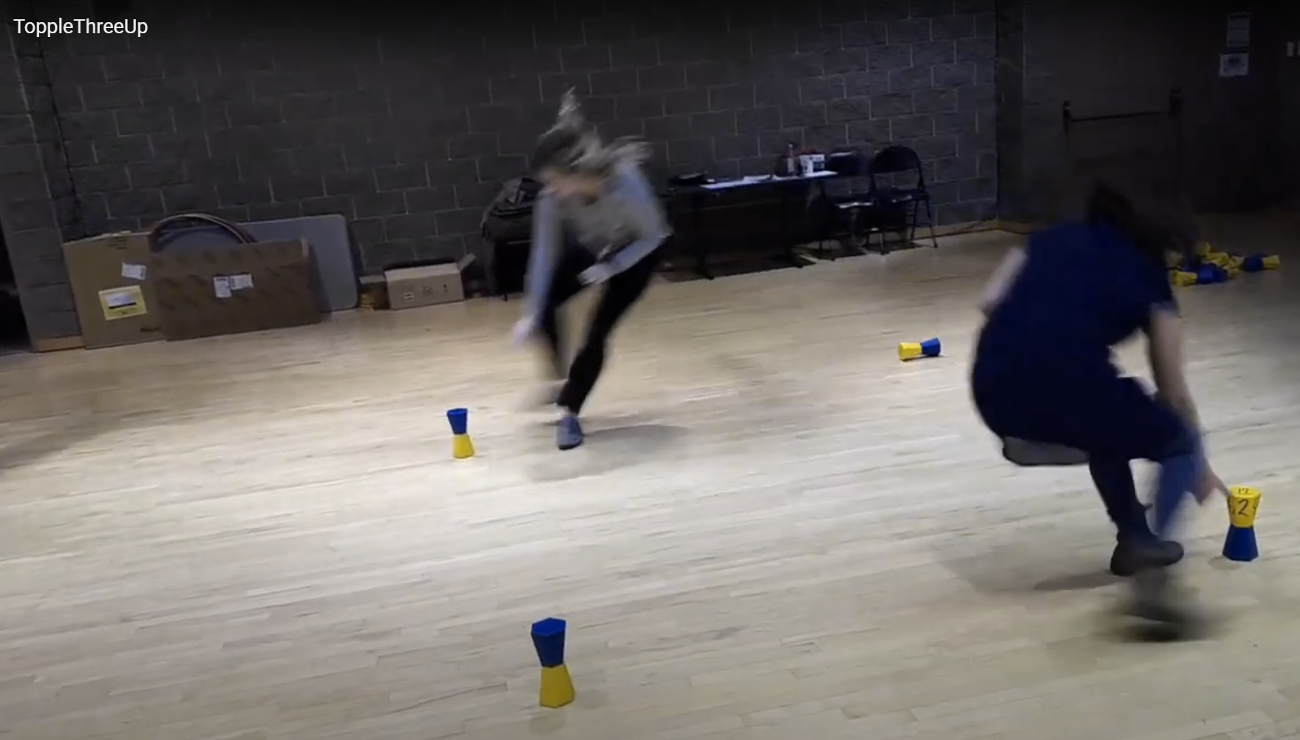
Locomotor

Slide 21
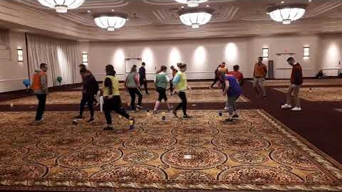
Your Colour Up with Feet (also feet for subsequent activities…) https://www.canadago4sport.com/Leadership/Your-Colour-Up-With-Feet

Slide 22
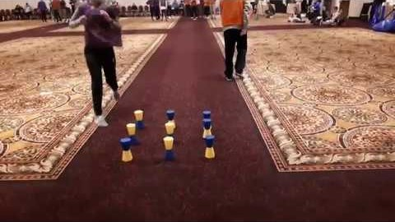
Topple Tic Tac https://www.canadago4sport.com/Numeracy/Topple-Tic-Tac

Slide 23
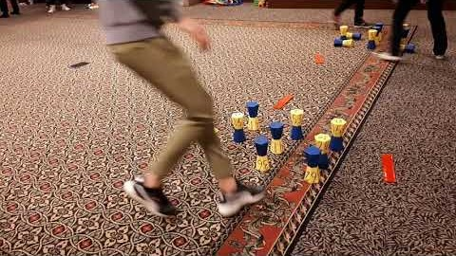
Topple Double Tic Tac https://www.canadago4sport.com/Numeracy/Topple-Double-Tic-Tac

Slide 24
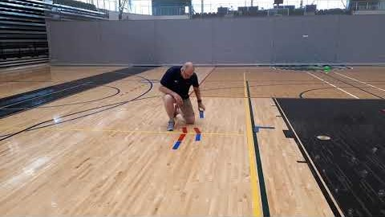
Tic Tac Toe No Grid Instructions--Individualized (Use ToppleTubes/cups instead of Rubber Bars) https://www.canadago4sport.com/Numeracy/Tic-Tac-Toe--No-Grid-Instructions

Slide 25
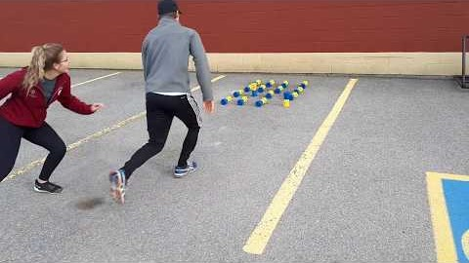
Tic Tac Four in a Row https://www.canadago4sport.com/Numeracy/Tic-Toc-Four-in-a-Row

Slide 26
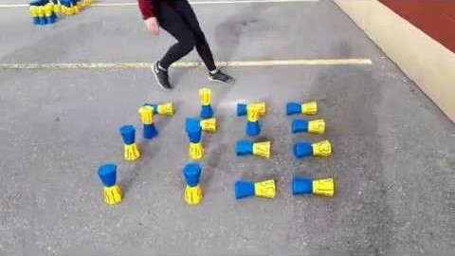
Tic Tac Double Four in a Row https://www.canadago4sport.com/Numeracy/Tic-Toc-Double-Four-in-a-Row

Slide 27
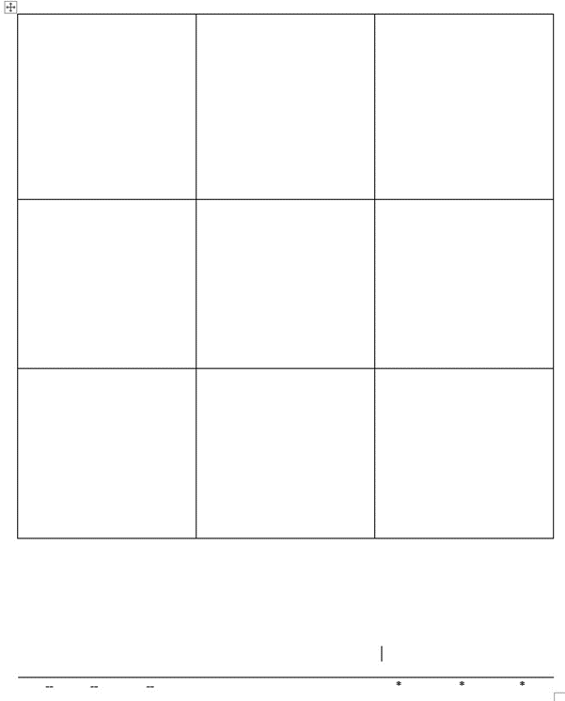
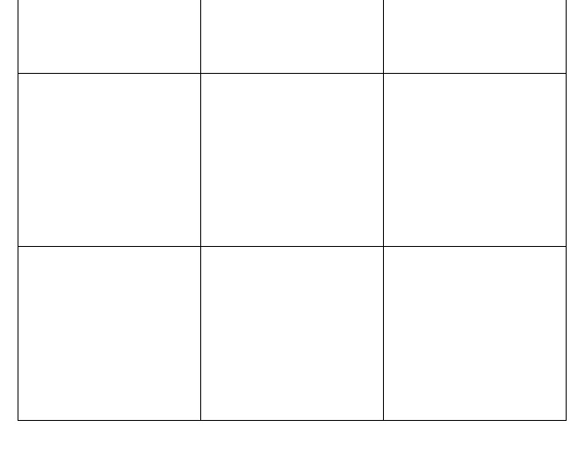
Human Tic Tac Toe
Create a large square with nine internal squares—or nine spots.
Three players per team line up (physically distanced from each other) behind a starting line.
Determine which teams are Xs (arms spread to the side), and which are Os (arms held together pointing up).
On the signal to begin the first player runs to a square and shows a line or a dot, then the second player goes, and then the third.
If no team has three in a row, the first player changes squares…
Variations:
Teams can decide who moves to a new square.
For more players have one player return to start line while next player moves onto one of the nine squares.

Slide 28
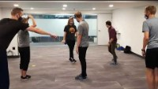
Human Tic Tac Toe In Order https://www.canadago4sport.com/Numeracy/Human-Tic-Tac-Toe-in-Order

Slide 29
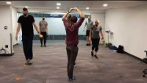
Human Tic Tac Toe Pick Order https://www.canadago4sport.com/Numeracy/Human-Tic-Tac-Toe-Players-Choose-Order

Slide 30
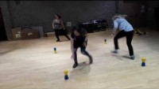
Topple Three Up https://www.canadago4sport.com/Locomotor/Topple-Three-Up
1,600,000+ views on Pinterest www.pinterest.ca/pin/283515739029933805/
Use masks

Slide 31
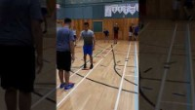
Rock, Paper, Scissors (RPS)
Football & Baseball
Use pool noodle each
From: Fair & Square, CIRA Ontario

Slide 32
Target Games
Target games work well but players should only use their own equipment and keep physical distancing from others.
Students are very capable of developing their own target games—encourage them ☺

Slide 33
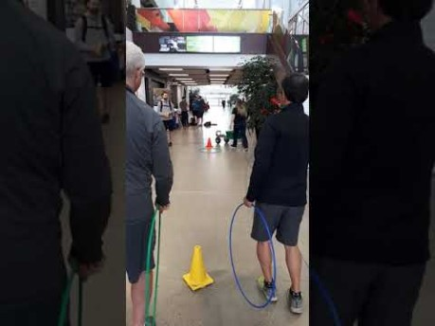
Hula Hoop Horseshoe https://www.canadago4sport.com/Target1/Hula-Hoop-Horseshoes

Slide 34
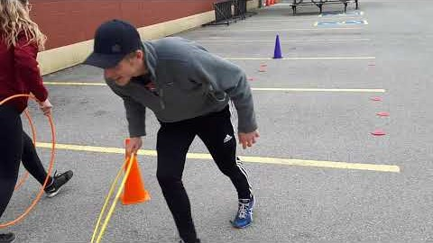
Hula Hoop Horseshoe Race https://www.canadago4sport.com/Target1/Hula-Hoop-Horseshoes-Race

Slide 35
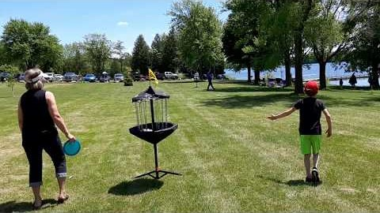
Disc Golf—With Mobile Stands https://www.canadago4sport.com/Target1/Disc-Golf-with-Mobile-Goals

Slide 36
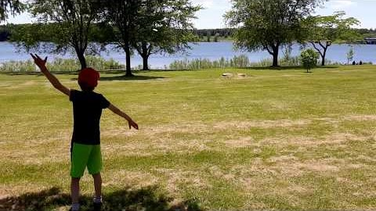
Disc Golf—With Natural Goals https://www.canadago4sport.com/Target1/Disc-Golf-with-Natural-Goals

Slide 37
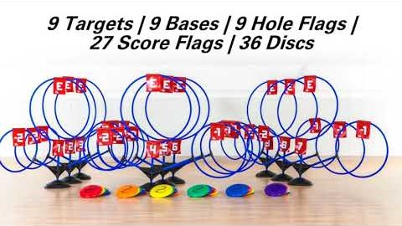
TripleShot Disc Target https://www.gophersport.com/sports/disc-golf/tripleshot-disc-target-set?item=169024

Slide 38
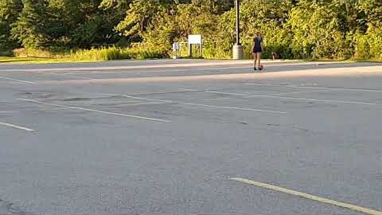
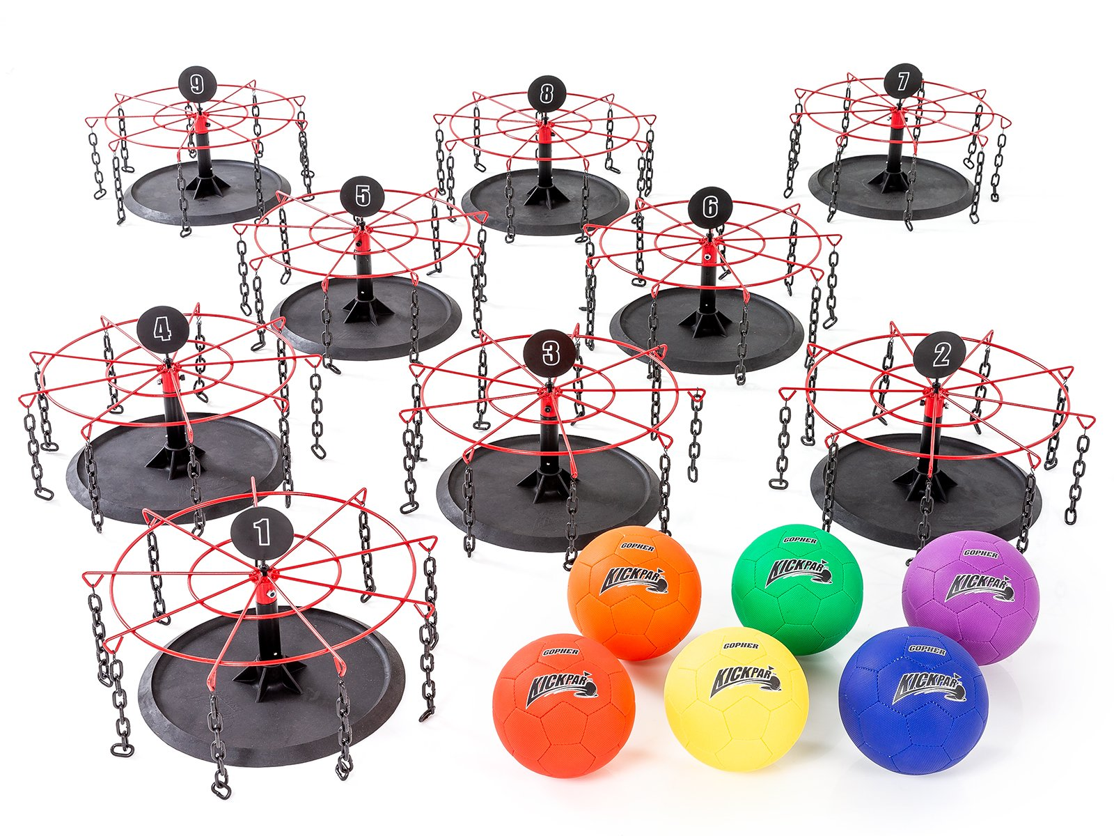
Kickpar https://www.canadago4sport.com/Target1/Kickpar
No video yet

Slide 39
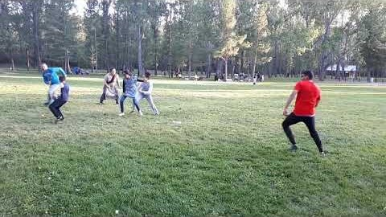
Seven Degree (use ToppleTubes instead of foam pins or water bottles) https://www.canadago4sport.com/Target1/Seven-Degree

Slide 40
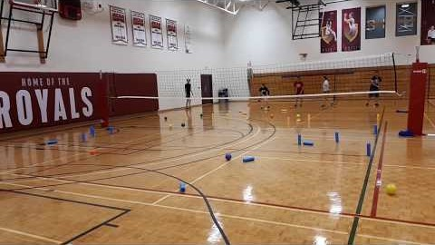
Target Under Net https://www.canadago4sport.com/Target1/Mission-Target-Under-Net

Slide 41
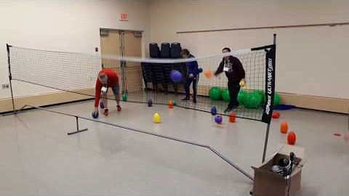
Target Over Net https://www.canadago4sport.com/Target1/Mission-Target-Over-Net

Slide 42
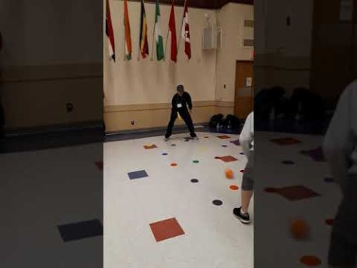
Net/Wall Activities Two Square or Four Square (Regular or Australian (own square) and use paddles) https://www.canadago4sport.com/Net/Two-Square-Stability-Ball

Slide 43
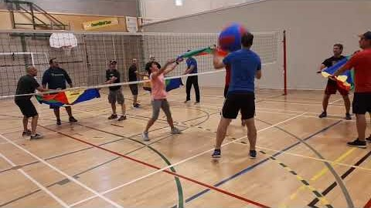
Team Launch https://www.canadago4sport.com/Net/Team-Launch-Light

Slide 44
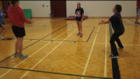
Bounce Over Line https://www.canadago4sport.com/Net/Bounce-Ball
With short and wide court, or deep and narrow court
Differences in strategy?

Slide 45
Striking/Fielding

Slide 46
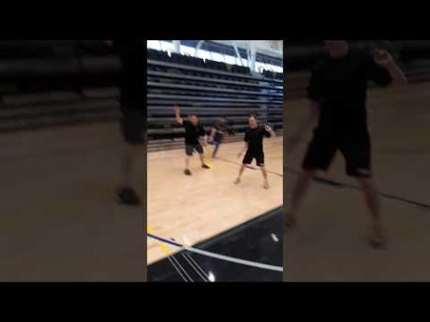
Kickit Cricket (use 6 ToppleTubes instead of wickets) https://www.canadago4sport.com/strike/Cricket-Kickit

Slide 47
Invasion Games that can Work Well: Though Physical Distancing will need to be Established
Broomball https://www.gophersport.com/sports/broomball?tg=1
Field Hockey https://www.gophersport.com/sports/field-hockey?tg=1
Floor Hockey https://www.gophersport.com/sports/floor-hockey?tg=1
Lacrosse https://www.gophersport.com/sports/lacrosse?tg=1
Scoops https://www.gophersport.com/search-unbxd?q=scoop
Soccer https://www.gophersport.com/search?q=soccer+eqiupment
You Fo https://www.gophersport.com/pe/activities/you-fo-set?item=162696

Slide 48
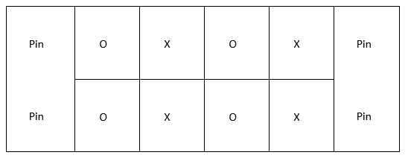
How to Physical Distance in Team Sports
No goalies--use pins
Create grids--players play within
3-5 second pass/shot rule
Add a second ball
Play small sided still, maybe four against four—see diagram below.

Slide 49
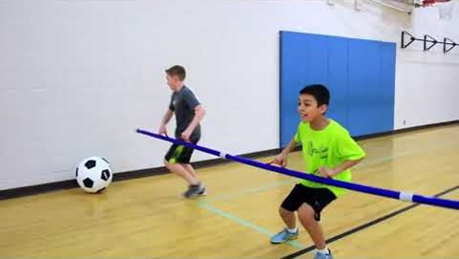
SyncroBall https://www.canadago4sport.com/Target1/SynchroBall
And Balloon Foosball with or without pool noodles, from: Fair & Square, CIRA Ontario

Slide 50

Ultimate https://www.youtube.com/watch?v=zEKnqFBajiI

Slide 51
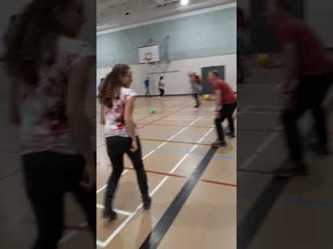
Thin Pin Guard https://www.canadago4sport.com/Target1/Team-Thin-Pin-Guard

Slide 52
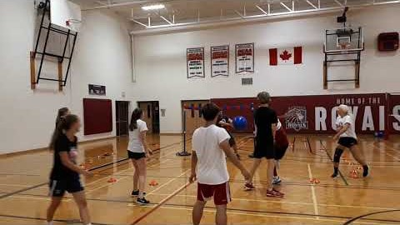
Quadriball (2 teams of 5-10) Defined areas https://www.canadago4sport.com/invasion1-1/Quadriball

Slide 53
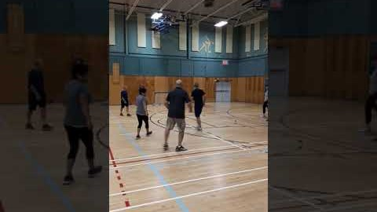
No Goalie Indoor Soccer (2 teams of 5-10) https://www.canadago4sport.com/invasion1-1/No-Goalie-Indoor-Soccer
No video yet but played as shown but with feet not hands.

Slide 54
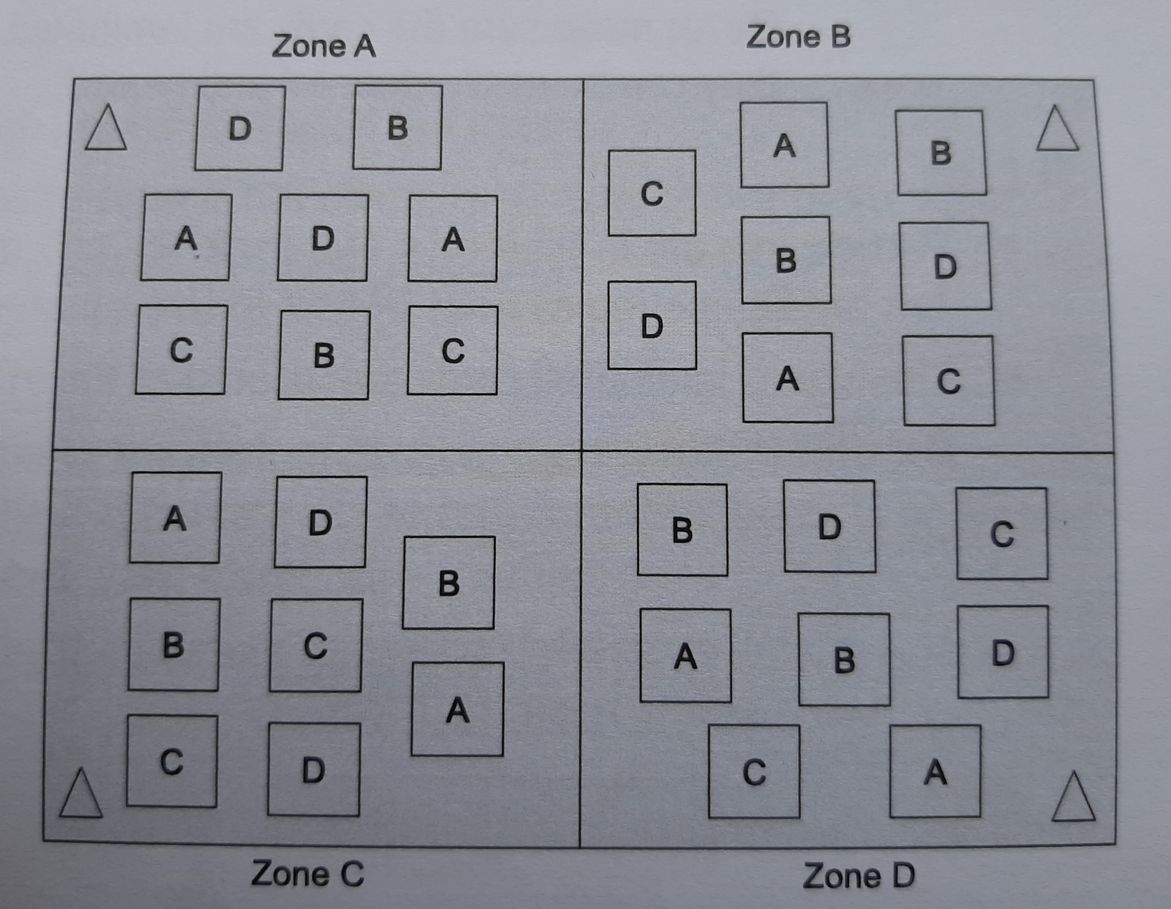
Four Corner Soccer with Pins (no goalies)
From: Fair & Square, CIRA Ontario

Slide 55
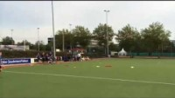
YouFo https://www.youtube.com/watch?v=ois0Va0gNVk

Slide 56
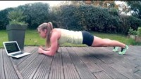
Activity Break followed by Questions
Can be done with standing and squats (can add weights)
Can be done with pushups

Slide 57

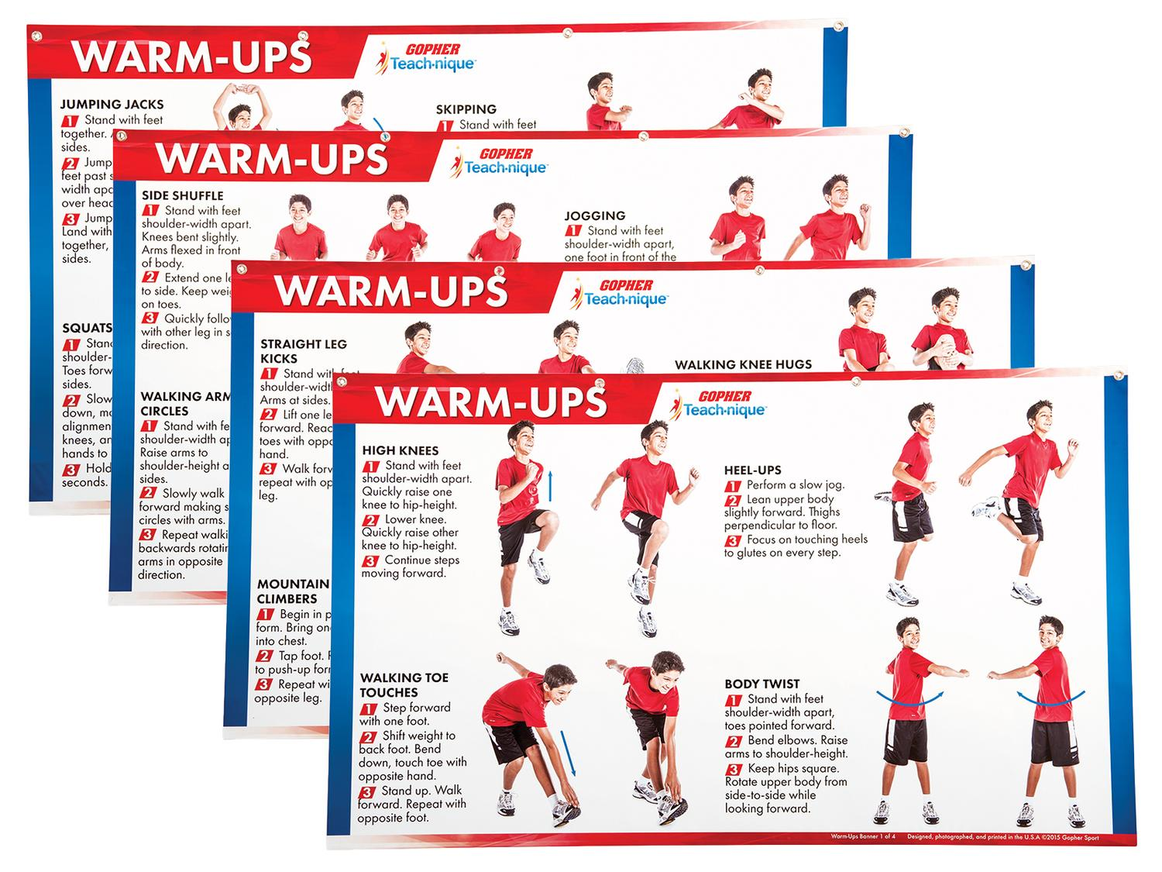
Fitness Activities
Warmup charts without equipment
https://www.gophersport.com/pe/gym-posters/teach-nique-warm-ups-banners?item=9332
F.I.T.T Banners
https://www.gophersport.com/pe/gym-posters/teach-nique-fitt-banners?item=10848

Slide 58
Walking https://sites.google.com/cpfpp.ab.ca/partage-education-physique/%C3%A0-lext%C3%A9rieur
This facility/neighbourhood tour can be relaxing or demanding, the choice is yours:
Do you need an excursion form to get out of the facility?
You can walk inside the facility?
What materials will the participants need?
A clipboard and pencil, colored pencils, a phone to write down their data, etc.
Something to sit on?
What do you want the participants to accomplish, to learn?
A relaxing walk, to chat and discover the facility
A race with fitness breaks
An organized scavenger hunt with a list of things to find
Will it be a repetitive activity with different goals each time or is it a unique experience?

Slide 59
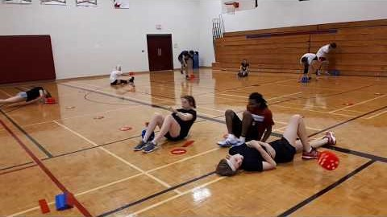
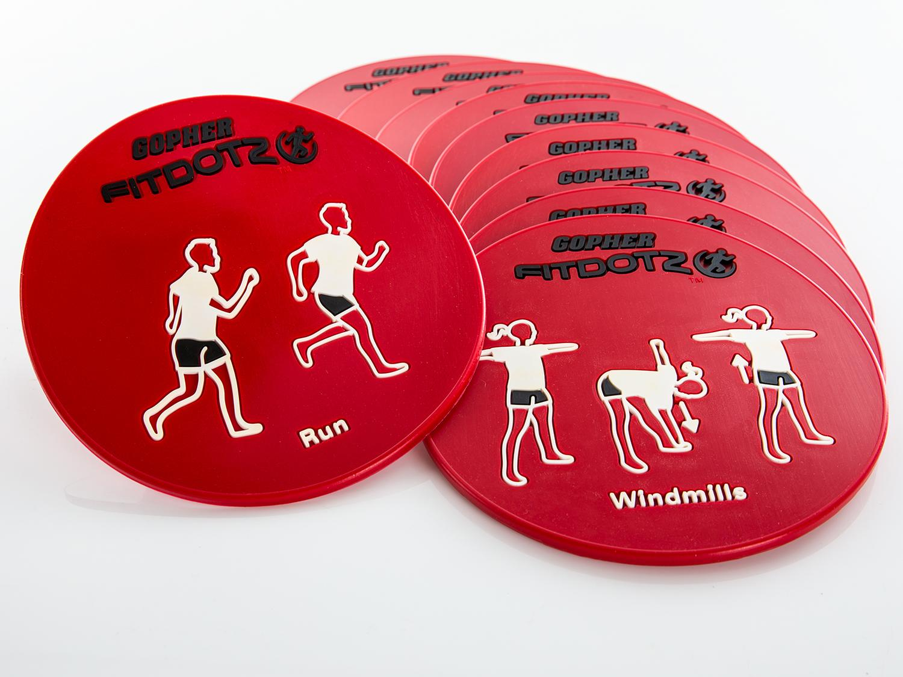
Fitness Activities Con`t Exeropoly https://www.canadago4sport.com/Warmups/Exeropoly

Slide 60
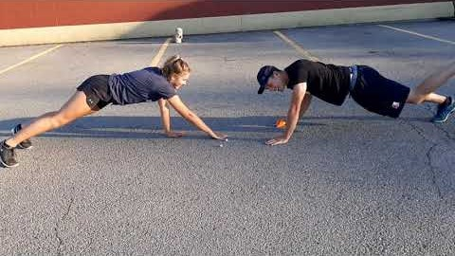
Planks till Odd Use own dice and beanbag (mask?) https://www.canadago4sport.com/Numeracy/Planks-till-odd

Slide 61
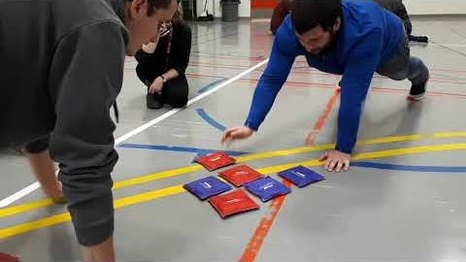
Pushup Tic Tac Toe (Use ToppleTubes… instead of Bean Bags—Mask?) https://www.canadago4sport.com/Numeracy/Tic-Tac-Toe%E2%80%94No-Grid-With-Push-Up

Slide 62


Push up Hockey in Pairs
https://www.canadago4sport.com/Warmups/Push-Up-Hockey-in-Pairs
https://www.canadago4sport.com/Manipulative-Receive/Feet-to-Feet-Hockey

Slide 63
Four Square Skipping
Skip till those ahead of you mess up or stop.
Also
I spy no add 1 exercise or yes do same number
Huckle buckle body part to specific corner
From: Fair & Square, CIRA Ontario

Slide 64

Scavenger Hunt https://drive.google.com/file/d/1fcXBksG5a_3Bnb-13LwpxVTDz3d3csz1/view

Slide 65
Rock, Paper, Scissors (RPS)
From squares or hoops…
RPS Evolution but from squares
RPS I won you run or other activity
RPS ready set shoot and activity in square
RPS stretch to heel-toe across square
From open space
RPS Push them back
From: Fair & Square, CIRA Ontario

Slide 66
Ladder Activities
Ladder activities—for about 50 different ways https://www.canadago4sport.com/agility-ladders

Slide 67

Hop Scotch
Need video still

Slide 68

Ladder Activities Con`t Just with Feet
For example:

Slide 69

Ladder Activities Con`t With Feet and Hands
For example:

Slide 70

Ladder Activities Con`t With Additional Equipment
For example:

Slide 71
Most Tag Games With Cleaned Pool Noodles for Its https://www.gophersport.com/sports/swimming/funoodles-foam-rod-floats?item=-204621

Slide 72

Sponge Tag https://www.canadago4sport.com/Locomotor/Sponge-Tag

Slide 73

Penguin Lobster Tag https://www.canadago4sport.com/Locomotor/Penguin-Lobster-Tag

Slide 74

CIRA Ontario Covid19 Safe Tag
Pacman on lines and about face when meeting another player.
Head and shoulder knees and toes with GO and noodle.
Streets and alleys with spots and noodles.
Run the square gauntlet.
Noodle slap small on back of hands with spots and noodles. Rotate and switch with someone.
From: Fair & Square, CIRA Ontario

Slide 75





Obstacle Courses
Maneuver Maze https://www.gophersport.com/pe/movement/maneuvermaze-obstacle-course?item=162174
Simple Step https://www.gophersport.com/pe/movement/simplestep-balance-beam?item=154075
Figure 8 https://www.gophersport.com/pe/movement/figure-8-balance-beam?item=5275
Create a Course https://www.gophersport.com/pe/movement/create-a-beam-plus-balance-set?item=9753
Spooner https://www.gophersport.com/pe/movement/the-spooner?item=5584

Slide 76

Sample Obstacle Course https://www.canadago4sport.com/Locomotor/Obstacle-Course

Slide 77


Dance
Resources https://www.gophersport.com/pe/dance?tg=1
Everybody Move https://www.gophersport.com/pe/movement/everybody-move?item=6202
Samples https://www.pinterest.ca/canadago4sport/dance/
Don`t Sit Still Swimming Groove

Slide 78
Secret Dancers
Secret dancers (2) with detective (1) in the middle—switch moves at least every 15 seconds.
From: Fair & Square, CIRA Ontario

Slide 79

Daily Physical Activity (DPA)
Everybody Move https://www.gophersport.com/pe/movement/everybody-move?item=6202
Sample of 8 beat dance, then build with two people, then four people….

Slide 80

Simon Says https://www.canadago4sport.com/Leadership/Simon-Says

Slide 81

Simon Says do Previous https://www.canadago4sport.com/Leadership/Simon-Says-Do-Previous

Slide 82

Simon Says do Opposite https://www.canadago4sport.com/Leadership/Simon-Says-Do-Opposite

Slide 83

Ying Yang You Instructions https://www.canadago4sport.com/Leadership/Ying-Yang-You-Instructions

Slide 84

Ying Yang You Slow https://www.canadago4sport.com/Leadership/Ying-Yang-You-Slow

Slide 85

Ying Yang You Faster https://www.canadago4sport.com/Leadership/Ying-Yang-You-Faster

Slide 86

Ying Yang You Back https://www.canadago4sport.com/Leadership/Ying-Yang-You-Back

Slide 87
Leadership Games

Slide 88

Tip the Bucket https://www.canadago4sport.com/Leadership/Tip-the-Bucket

Slide 89

Carry and Drop the Bean Bag https://www.canadago4sport.com/Leadership/Carry-and-Drop-the-Bean-Bags

Slide 90

Cooperative Writing https://www.canadago4sport.com/Leadership/Cooperative-Writing

Slide 91

Cooperative Ball Carry https://www.canadago4sport.com/Leadership/Carry-a-ball

Slide 92

Architect https://www.canadago4sport.com/Leadership/Architect

Slide 93
Numeracy
Also include Tic Tac Toe Series.

Slide 94

Connect Four Up (with partener for this and subsequent activities) https://www.canadago4sport.com/Numeracy/Connect-Four-Up

Slide 95

Active Checkers https://www.canadago4sport.com/Numeracy/Active-Checkers

Slide 96

Number Sequence (use playing cards instead of spots) Done Individually? https://www.canadago4sport.com/Numeracy/Number-Sequence-Relay

Slide 97

Even and Odd With Wall Sit and Run https://www.canadago4sport.com/Numeracy/Even-and-Odd-With-Wall-Sit-and-Run

Slide 98

StrykN the Pins: Inhibitory Control https://www.canadago4sport.com/Numeracy/StrykeN-the-Pins

Slide 99

StrykN the Pins Over 50: Working Memory https://www.canadago4sport.com/Numeracy/StrykeN-the-Pins-to-Over-50

Slide 100

StrykN the Pins to Exactly 40: Cognitive Flexibility https://www.canadago4sport.com/Numeracy/StrykeN-the-Pins-to-Exactly-40

Slide 101

Topple a Specific Number https://www.canadago4sport.com/Numeracy/Topple-Specific-Number

Slide 102

Topple Numbers in Sequence https://www.canadago4sport.com/Numeracy/Topple-Tube-Number-Sequence

Slide 103

Math From CIRA Ontario
Higher or lower guess by leader
Roll the Dice—Odds and Evens
Partner true or false with own noodle
From: Fair & Square, CIRA Ontario

Slide 104

Literacy

Slide 105

Word Relay https://www.canadago4sport.com/Leadership/Word-Relay

Slide 106

Social Distancing Activities
11 Minute video on Fair & Square at:
https://www.chch.com/distanced-phys-ed/

Slide 107
Web Resources
Canadago4sport:
750+ game docs and 400+ game videos
www.canadago4sport.com
Including nearly 50 different ladder activities
https://www.canadago4sport.com/agility-ladders
Gopher Sport:
https://www.gophersport.com/
Unconditional 100% satisfaction guarantee
Your satisfaction is our #1 concern! If you are not satisfied with any product you buy from us, we'll simply replace it or refund your money. No questions. No hassles. No exclusions. No kidding!

Slide 108
Pinterest and YouTube
Pinterest:
25 boards, plus 8 sections, and 600+ pins
Follow at https://www.pinterest.ca/canadago4sport/
YouTube:
700+ videos
Subscribe at https://www.youtube.com/c/canadago4sport/

Slide 109
Social Media and Further Questions
Twitter & Instagram:
Tuesday (during the Summer months) & Thursdays (sometimes other days) posts
Follow at @canadago4sport
Love to hear from you:
JOHNBYL50@gmail.com

Slide 110
With thanks
To all of the wonderful people
who inspire each other
at conferences and other places!
To Gopher Sport
for their innovative products
and high quality equipment!

Slide 111
Questions and Comments

