Slide 1
Teaching Games for Understanding (TGfU)
Dr. John Byl
JOHNBYL50@gmail.com
While we wait, sign up for Tuesday & Thursday activity postings on:
Twitter or Instagram
@canadago4sport
Download slides at:
https://www.canadago4sport.com/conferences-and-workshops

Slide 2
COVID-19: PHE Canada

Slide 3
Physical Education (PE): Key Points (PHE Canada)
How do we engage our students in meaningful learning to help them connect what they are learning at school to their personal lives?
Include more individual pursuits than traditional team activities such as dance, alternative environment and land-based activities, exercises without equipment, fitness, mindfulness, gymnastics, and target games.

Slide 4
In-School Learning (PHE Canada)
Respect the physical distance of 2 metres always
For small sided games, use visual guides to define space and ensure physical distancing is maintained
Incorporate proper hand washing and personal hygiene routines
If possible, create a hand washing station
Use outdoor spaces and parks as much as possible

Slide 5
Equipment & Gear (PHE Canada)
Equipment Sharing
Minimize shared equipment—unless the equipment is kicked (soccer balls for example).
Physical Distancing
Try to create playing spaces for each player with the use of poly spots or half-cones…
Masks
Think through wearing of masks in line with safety and institution policies…

Slide 6
Competition— Challenging Each Other to Grow
Iron sharpening iron
Encouraging each other to grow

Slide 7
Teaching Games for Understanding (TGfU) Approach
The Teaching Games for Understanding (TGfU) approach was developed by researchers at Loughborough University in the United Kingdom to tap into children’s inherent desire to play. Bunker and Thorpe (1982) developed TGfU around the concept of teaching kids games by playing games. Butler et al. (2008) identified six Basic TGfU Concepts:
Teach games through games.
Break games into their simplest format - then increase complexity.
Participants are intelligent performers in games.
Every learner is important and is involved.
Participants need to know the subject matter.
Need to match participants’ skill and challenge.

Slide 8
Teaching Games for Understanding (TGfU) Approach--Continued
Recent approaches to TGfU have advocated for a thematic approach to teaching games. Rather than teaching sport-specific units (e.g., volleyball unit, soccer unit), children and youth gain skills and knowledge to apply to different sports by playing a variety of games associated with 4 game categories:
Target Games in which the participant propels an object, preferably with a high degree of accuracy, at a target.
Net/Wall Games in which the participant propels an object into space trying to make it difficult for an opponent to return it.
Striking/Fielding Games in which the participant strikes an object so it is placed away from defenders in the field.
Territory Games in which participants invade an opponent's territory to score.

Slide 9
Teaching Games for Understanding (TGfU) Approach--Continued
Teaching Games for Understanding is a child-centred approach where the leader acts as a facilitator and the participants make their own adaptations in order to maximize the level of challenge and fun! The following steps are elements of a Teaching Games for Understanding approach:
Activity Appreciation: trying out a version of the activity in a small-group
Tactical Awareness: developing understanding of common elements of games and tactics needed for success
Decision-Making: learning and practising making decisions in action, in response to different situations
Application of Skills: identifying and practising the skills needed to improve play
Performance: putting it all together, applying the skills, decision-making and tactics in game situations

Slide 10
Target Games
Target games work well but players should only use their own equipment and keep physical distancing from others.
Students are very capable of developing their own target games—encourage them ☺

Slide 11
Hula Hoop Horseshoe https://www.canadago4sport.com/Target1/Hula-Hoop-Horseshoes

Slide 12
Hula Hoop Horseshoe Race— Repeat from previous grades https://youtu.be/D-lAsMyun3M https://www.canadago4sport.com/Target1/Hula-Hoop-Horseshoes-Race

Slide 13
Hidden Treasure https://www.canadago4sport.com/Target1/Hidden-Treasurer

Slide 14
Boccia https://www.canadago4sport.com/Target1/Boccia

Slide 15
Big Top Bucketz https://www.canadago4sport.com/Target1/Big-Top-Bucketz

Slide 16
Disc Golf—With Mobile Stands https://www.canadago4sport.com/Target1/Disc-Golf-with-Mobile-Goals

Slide 17
Disc Golf—With Natural Goals https://www.canadago4sport.com/Target1/Disc-Golf-with-Natural-Goals

Slide 18
TripleShot Disc Target https://www.gophersport.com/sports/disc-golf/tripleshot-disc-target-set?item=169024

Slide 19
Kickpar https://www.canadago4sport.com/Target1/Kickpar

Slide 20
Seven Degree (use ToppleTubes instead of foam pins or water bottles) https://www.canadago4sport.com/Target1/Seven-Degree

Slide 21
Thin Pin Guard https://www.canadago4sport.com/Target1/Team-Thin-Pin-Guard

Slide 22
Frog Fling https://www.canadago4sport.com/Target1/Frog-Fling

Slide 23
Balance Buster https://www.canadago4sport.com/Target1/Balance-Buster

Slide 24
Bubblegum Bulldog Omnikin https://www.canadago4sport.com/Target1/Bubblegum-Bulldog-Omnikin

Slide 25
Stick it On https://www.canadago4sport.com/Target1/StickIt-On

Slide 26
Net/Wall Activities Two Square or Four Square (Regular or Australian (own square) and use paddles) https://www.canadago4sport.com/Net/Two-Square-Stability-Ball

Slide 27
Pickleball—Other Racquet Sports
Identify a pickleball (or use pickleballs from two different companies).
Play solo against a wall
One player picks up a pickleball with his hands, and the other player picks up the other pickleball with his hands. Players can flip or kick opponent’s pickleball to their side and keep their pickleball out of play, when not serving, by rolling their ball to the wall behind them.

Slide 28
Pickleball https://www.canadago4sport.com/Net/Racquet-to-Wall

Slide 29
Target Under Net https://www.canadago4sport.com/Target1/Mission-Target-Under-Net

Slide 30
Target Over Net https://www.canadago4sport.com/Target1/Mission-Target-Over-Net

Slide 31
Team Launch https://www.canadago4sport.com/Net/Team-Launch-Light

Slide 32
Big Ball Over Net https://www.canadago4sport.com/Net/Big-Ball-Tennis

Slide 33
Bounce Over Line https://www.canadago4sport.com/Net/Bounce-Ball
With short and wide court, or deep and narrow court
Differences in strategy?

Slide 34
Pickleball Around the World https://www.canadago4sport.com/Net/Pickleball-Around-the-World

Slide 35
Opposites Bump Set https://www.canadago4sport.com/Net/Opposites-Bump-Set

Slide 36
Four Square Bump https://www.canadago4sport.com/Net/Four-Square-Bump

Slide 37
Six-Square Bump https://www.canadago4sport.com/Manipulative-Send/Six-Square-Bump

Slide 38
Smashing Volleyball https://www.canadago4sport.com/Net/Smashing-Volleyball

Slide 39
Fit Toss https://www.canadago4sport.com/Net/Fit-Toss

Slide 40
Newcomb https://www.canadago4sport.com/Net/Newcomb

Slide 41
Floating Volleyball https://www.canadago4sport.com/Net/Floating-Volleyball

Slide 42
Volley Bound https://www.canadago4sport.com/Net/Volley-Bound

Slide 43
Don’t Dodge Ball https://www.canadago4sport.com/Net/Don't-Dodgeball

Slide 44
Visually Impaired Volleyball https://www.canadago4sport.com/Net/Blind-Volleyball

Slide 45
Bounce Ball https://www.canadago4sport.com/Net/Bounce-Ball

Slide 46
Volleyball Passes off the Wall https://www.canadago4sport.com/Train-Net-NoRacquet/Volleyball-Forearm-With-Team-and-Wall

Slide 47
Circle Pass, Run, Pass https://www.canadago4sport.com/Train-Net-NoRacquet/Circle-Pass-to-Same-Player-and-Run

Slide 48
Nitro Ball https://www.canadago4sport.com/Net/Nitro-Ball

Slide 49
Strike/Field

Slide 50
Big Hitter https://www.canadago4sport.com/strike/Big-Hitter

Slide 51
Cricket Foam Ball (use 6 ToppleTubes instead of wickets) https://www.canadago4sport.com/strike/Cricket-Foamball

Slide 52
Kickit Cricket (use 6 ToppleTubes instead of wickets) https://www.canadago4sport.com/strike/Cricket-Kickit

Slide 53
Ramped Up Catch https://www.canadago4sport.com/strike/RampedUp-Catch-Own

Slide 54
Beat the Ball Home https://www.canadago4sport.com/strike/Beat-the-ball-home

Slide 55
Baseball to Pitcher https://www.canadago4sport.com/strike/Baseball-to-Pitcher

Slide 56
Diamond Dash https://www.canadago4sport.com/strike/Diamond-Dash

Slide 57
Activity Break Idea Thanks to the Wonderful Boks folks
Can be done with standing and squats (can add weights)
Can be done with pushups

Slide 58
Invasion Games

Slide 59
Grid Soccer Pass https://www.canadago4sport.com/Manipulative-Retain/Grid-Soccer-Pass

Slide 60
Grid Stability Ball https://www.canadago4sport.com/Stability-Ball1/Grid-Stability-Ball

Slide 61
Invasion Games that can Work Well: Though Physical Distancing will need to be Established
Broomball https://www.gophersport.com/sports/broomball?tg=1
Field Hockey https://www.gophersport.com/sports/field-hockey?tg=1
Floor Hockey https://www.gophersport.com/sports/floor-hockey?tg=1
Lacrosse https://www.gophersport.com/sports/lacrosse?tg=1
Scoops https://www.gophersport.com/search-unbxd?q=scoop
Soccer https://www.gophersport.com/search?q=soccer+eqiupment
You Fo https://www.gophersport.com/pe/activities/you-fo-set?item=162696

Slide 62
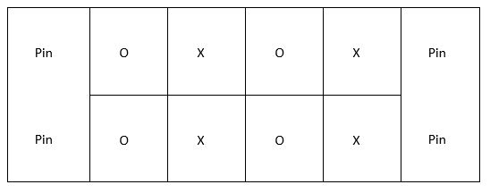
How to Physical Distance in Team Sports
No goalies--use pins
Create grids--players play within
3-5 second pass/shot rule
Add a second ball
Play small sided still, maybe four against four—see diagram below.

Slide 63
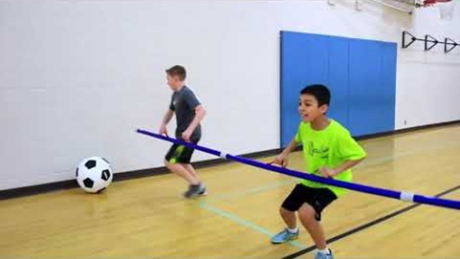
SyncroBall https://www.canadago4sport.com/Target1/SynchroBall
And Balloon Foosball with or without pool noodles, from: Fair & Square, CIRA Ontario

Slide 64
Ultimate https://www.youtube.com/watch?v=zEKnqFBajiI

Slide 65
Safe or Dare Thin Pin Guard https://www.canadago4sport.com/invasion1/Safe-or-Dare-Thin-Pin-Guard

Slide 66
Quadriball (2 teams of 5-10) https://www.canadago4sport.com/invasion1-1/Quadriball

Slide 67
No Goalie Indoor Soccer (2 teams of 5-10) https://www.canadago4sport.com/invasion1-1/No-Goalie-Indoor-Soccer
No video yet but played as shown but with feet not hands.

Slide 68
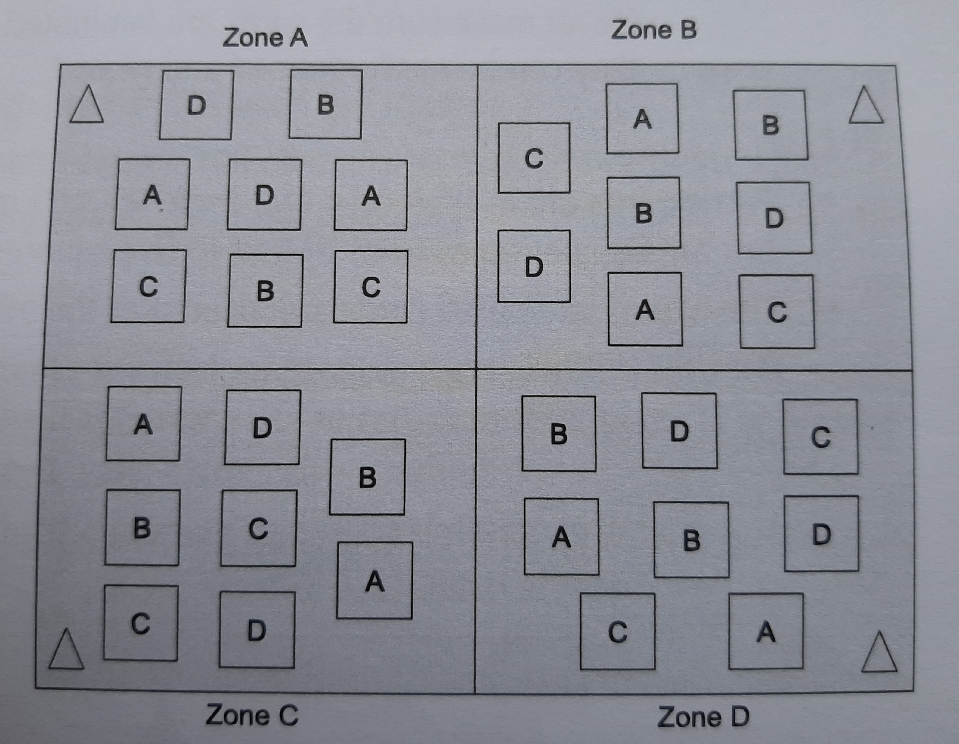
Four Corner Soccer with Pins (no goalies)
From: Fair & Square, CIRA Ontario

Slide 69
YouFo https://www.youtube.com/watch?v=ois0Va0gNVk

Slide 70
Pinned Down Team Handball (Use ToppleTubes instead of StrykN pins) https://www.canadago4sport.com/invasion1-1/Pinned-Down-Team-Handball
Sorry no video yet

Slide 71
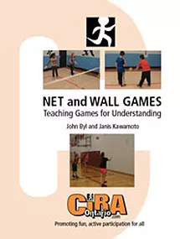
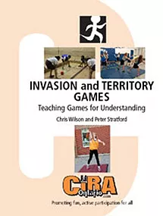
Four Helpful TGfU Books https://www.ciraontario.com/product-page/teaching-games-for-understanding-tgfu-bundle-1

Slide 72
Mark Verbeek https://www.youtube.com/channel/UCFIQCgADfLkcXvA0ymlo_5Q
5 Warm Ups:
https://www.youtube.com/playlist?list=PLjPpHYOWMa2jqC0pVEFrbZUs7HDWR0vIx
12 Workouts:
https://www.youtube.com/playlist?list=PLjPpHYOWMa2gxs4QdQpSKVVVVO-0hcadE
34 Active at Home:
https://www.youtube.com/playlist?list=PLjPpHYOWMa2iQkAniZ_5haI0P7IviXBvx

Slide 73
Mark Verbeek—Continued (TGfU) https://www.youtube.com/channel/UCFIQCgADfLkcXvA0ymlo_5Q
6 Target games:
https://www.youtube.com/playlist?list=PLjPpHYOWMa2idl3_53UVK5yFB9nAklfAb
3 Net/Wall games:
https://www.youtube.com/playlist?list=PLjPpHYOWMa2jirl-9R4kwtpdcCdoym2oW
3 Striking/Fielding games:
https://www.youtube.com/playlist?list=PLjPpHYOWMa2i3khDhY7xPGvxYSL2pQIJI
More and more….

Slide 74
Social Distancing Activities
11 Minute video on Fair & Square at:
https://www.chch.com/distanced-phys-ed/

Slide 75
Web Resources
Canadago4sport:
750+ game docs and 400+ game videos
www.canadago4sport.com
Including nearly 50 different ladder activities
https://www.canadago4sport.com/agility-ladders
Gopher Sport:
https://www.gophersport.com/
Unconditional 100% satisfaction guarantee
Your satisfaction is our #1 concern! If you are not satisfied with any product you buy from us, we'll simply replace it or refund your money. No questions. No hassles. No exclusions. No kidding!

Slide 76
Pinterest and YouTube
Pinterest:
25 boards, plus 8 sections, and 800+ pins
Follow at https://www.pinterest.ca/canadago4sport/
YouTube:
500+ videos
Subscribe at https://www.youtube.com/c/canadago4sport/

Slide 77
Social Media and Further Questions
Twitter & Instagram:
Tuesday (during the Summer months) & Thursdays (sometimes other days) posts
Follow at @canadago4sport
Love to hear from you:
JOHNBYL50@gmail.com

Slide 78
With thanks
To all of the wonderful people
who inspire each other
at conferences and other places!
To Gopher Sport
for their innovative products
and high quality equipment!

Slide 79
Questions and Comments

