Slide 1
Innovative
Agility Ladder
Fitness Challenges
With Feet Only
Dr. John Byl
JOHNBYL50@gmail.com
While we wait, sign up for weekly activity postings on:
Twitter or Instagram
@canadago4sport

Slide 2
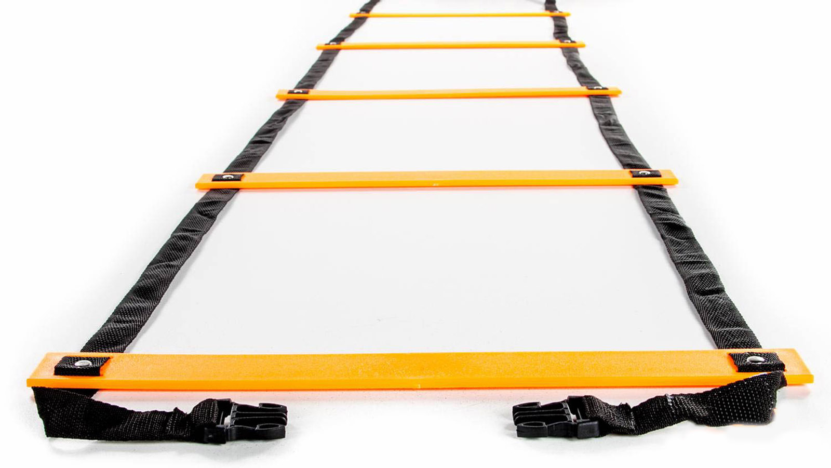
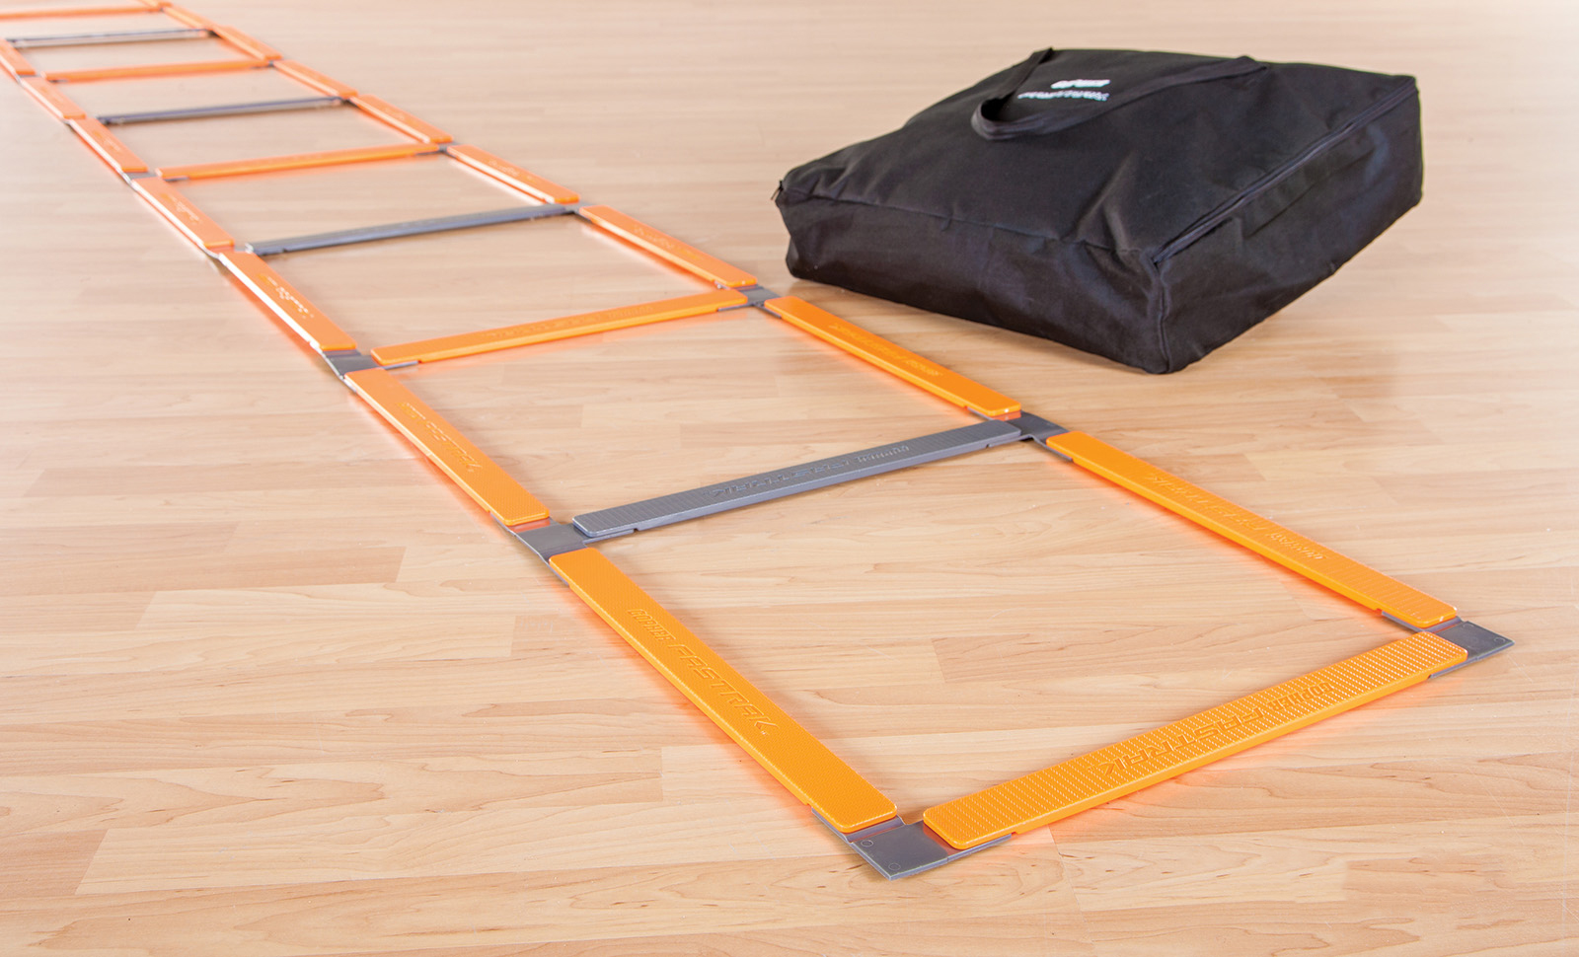
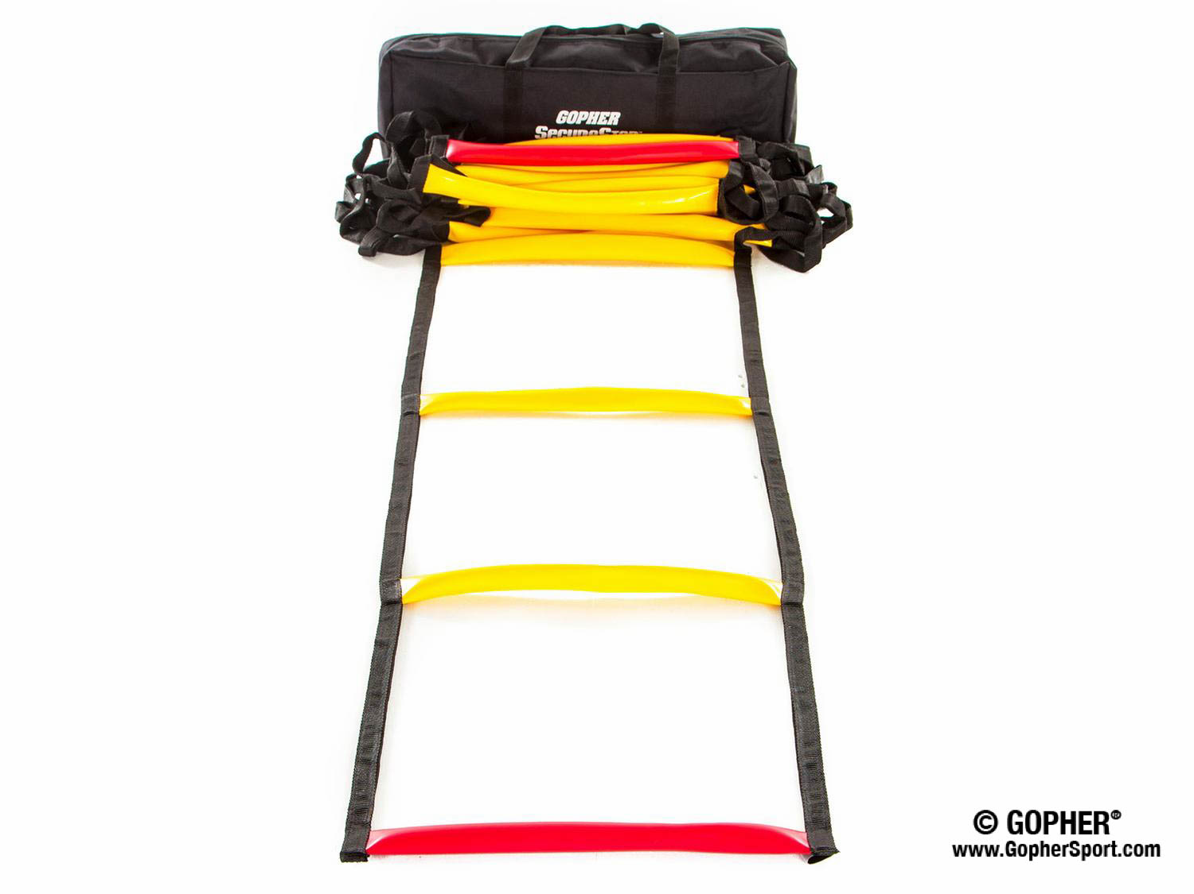
Ladders Used 1
(Click on Pics to go to Website)
Screamin Orange Agility Ladder
  Inexpensive
  Great for beginners
Fast Trak Agility Ladder
  Safe flat design
  Never gets tangled
SecureStep Agility Ladder
  Ruberized treads will not slip on floor
  Extremely durable

Slide 3
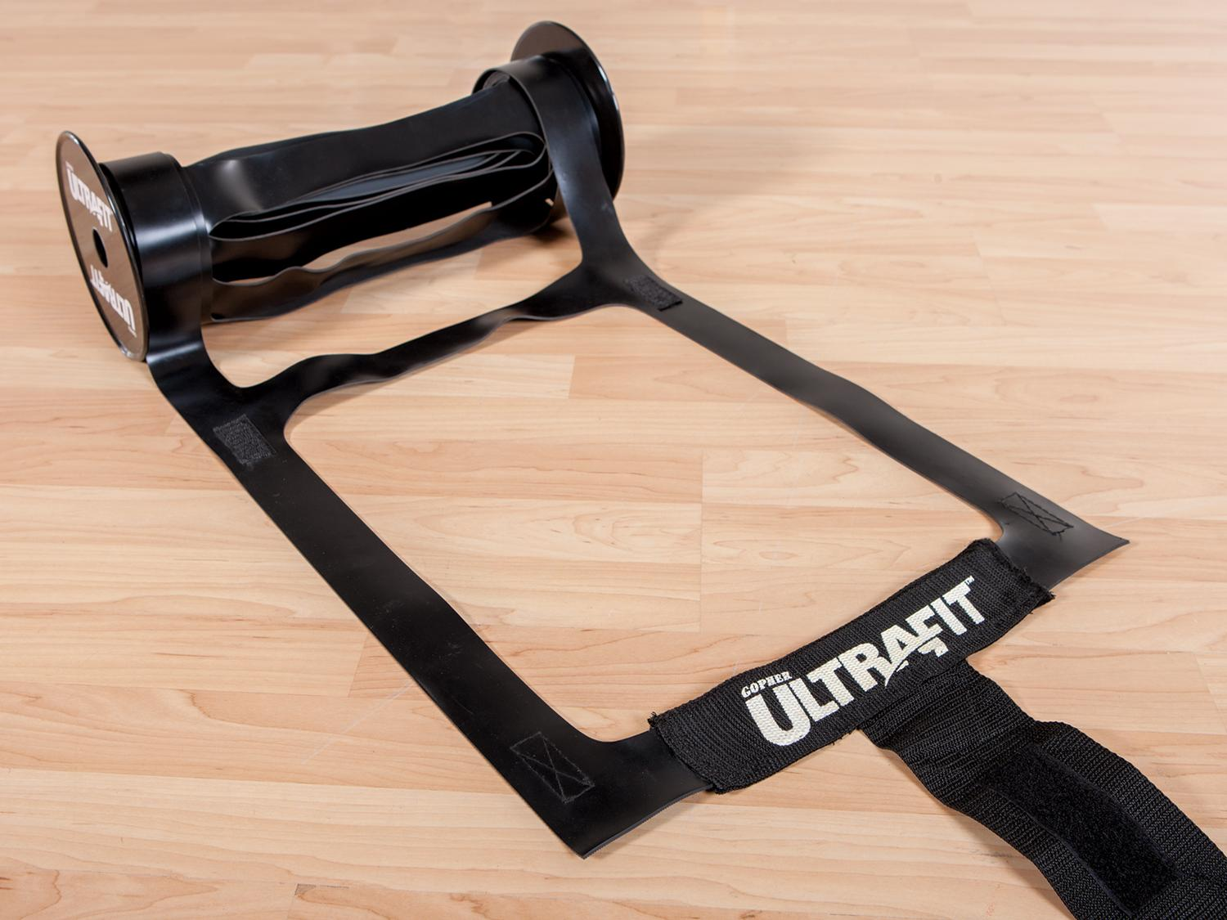
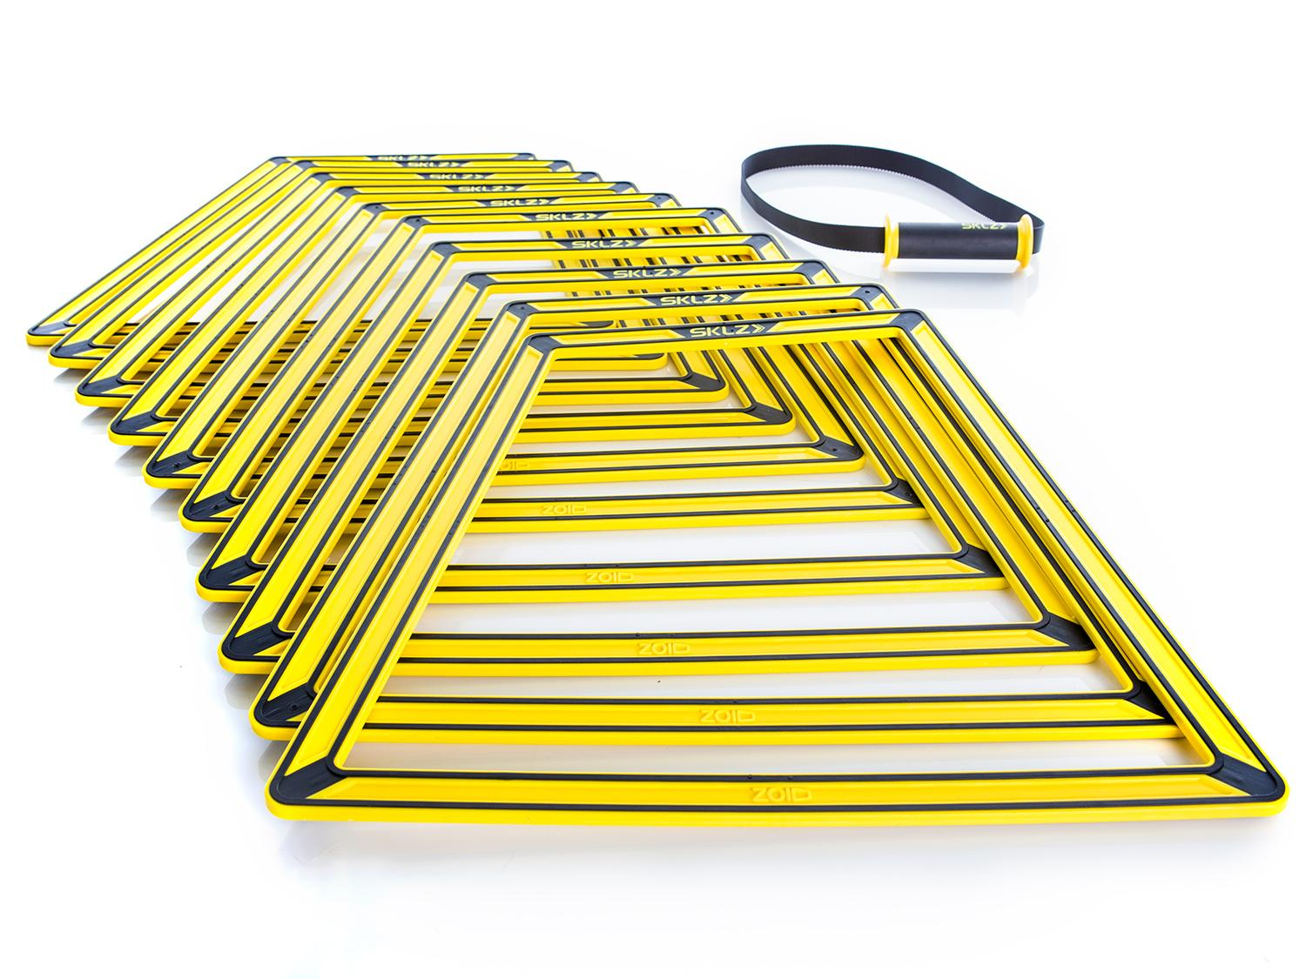
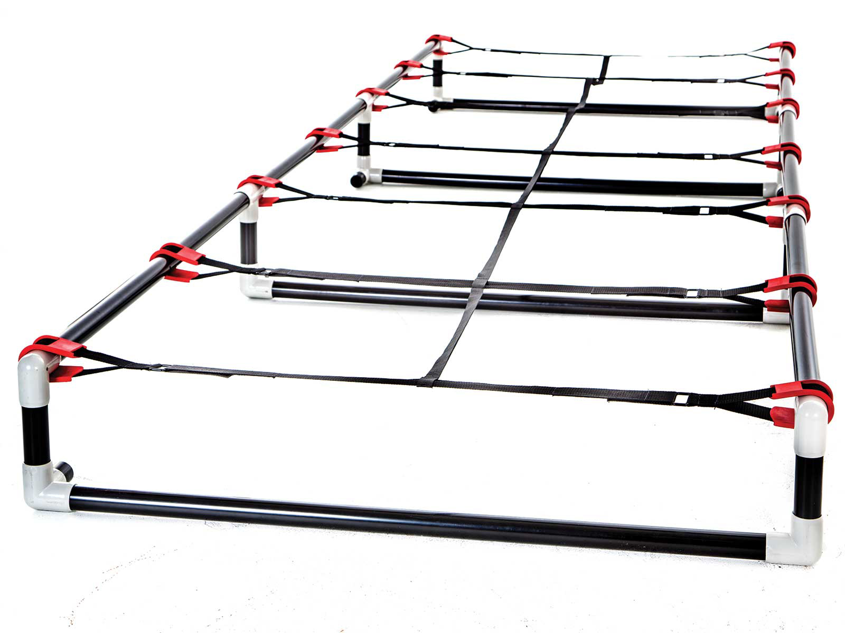
Ladders Used 2
(Click on Pics to go to Website)
Ultra Fit Roll Out Ladder
  Adheres to floor well
  Easy to roll out and store
Sklz Agility Trainer Pro
  Easily create different ladder patterns
  Can also add a hurdle in the middle of the ladder
High Rise Agility Ladder
  More challenging with 6`` or 9`` rise
  Very durable

Slide 4
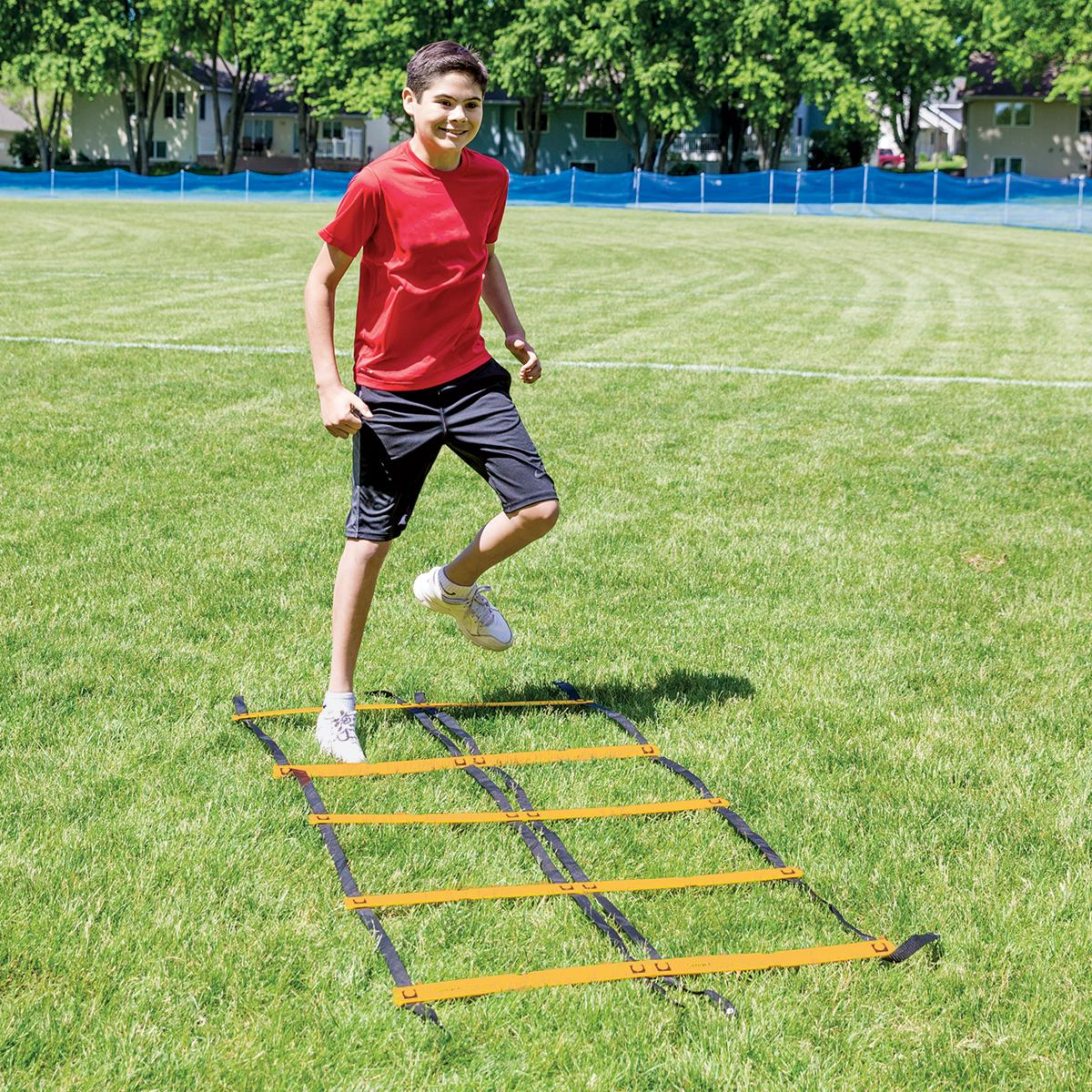
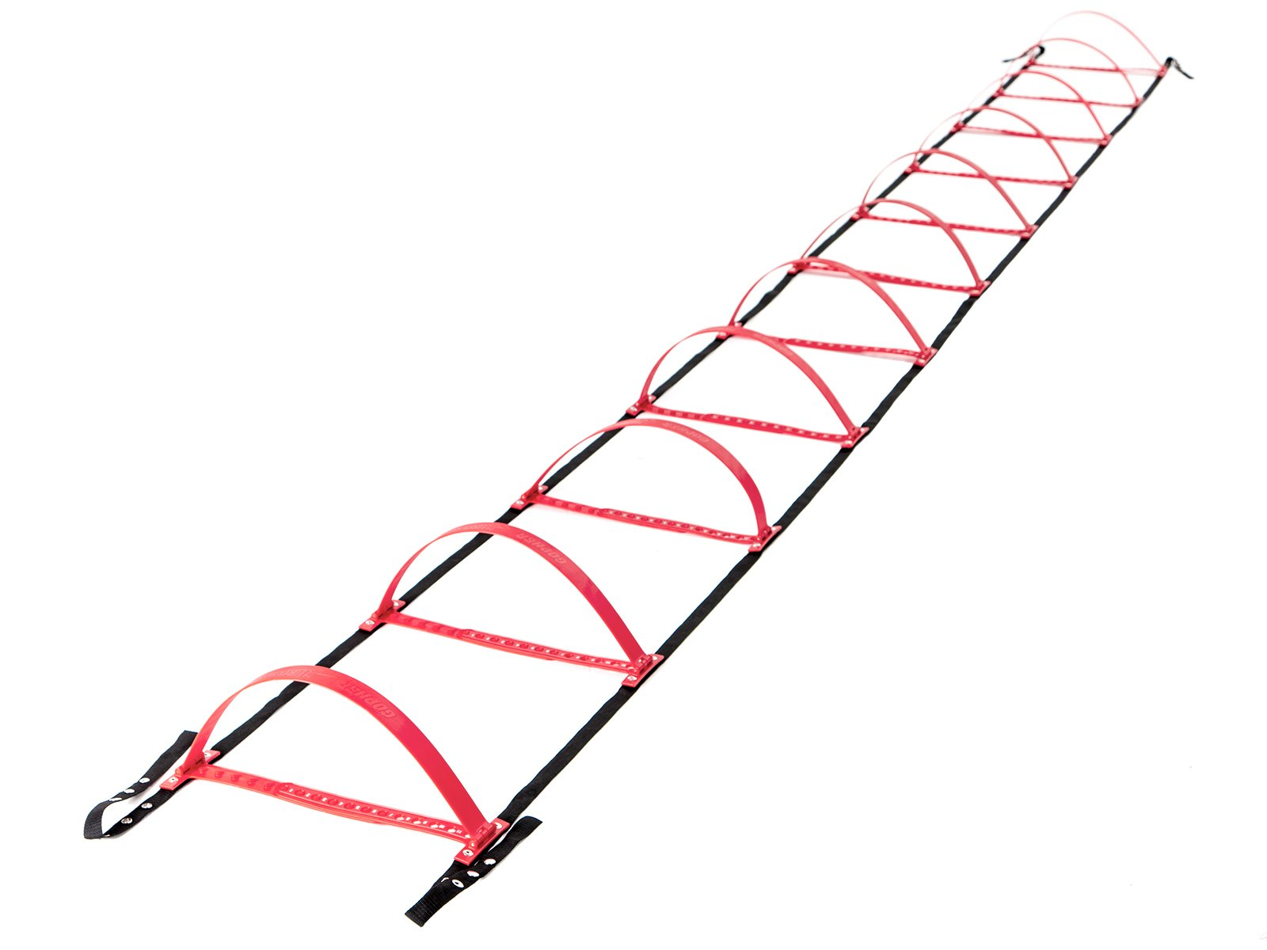
Ladders Used 3
(Click on Pics to go to Website)
Smart Modular Agility Ladder
  Easily create side-by-side ladders
Gopher HurdLadder Agility Ladder
  Easily adjusts to various heights

Slide 5
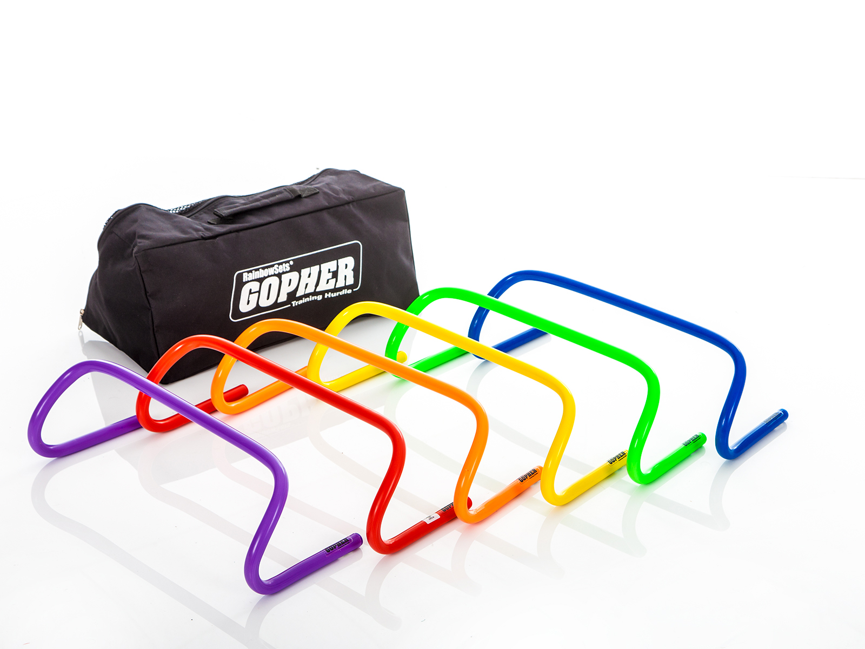
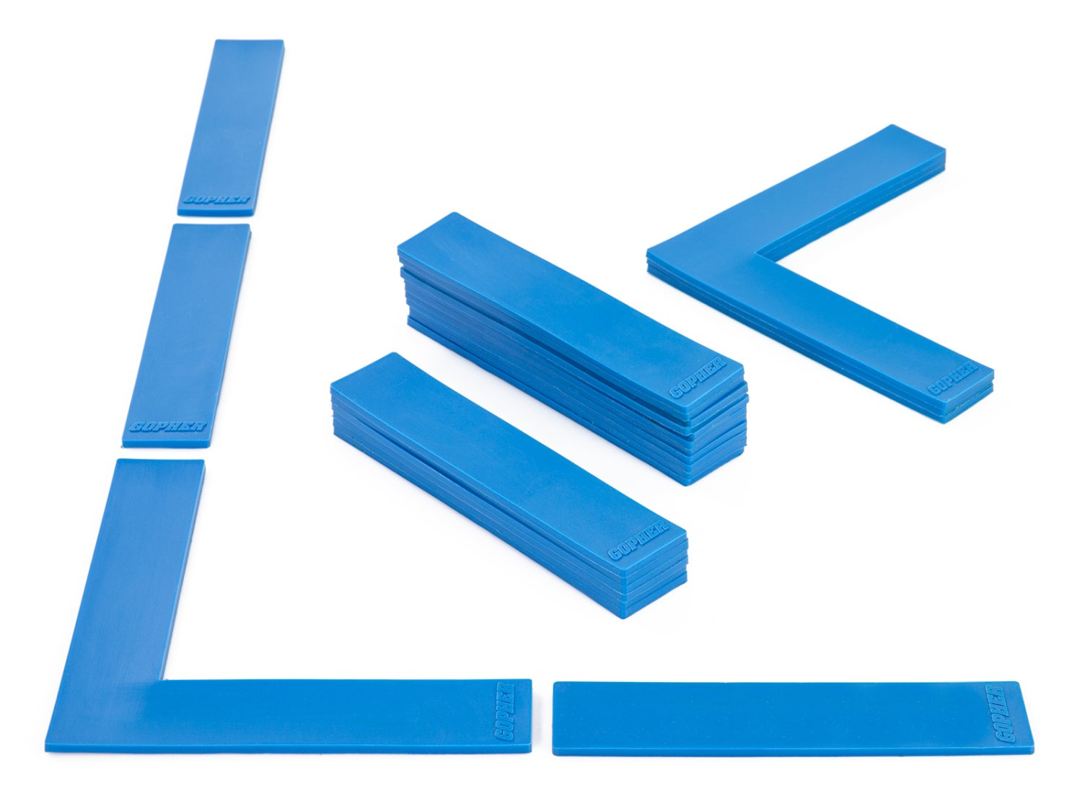
Ladders Used 4
(Click on Pics to go to Website)
Ultrafit Training Hurdles
  Come in 4 different heights 6`` to 16``
Boundary Markers
  Secure on the floor
  Moving one tread will not impact other treads

Slide 6
Definitions
Running
  Quicker than a walk so that both feet are not on the ground at the same time.
Jumping
  Pushing oneself off a surface with both feet.
Hoping
  Pushing oneself off a surface balanced from one foot.

Slide 7
On Your Feet
Ladder Activities
Each of these activities has participants running, jumping, and hoping through the various ladders.
For almost all ladder activities in this slideshow leaders and participants can also use chalk to outline the ladders.

Slide 8
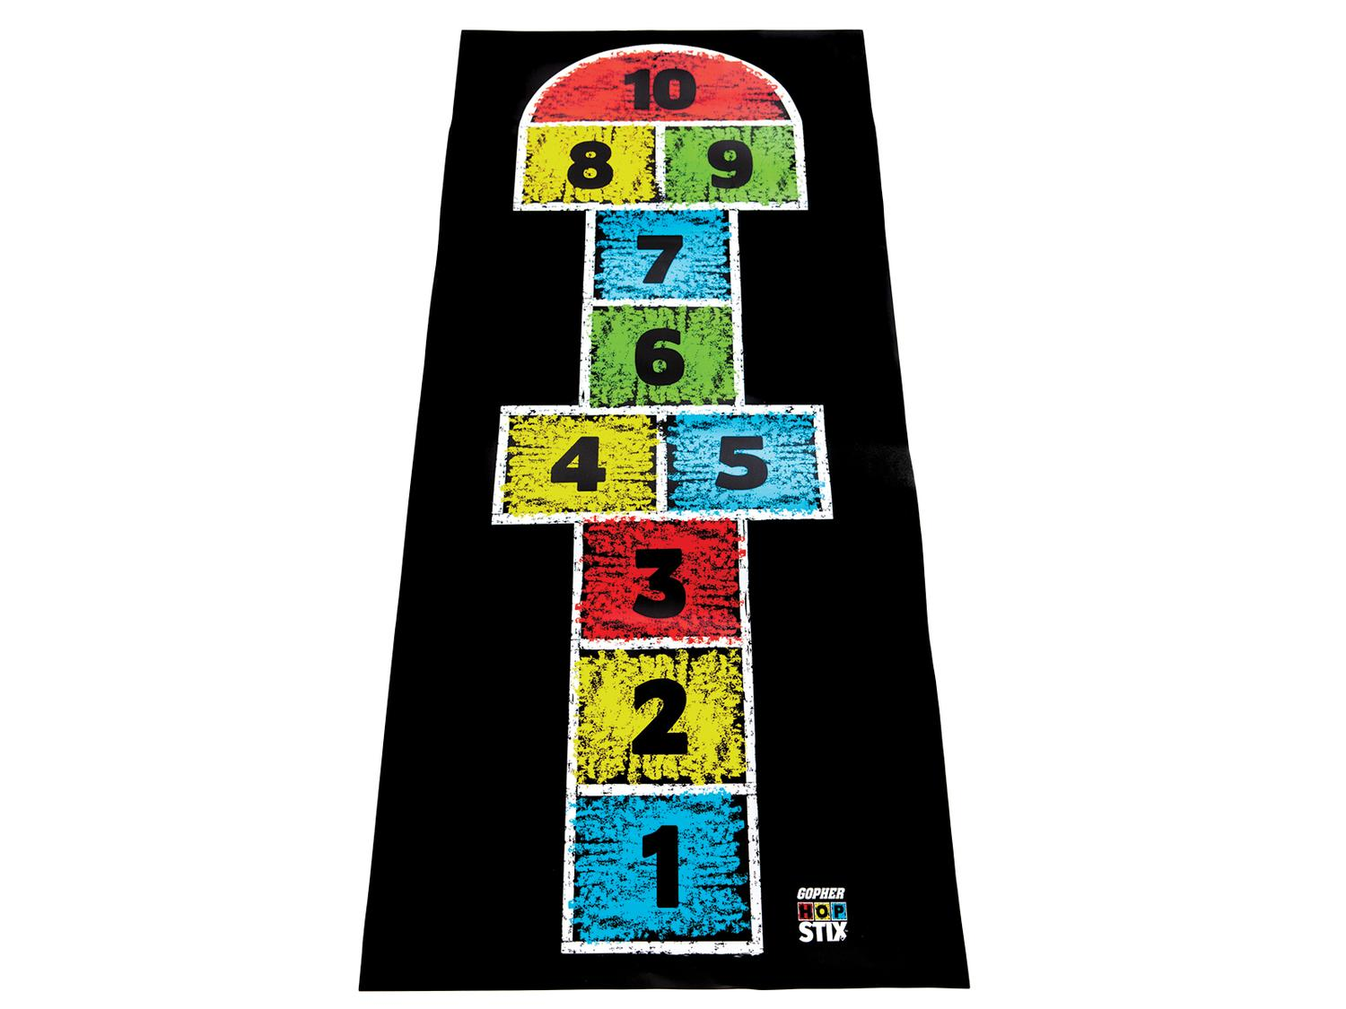
Hop Scotch
Need to add still
Need video still

Slide 9
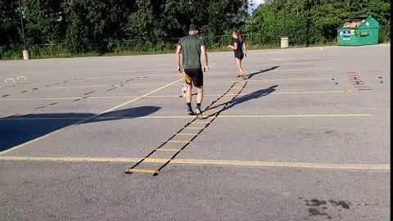
Every Other Rung Run https://www.canadago4sport.com/Ladders/Every-Other-Rung-Run

Slide 10
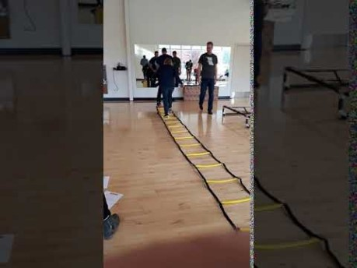
Every Rung Run https://www.canadago4sport.com/Ladders/Every-Rung-Run

Slide 11
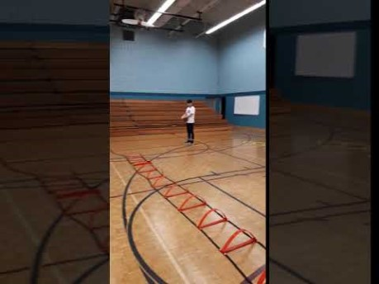
High Knee Every Other Rung https://www.canadago4sport.com/Ladders/High-knee%E2%80%94Every-Other-Rung

Slide 12
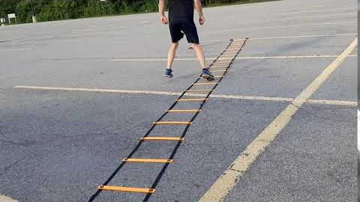
Tap In https://www.canadago4sport.com/Ladders/Tap-In

Slide 13
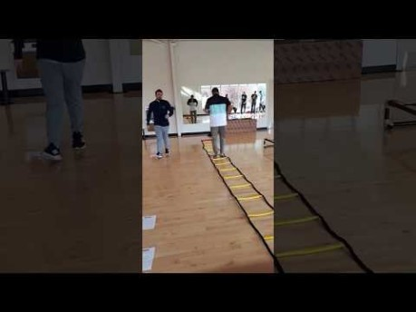
Three Jumps and Three Runs… https://www.canadago4sport.com/Ladders/Three-Jumps-and-Three-Runs

Slide 14
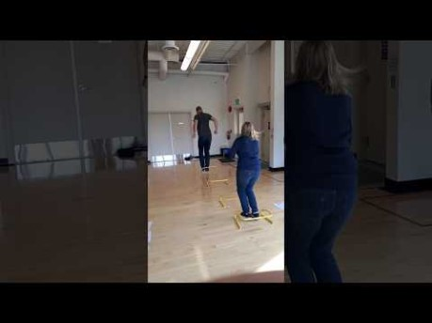
Jump Every Rung https://www.canadago4sport.com/Ladders/Two-Foot-Jump%E2%80%94Every-Rung

Slide 15
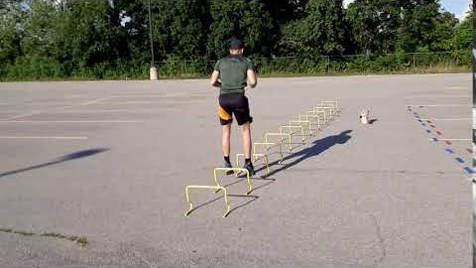
High Vertical Jumps https://www.canadago4sport.com/Ladders/High-Vertical-Jumps

Slide 16
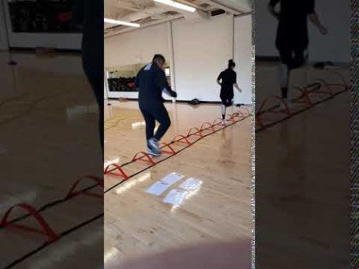
Jump Forward In and Hop Out https://www.canadago4sport.com/Ladders/Jump-Forward-and-In%2C-Hop-Out

Slide 17
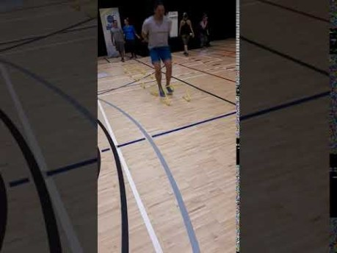
Jump In In Straddle Out https://www.canadago4sport.com/Ladders/Ladder-Jump-In-In-Out-In-In

Slide 18
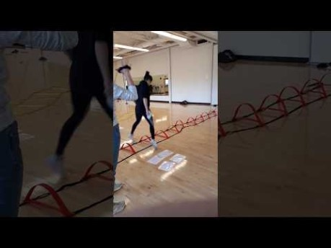
In and Out Jumps https://www.canadago4sport.com/Ladders/In-Then-Out-Jumps

Slide 19
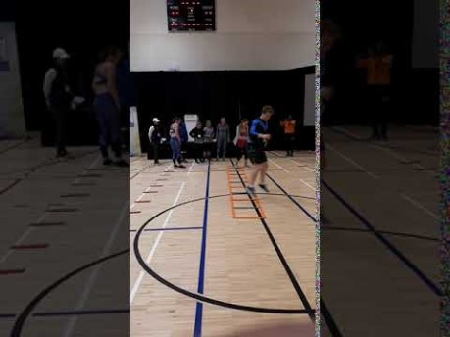
180s https://www.canadago4sport.com/Ladders/180s

Slide 20
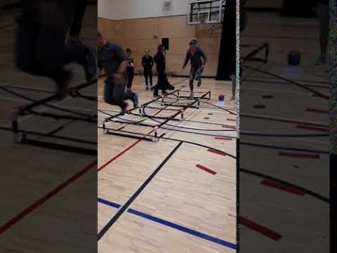
Hops https://www.canadago4sport.com/Ladders/Hops-

Slide 21
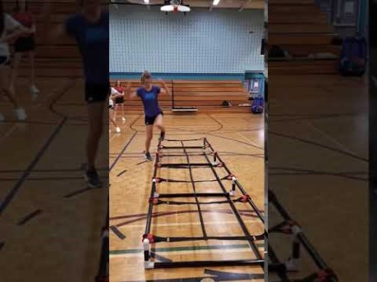
Hop In and Out https://www.canadago4sport.com/Ladders/Hop-In-Out

Slide 22
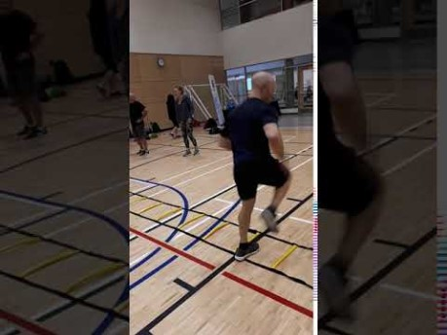
Every Rung Sideways Run https://www.canadago4sport.com/Ladders/Every-Rung-Sideways-Run

Slide 23
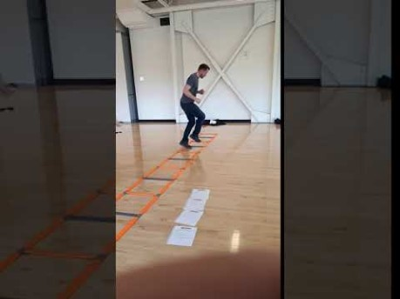
Sideways Crossover Run https://www.canadago4sport.com/Ladders/Every-Rung-Sideways-Crossover-Run

Slide 24
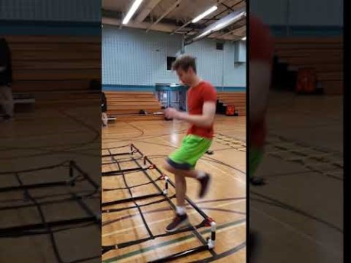
In and Out Sideways Run https://www.canadago4sport.com/Ladders/Alternate-In-and-Out-Sideways-Run

Slide 25
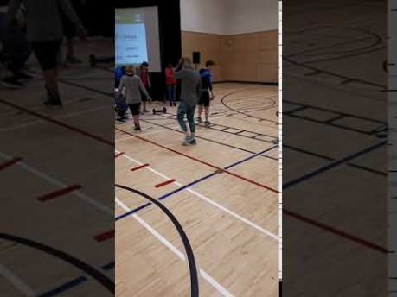
In In Out Out Each Rung https://www.canadago4sport.com/Ladders/In-and-Out-Every-Rung

Slide 26
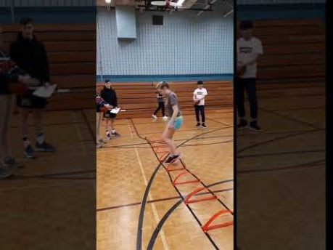
In In Out Out Through Each Rung https://www.canadago4sport.com/Ladders/In-and-Out-Run

Slide 27
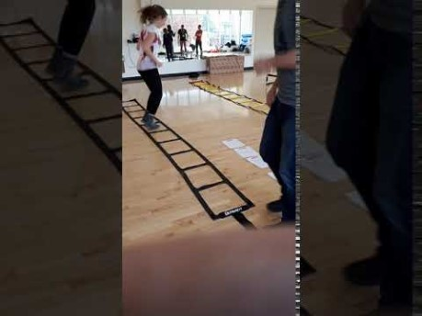
Jump In In Out https://www.canadago4sport.com/Ladders/In-In-Out

Slide 28
Jump In In Out Out In In https://www.canadago4sport.com/Ladders/In-In-Out-Out
New video needed

Slide 29
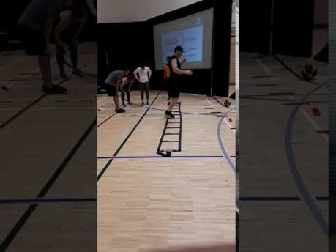
In In Out Jumps

Slide 30
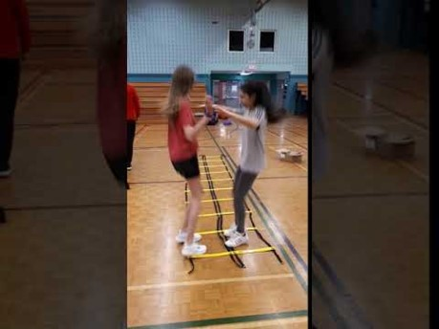
In with High Ten and Out https://www.canadago4sport.com/Ladders/In-Outs

Slide 31
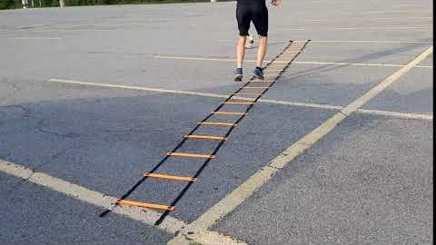
Downhill Skiing https://www.canadago4sport.com/Ladders/Downhill-Skiing

Slide 32
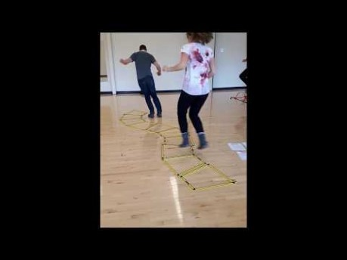
Slalom Skiing https://www.canadago4sport.com/Ladders/Slalom-Skiing

Slide 33
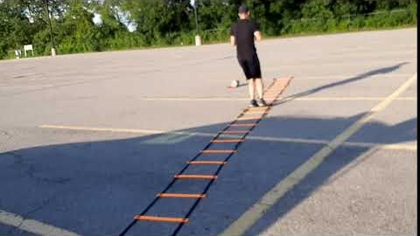
Boxing Shuffle https://www.canadago4sport.com/Ladders/Boxing-Shuffle

Slide 34
Web Resources
Canadago4sport:
  600+ game docs and 250+ game videos
    www.canadago4sport.com
  Nearly 50 different ladder activities
    https://www.canadago4sport.com/agility-ladders
Gopher Sport:
  Order from over 12 different ladders
    https://www.gophersport.com/fitness/saq?tag=agility
  Order from hundreds of equipment ideas.
    https://www.gophersport.com/
  Unconditional 100% satisfaction guarantee
    Your satisfaction is our #1 concern! If you are not satisfied with any product you buy from us, we'll simply replace it or refund your money. No questions. No hassles. No exclusions. No kidding!

Slide 35
Pinterest and YouTube
  Pinterest:
    23 boards, and 600+ pins
    Follow at https://www.pinterest.ca/canadago4sport/
  YouTube:
    330+ videos
    Subscribe at https://www.youtube.com/c/canadago4sport/

Slide 36
Social Media and Further Questions
  Twitter & Instagram:
    Tuesday (sometimes other days) posts
    Follow at @canadago4sport
  Love to hear from you:
    JOHNBYL50@gmail.com

Slide 37
With thanks
To all of the wonderful people
who inspire each other
at conferences and other places!
To Gopher Sport
for their innovative products
and high quality equipment!

Slide 38
Download slides at:
https://www.canadago4sport.com/conferences-and-workshops

