Slide 1
Sending and Receiving With Feet
Dr. John Byl
JOHNBYL50@gmail.com
While we wait, sign up for weekly activity postings on:
Twitter or Instagram
@canadago4sport

Slide 2
Key Cues for Sending
Kicking – players propel an object by striking it with a foot
What to Look For
Preparation Stage
Does the player start by standing behind the ball?
Is there a quick movement towards the ball that includes planting the non-kicking foot beside the ball?
Are the eyes on the object to be kicked?
Is there a step towards the object with the kicking foot?

Slide 3
Key Cues for Sending Con’t
Kicking Stage
Does the kicking leg swing freely from the hip?
Is the whole movement balanced?
Does the player lean into the kick?
Is contact made with the instep or shoelaces?
Is contact made just below the center of the object being kicked?
Follow-Through Stage
Does the kicking leg continue towards the target and across the body?
Are the arms used to maintain balance?

Slide 4
Helpful Resource

Slide 5
Balloon Dribble Relay (groups of 2) https://www.canadago4sport.com/Manipulative-Send/Balloon-Dribble-with-Feet

Slide 6
Kick Par (groups of 2) https://www.canadago4sport.com/Target1/Kickpar

Slide 7
Kick Pylon (groups of 4) https://www.canadago4sport.com/invasion1-1/Kick-Pylon
No video yet

Slide 8
Double Dribble (groups of 2) https://www.canadago4sport.com/Manipulative-Retain/Double-Dribble

Slide 9
Kick Beach Ball In Basket (groups of 4) https://www.canadago4sport.com/Manipulative-Retain/Kick-Beachball-Into-Basket

Slide 10
Kick Soccer Ball In Basket (groups of 4) https://www.canadago4sport.com/Manipulative-Retain/Kick-Soccer-Ball-Into-Basket

Slide 11
Cricket KickIt (2 teams of 5-10) https://www.canadago4sport.com/strike/Cricket-Kickit

Slide 12
Quadriball (2 teams of 5-10) https://www.canadago4sport.com/invasion1-1/Quadriball

Slide 13
No Goalie Indoor Soccer (2 teams of 5-10) https://www.canadago4sport.com/invasion1-1/No-Goalie-Indoor-Soccer
No video yet but played as shown but with feet not hands.

Slide 14
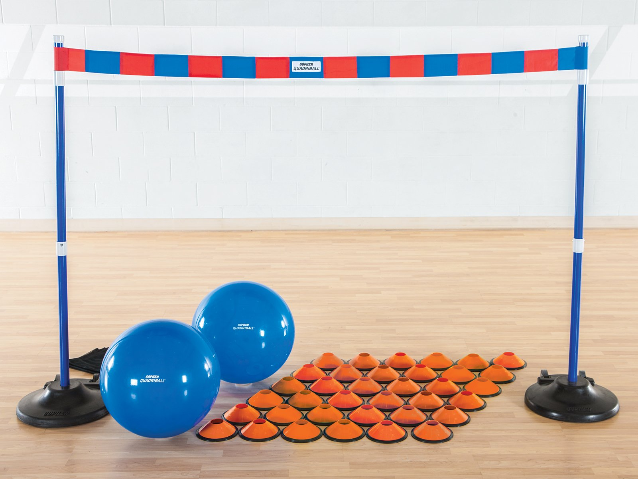
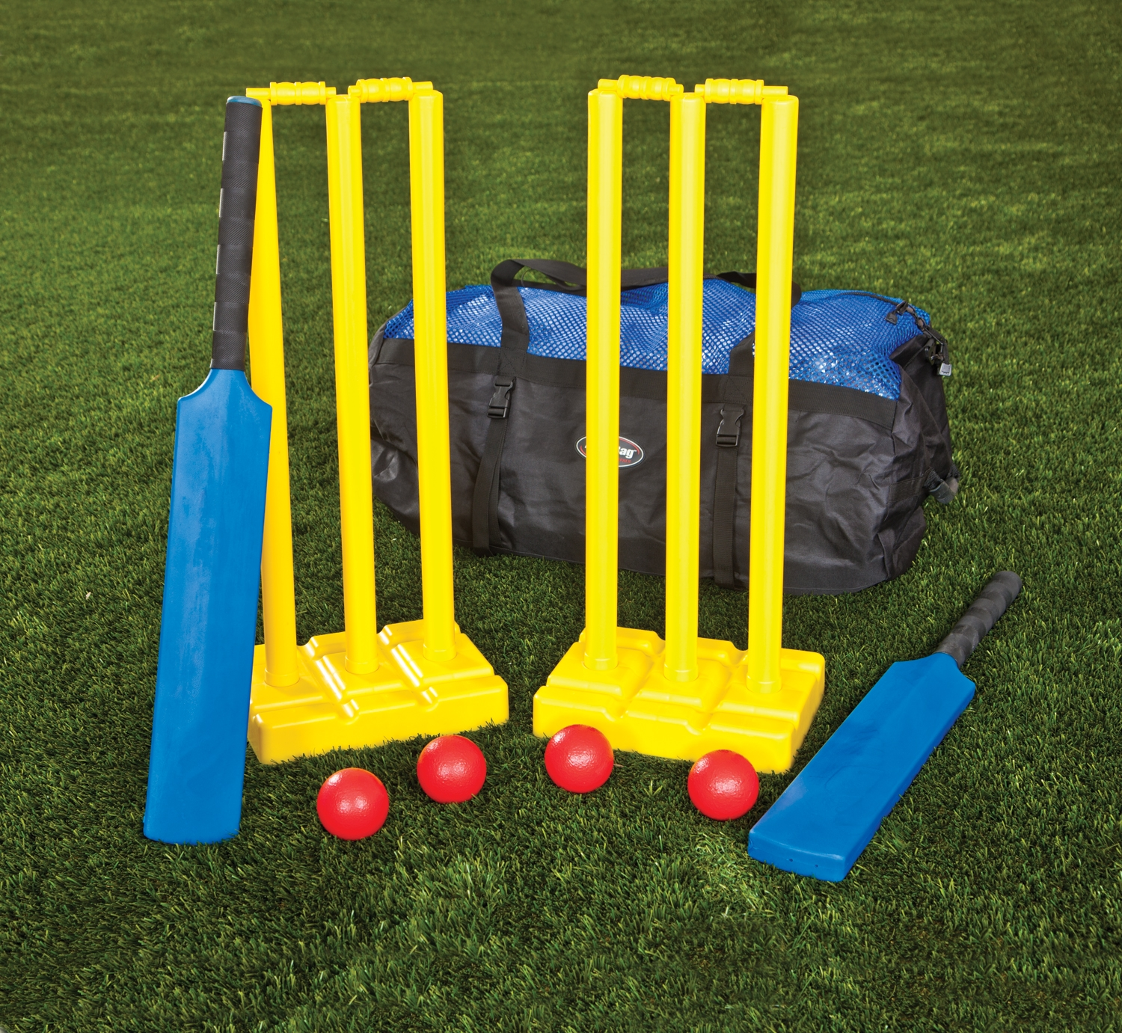
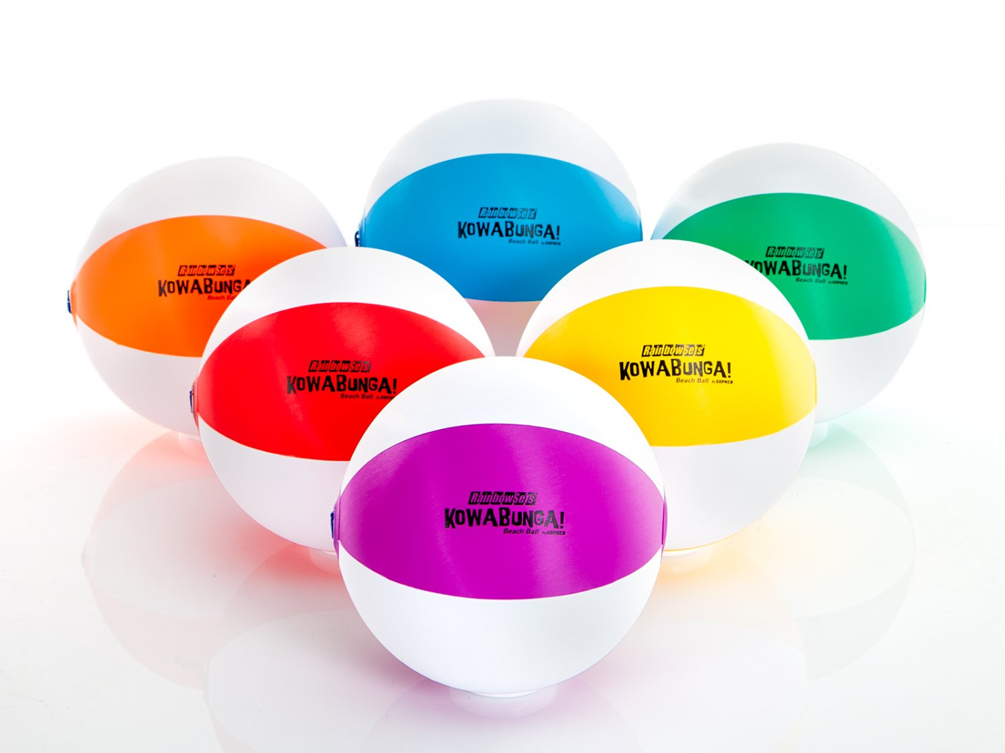
Equipment
QuadriBall – QuadriBall Item No: 34-526
1 set = $475.00 CDN (Less in US$)
Soft-Stix™ Cricket Set - Soft-Stix™ Cricket Set Item No: 58-146
1 set = $149.00 CDN (Less in US$)
ProTuff Half-Cones - Rainbow Set, 5"H x 12" dia Item No: 93-013
1 set of 36 = $125.00 CDN (Less in US$)
Kowabunga! Beach Balls - 12" dia Item No: 71-590
1 set of 6 = $44.00 CDN (Less in US$)

Slide 15
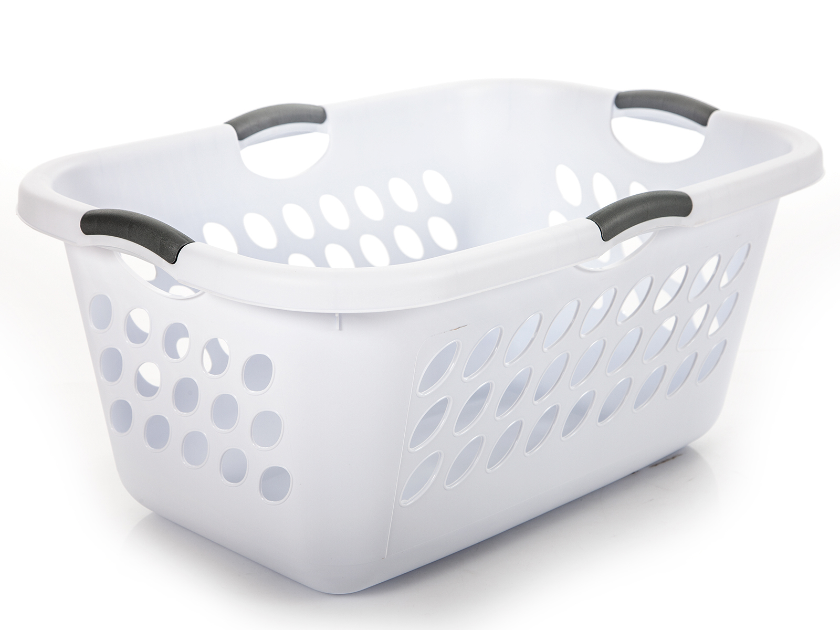
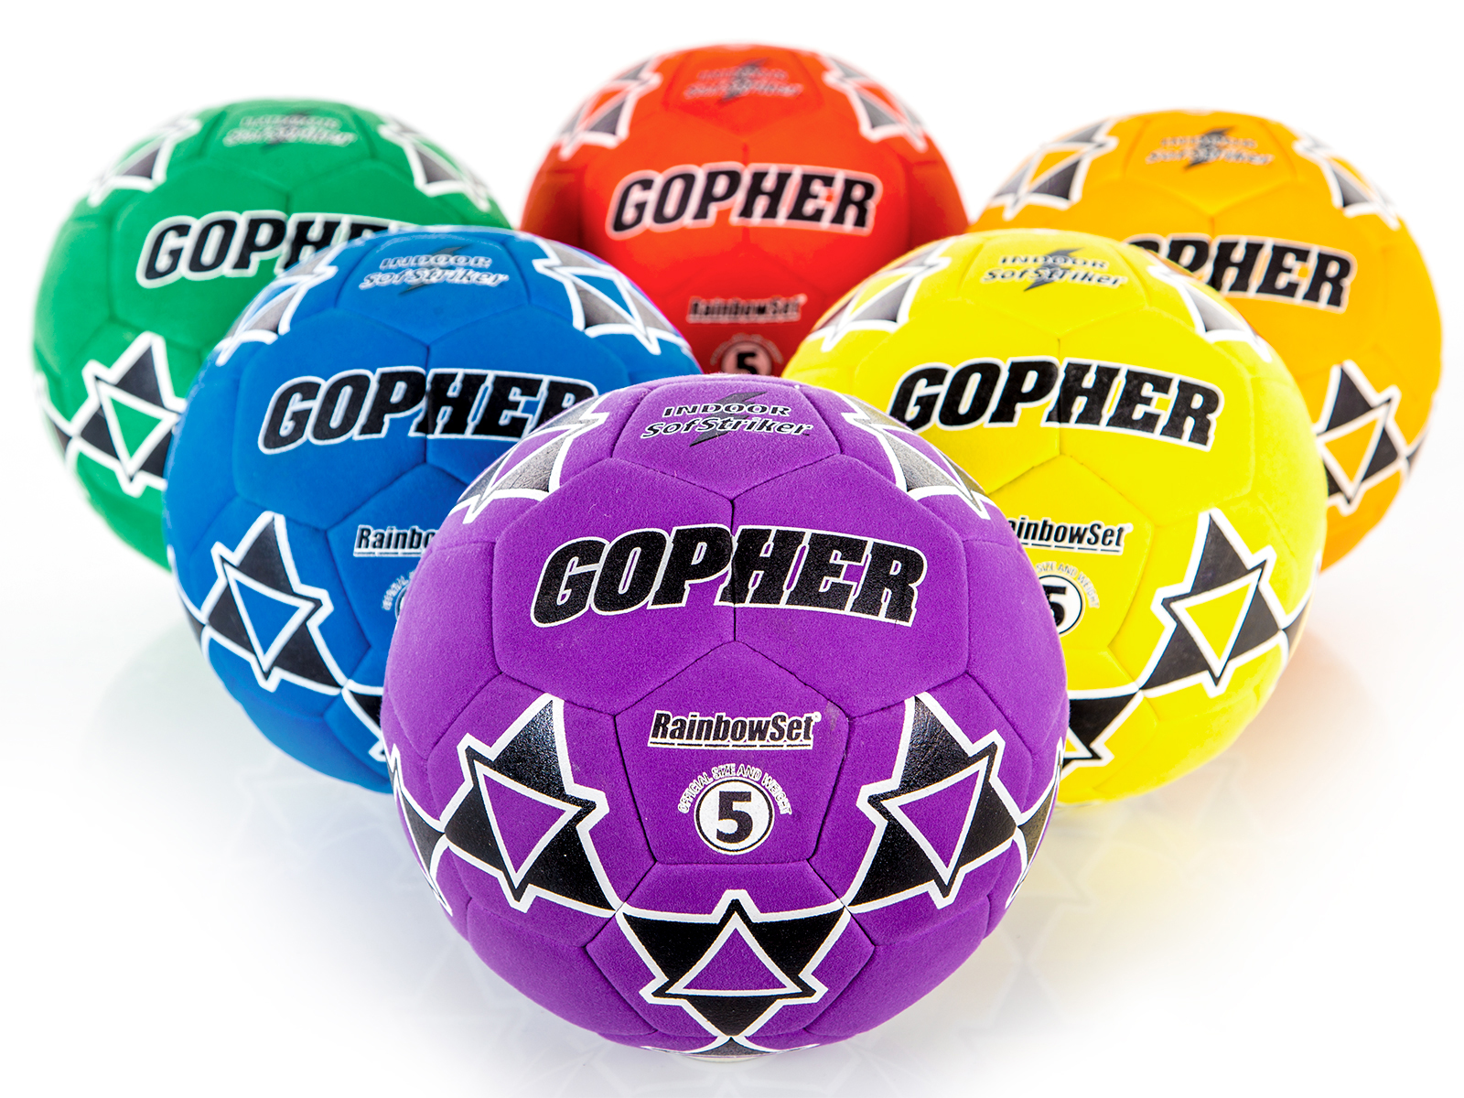
Equipment Con’t
Heavy-Duty Balloons - 12" dia Item No: 92-570
Pkg of 100 = $13.00 CDN (Less in US$)
Magnus Carry-All Cart Basket - Magnus Carry-All Cart Basket Item No: 82-000
1 Set of 4 = $76.00 CDN (Less in US$)
SofStriker Indoor Soccer Balls - Size 4
1 Set of 6 = $209.00 CDN (Less in US$)
SofStriker Indoor Soccer Balls - Size 5 Item No: 62-202
1 Set of 6 = $215.00 CDN (Less in US$)

Slide 16
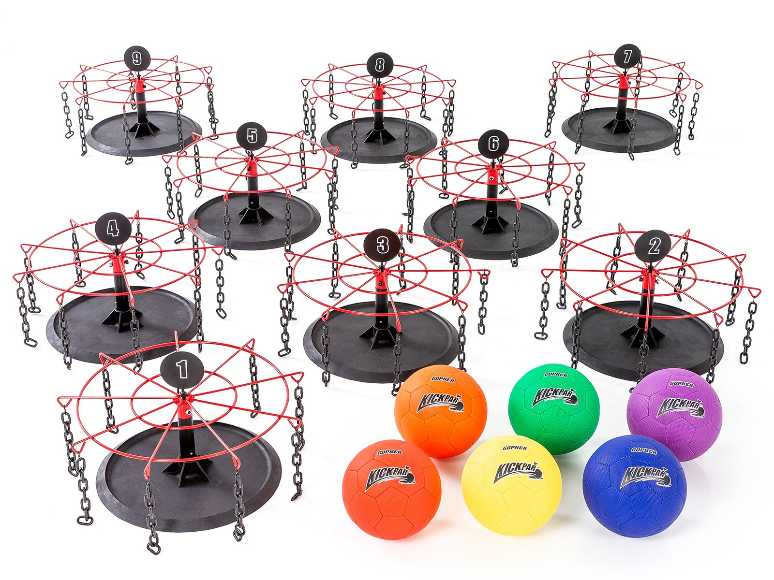
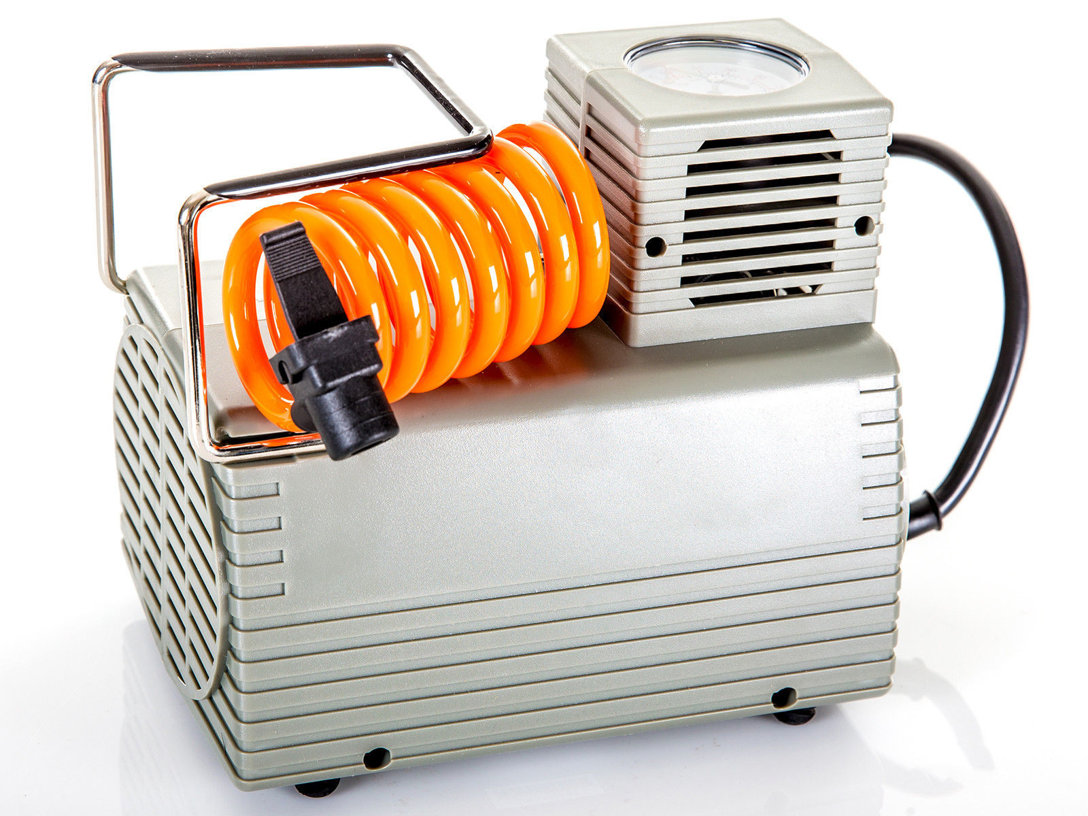
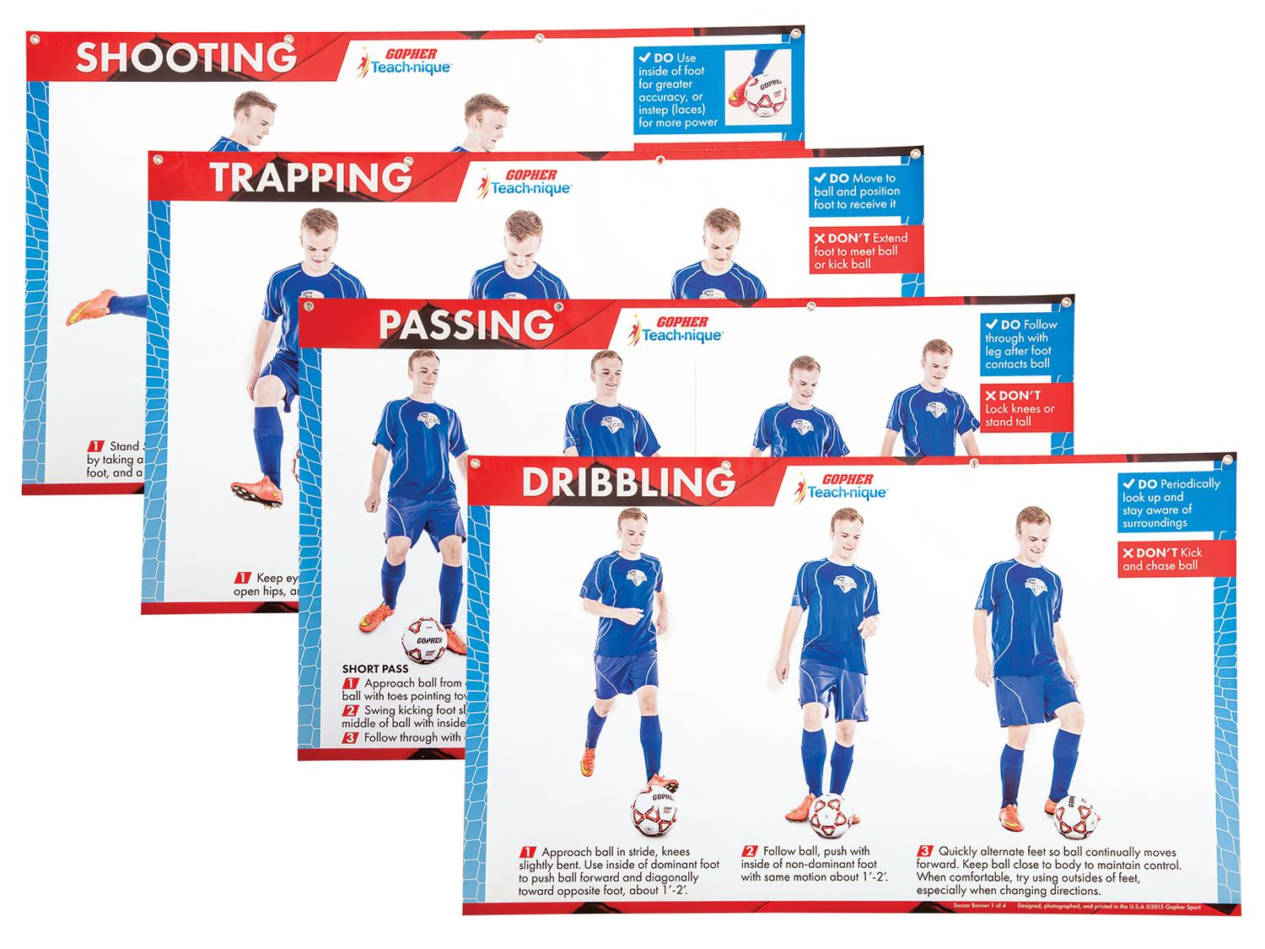
Equipment Con’t
KickPar Set - Individual Goal Set Item No: 58-916
1 Set of 3 = $417.00 CDN (Less in US$)
Compact Inflator - Compact Inflator Item No: 66-620
1 = $135.00 CDN (Less in US$)
Teach-nique™ Soccer Banners - Teach-nique™ Soccer Banners Item No: 49-253
1 Set of 4 = C$215.00 CDN (Less in US$)

Slide 17
Web Resources
Canadago4sport:
600+ game docs and 250+ game videos
www.canadago4sport.com
Nearly 50 different ladder activities
https://www.canadago4sport.com/agility-ladders
Gopher Sport:
Order from over 12 different ladders
https://www.gophersport.com/fitness/saq?tag=agility
Order from hundreds of equipment ideas.
https://www.gophersport.com/
Unconditional 100% satisfaction guarantee
Your satisfaction is our #1 concern! If you are not satisfied with any product you buy from us, we'll simply replace it or refund your money. No questions. No hassles. No exclusions. No kidding!

Slide 18
Pinterest and YouTube
Pinterest:
23 boards, and 600+ pins
Follow at https://www.pinterest.ca/canadago4sport/
YouTube:
330+ videos
Subscribe at https://www.youtube.com/c/canadago4sport/

Slide 19
Social Media and Further Questions
Twitter & Instagram:
Tuesday (sometimes other days) posts
Follow at @canadago4sport
Love to hear from you:
JOHNBYL50@gmail.com

Slide 20
With thanks
To all of the wonderful people
who inspire each other
at conferences and other places!
To Gopher Sport
for their innovative products
and high quality equipment!

Slide 21
Download slides at:
https://www.canadago4sport.com/conferences-and-workshops

