Slide 1
Covid-19 Safe Physical Education
Dr. John Byl
JOHNBYL50@gmail.com
While we wait, sign up for weekly activity postings on:
Twitter or Instagram
@canadago4sport

Slide 2
Covid-19: PHE Canada

Slide 3
Physical Education (PE): Key Points (PHE Canada)
How do we engage our students in meaningful learning to help them connect what they are learning at school to their personal lives?
Include more individual pursuits than traditional team activities such as dance, alternative environment and land-based activities, exercises without equipment, fitness, mindfulness, gymnastics, and target games.

Slide 4
In-School Learning (PHE Canada)
Respect the physical distance of 2 metres always
For small sided games, use visual guides to define space and ensure physical distancing is maintained
Ensure safe, healthy equipment management
Incorporate proper hand washing and personal hygiene routines
If possible, create a hand washing station outside all classrooms
Use outdoor spaces and parks as much as possible
Modify layouts and use physical and visual guides, such as tape or ropes on floors, grass or sidewalks, and signs on walls
Manage and practice movement through spaces
Clearly communicate the route and rules with students ahead of every location move and transition. Review with students how the move went and how it can be improved
Stagger scheduling to limit mixing between cohorts
Close play structures and small communal spaces (e.g. change rooms)

Slide 5
Equipment & Gear (PHE Canada)
How do we ensure healthy equipment management? How do we ensure students have suitable gear for PE?
Focus on activities that do not use equipment
If equipment must be used
Avoid sharing equipment by numbering and assigning each student their own supplies
Assemble individualized PE kits that can be assigned to students
Have students create their own PE kits to use at home or school and set aside budget for additional kits to be purchased
Make sure the equipment has been properly disinfected after each use and not touched after disinfection
Anticipate equipment hygiene compromises and keep extra equipment on hand so that instructional time is not lost to re-cleaning equipment

Slide 6
Equipment & Gear Con’t (PHE Canada)
Disinfect teaching aids (clipboards, white boards, pens, plastic bins for transporting materials etc.)
Encourage students to come to school in clothing that is appropriate for PE and the weather conditions to eliminate the use of change rooms
When transitioning to/from outside remind, and monitor, students to use designated areas for changing into jackets and winter clothing if moving outdoors, such as in designated desk area or a marked side of the hallway

Slide 7
Space (PHE Canada)
Where can PE be taught? If the gymnasium is unavailable for PE, what types of activities can be taught?
If using the gymnasium, open the doors to maximize air flow
Match the instructional design to the available space – use stations, marked off areas, poly spots, etc., to ensure separation among students
Maximize outdoor time while avoiding use of permanent playground structures, benches, and walls
Complete an inventory of outdoor spaces (school yard, local parks and green spaces) and designate zones that can be used for PE
Communicate with families/caregivers at the start of the term to inform them of the areas that will be accessed
If students are remaining in one location, have PE teachers rotate through to each class during the day and deliver PE in place
If blended learning has been chosen, consider assigning tasks for at-home completion and then having students apply the knowledge gained in the school setting
Ensure that whatever learnings are to be done at home or online are accessible for all students

Slide 8
Teacher Ideas
Protect yourself and your students:
Follow the same procedures as expected of your students.
Ensure that students follow the healthy protocol.
Consider wearing a mask.

Slide 9
Teacher Ideas Con`t
Teaching suggestions
Establish a disinfection routine—try include students in that process so they learn and so that process happens more quickly.
As always, if you have a large teaching space, develop many small-sized games to encourage skill development and keep students safe.
If you have a small space to have students active in, then some students will need to be playing while others are on the side. For those on the side they need to be spread out:
Consider putting tape or some spot identification spots on walls to spread these students out.
Students on the sides can be on teams that are playing, and pass any balls (with feet) that go to the sidelines.
Develop a circuit of exercises stations and when everyone is completed their station, the students rotate or switch with players active on the playing area.

Slide 10
Invasion Games that can Work Well: Though Physical Distancing will need to be Established
Broomball https://www.gophersport.com/sports/broomball?tg=1
Field Hockey https://www.gophersport.com/sports/field-hockey?tg=1
Floor Hockey https://www.gophersport.com/sports/floor-hockey?tg=1
Lacrosse https://www.gophersport.com/sports/lacrosse?tg=1
Scoops https://www.gophersport.com/search-unbxd?q=scoop
Soccer https://www.gophersport.com/search?q=soccer+eqiupment
You Fo https://www.gophersport.com/pe/activities/you-fo-set?item=162696

Slide 11
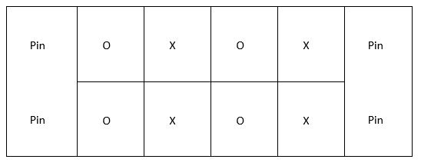
How to Physical Distance in Team Sports
No goalies--use pins
Create grids--players play within
3-5 second pass/shot rule
Add a second ball
Play small sided still, maybe four against four—see diagram below.

Slide 12
Target Games
Target games work well but players should only use their own equipment and keep physical distancing from others.
Students are very capable of developing their own target games—encourage them ☺

Slide 13
Hula Hoop Horseshoe https://www.canadago4sport.com/Target1/Hula-Hoop-Horseshoes

Slide 14
Hula Hoop Horseshoe Race https://www.canadago4sport.com/Target1/Hula-Hoop-Horseshoes-Race

Slide 15
Kickpar https://www.canadago4sport.com/Target1/Kickpar
No video yet

Slide 16
SyncroBall https://www.canadago4sport.com/Target1/SynchroBall

Slide 17
TripleShot Disc Target https://www.gophersport.com/sports/disc-golf/tripleshot-disc-target-set?item=169024

Slide 18
Launch Baseball https://www.canadago4sport.com/strike/Launch-Baseball

Slide 19
Golf https://www.gophersport.com/search-unbxd?&q=Golf%20Equipment&rows=40&view=grid&start=0
Regular Golf

Slide 20
Disc Golf—With Mobile Stands https://www.canadago4sport.com/Target1/Disc-Golf-with-Mobile-Goals

Slide 21
Disc Golf—With Natural Goals https://www.canadago4sport.com/Target1/Disc-Golf-with-Natural-Goals

Slide 22
Net Game Team Launch https://www.canadago4sport.com/Net/Team-Launch-Light

Slide 23
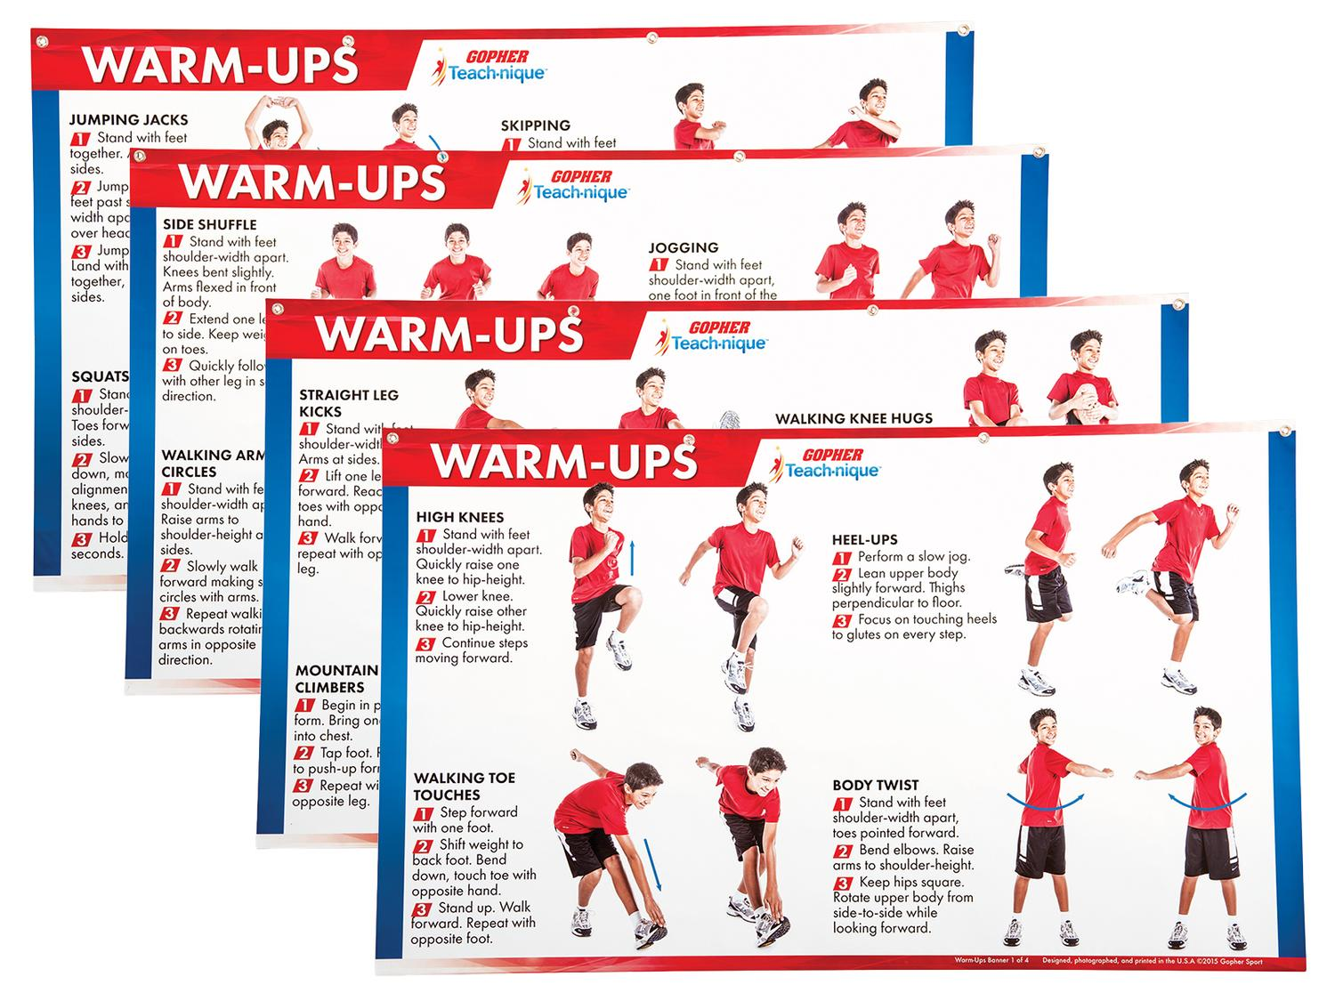
Fitness Activities
Warmup charts without equipment
https://www.gophersport.com/pe/gym-posters/teach-nique-warm-ups-banners?item=9332
F.I.T.T Banners
https://www.gophersport.com/pe/gym-posters/teach-nique-fitt-banners?item=10848

Slide 24
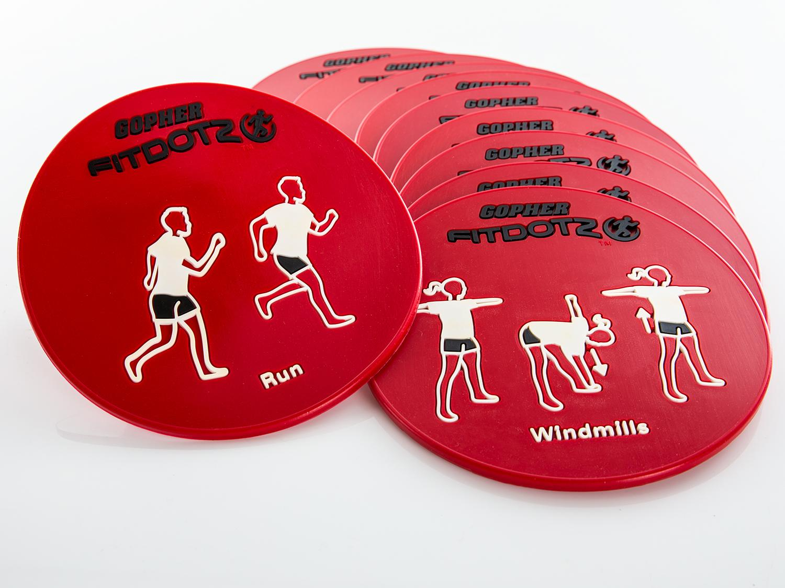
Fitness Activities Con`t Exeropoly https://www.canadago4sport.com/Warmups/Exeropoly

Slide 25
Ladder Activities
Ladder activities—for about 50 different ways https://www.canadago4sport.com/agility-ladders

Slide 26
Ladder Activities Con`t Just with Feet
For example:

Slide 27
Ladder Activities Con`t With Feet and Hands
For example:

Slide 28
Ladder Activities Con`t With Additional Equipment
For example:

Slide 29
Most Tag Games With Cleaned Pool Noodles for Its https://www.gophersport.com/sports/swimming/funoodles-foam-rod-floats?item=-204621

Slide 30
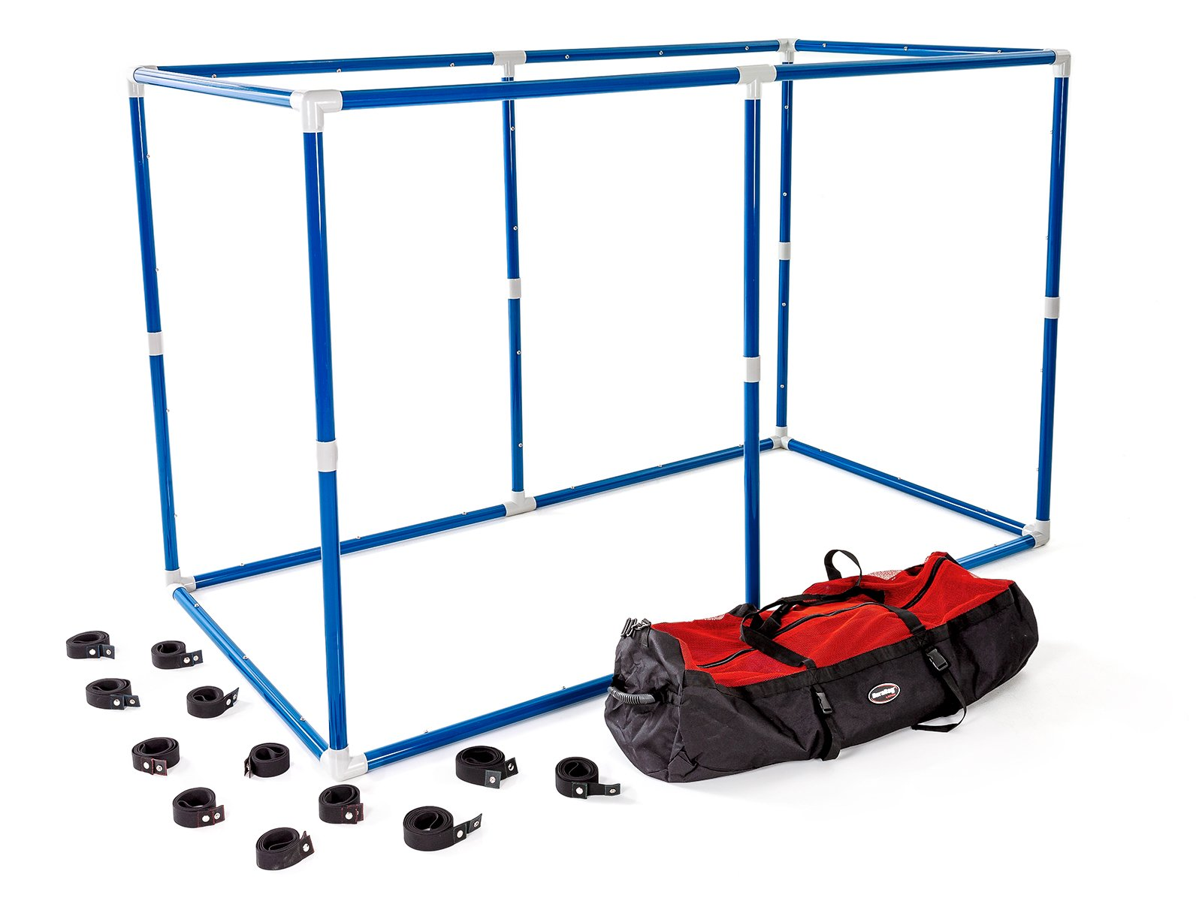
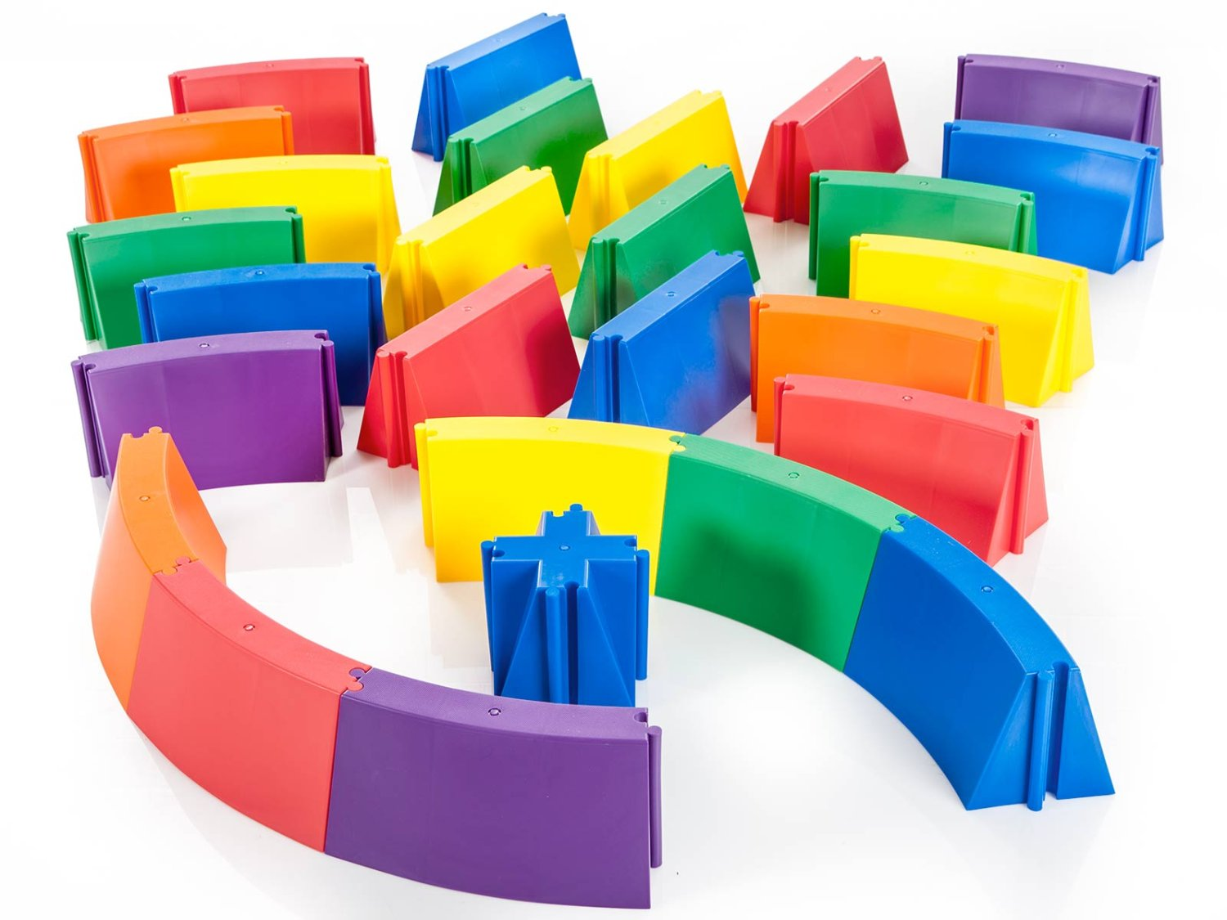
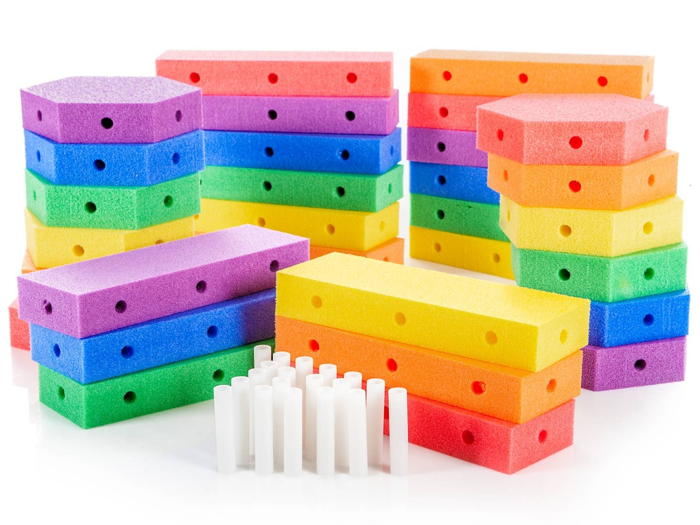
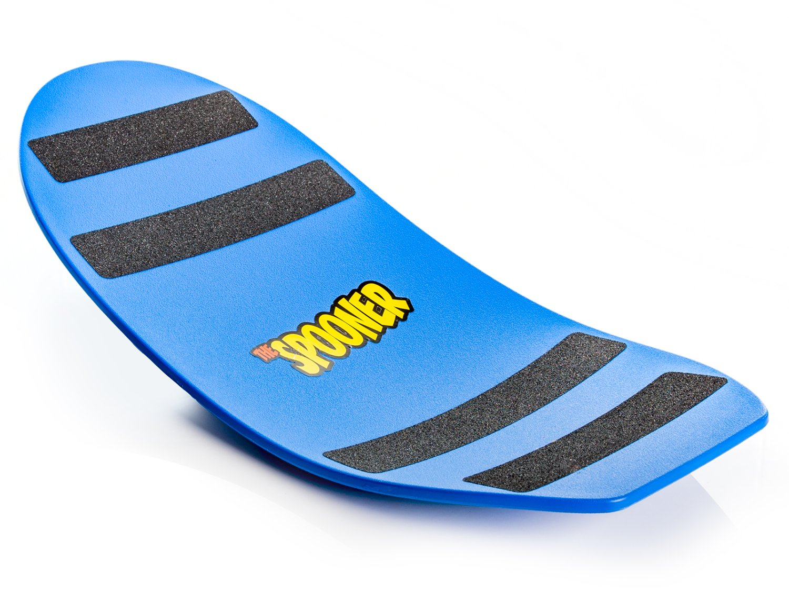
Obstacle Courses
Maneuver Maze https://www.gophersport.com/pe/movement/maneuvermaze-obstacle-course?item=162174
Simple Step https://www.gophersport.com/pe/movement/simplestep-balance-beam?item=154075
Figure 8 https://www.gophersport.com/pe/movement/figure-8-balance-beam?item=5275
Create a Course https://www.gophersport.com/pe/movement/create-a-beam-plus-balance-set?item=9753
Spooner https://www.gophersport.com/pe/movement/the-spooner?item=5584

Slide 31
Sample Obstacle Course https://www.canadago4sport.com/Locomotor/Obstacle-Course

Slide 32
Dance
Resources https://www.gophersport.com/pe/dance?tg=1
Everybody Move https://www.gophersport.com/pe/movement/everybody-move?item=6202
Samples https://www.pinterest.ca/canadago4sport/dance/
Don`t Sit Still Swimming Groove

Slide 33
Daily Physical Activity (DPA)
Everybody Move https://www.gophersport.com/pe/movement/everybody-move?item=6202

Slide 34
Simon Says https://www.canadago4sport.com/Leadership/Simon-Says

Slide 35
Simon Says do Previous https://www.canadago4sport.com/Leadership/Simon-Says-Do-Previous

Slide 36
Simon Says do Opposite https://www.canadago4sport.com/Leadership/Simon-Says-Do-Opposite

Slide 37
Ying Yang You Instructions https://www.canadago4sport.com/Leadership/Ying-Yang-You-Instructions

Slide 38
Ying Yang You Slow https://www.canadago4sport.com/Leadership/Ying-Yang-You-Slow

Slide 39
Ying Yang You Faster https://www.canadago4sport.com/Leadership/Ying-Yang-You-Faster

Slide 40
Ying Yang You Back https://www.canadago4sport.com/Leadership/Ying-Yang-You-Back

Slide 41
Leadership Games

Slide 42
Tip the Bucket https://www.canadago4sport.com/Leadership/Tip-the-Bucket

Slide 43
Carry and Drop the Bean Bag https://www.canadago4sport.com/Leadership/Carry-and-Drop-the-Bean-Bags

Slide 44
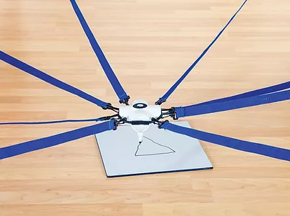
Cooperative Writing https://www.canadago4sport.com/Leadership/Cooperative-Writing
No video yet:

Slide 45
Architect https://www.canadago4sport.com/Leadership/Architect

Slide 46
Numeracy

Slide 47
Even and Odd With Wall Sit and Run https://www.canadago4sport.com/Numeracy/Even-and-Odd-With-Wall-Sit-and-Run

Slide 48
Ready Set Select https://www.canadago4sport.com/Numeracy/Ready-Set-Select-

Slide 49
Social Distancing Activities
11 Minute video on Fair & Square at:
https://www.chch.com/distanced-phys-ed/

Slide 50
Web Resources
Canadago4sport:
600+ game docs and 250+ game videos
www.canadago4sport.com
Nearly 50 different ladder activities
https://www.canadago4sport.com/agility-ladders
Gopher Sport:
Order from over 12 different ladders
https://www.gophersport.com/fitness/saq?tag=agility
Order from hundreds of equipment ideas.
https://www.gophersport.com/
Unconditional 100% satisfaction guarantee
Your satisfaction is our #1 concern! If you are not satisfied with any product you buy from us, we'll simply replace it or refund your money. No questions. No hassles. No exclusions. No kidding!

Slide 51
Pinterest and YouTube
Pinterest:
23 boards, and 600+ pins
Follow at https://www.pinterest.ca/canadago4sport/
YouTube:
330+ videos
Subscribe at https://www.youtube.com/c/canadago4sport/

Slide 52
Social Media and Further Questions
Twitter & Instagram:
Tuesday (sometimes other days) posts
Follow at @canadago4sport
Love to hear from you:
JOHNBYL50@gmail.com

Slide 53
With thanks
To all of the wonderful people
who inspire each other
at conferences and other places!
To Gopher Sport
for their innovative products
and high quality equipment!

Slide 54
Download slides at:
https://www.canadago4sport.com/conferences-and-workshops

