Slide 1
Succeeding at Stay-at-Home Physical Health Education— 50+ Ideas…
Dr. John Byl
JOHNBYL50@gmail.com
PowerPoint with all Videos Available at:
https://www.canadago4sport.com/confences-and-workshops
“Succeeding at Stay-at-Home PHE”

Slide 2
Engaging In Your Neighbourhood

Slide 6
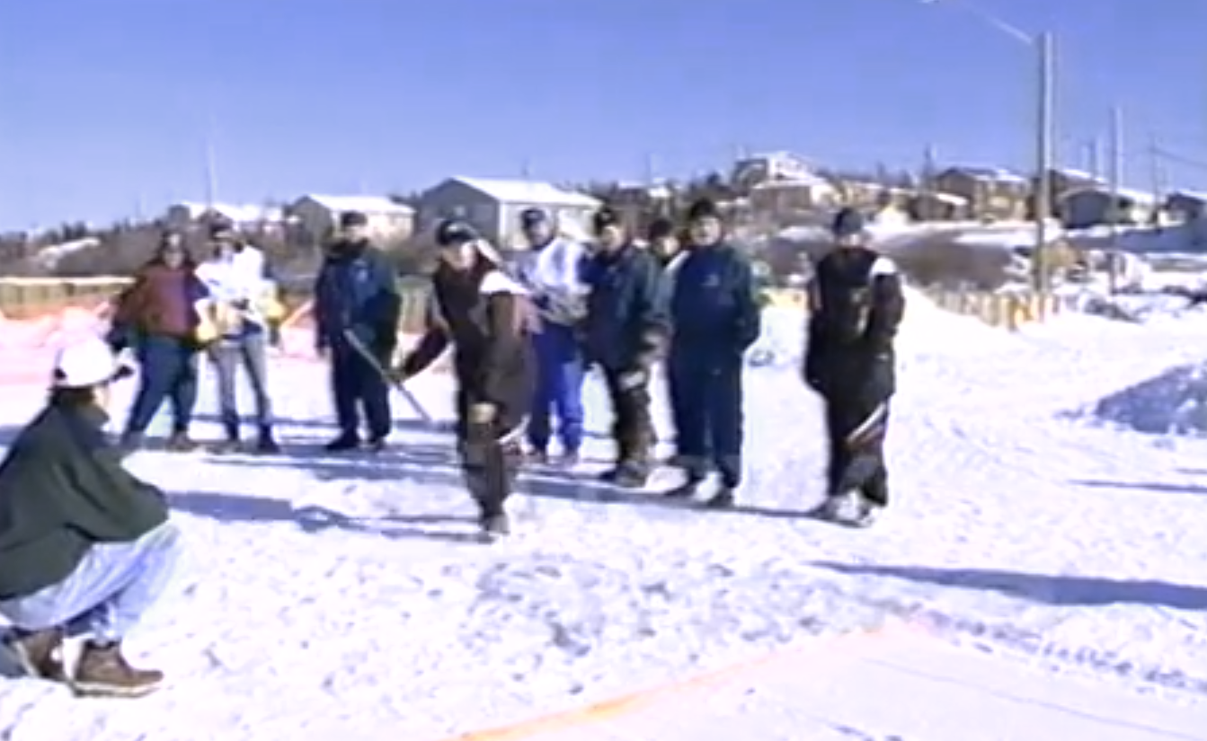
Dene Games Snow Snake

Slide 7
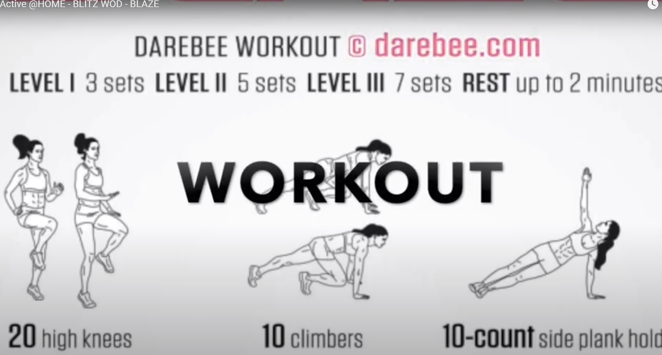
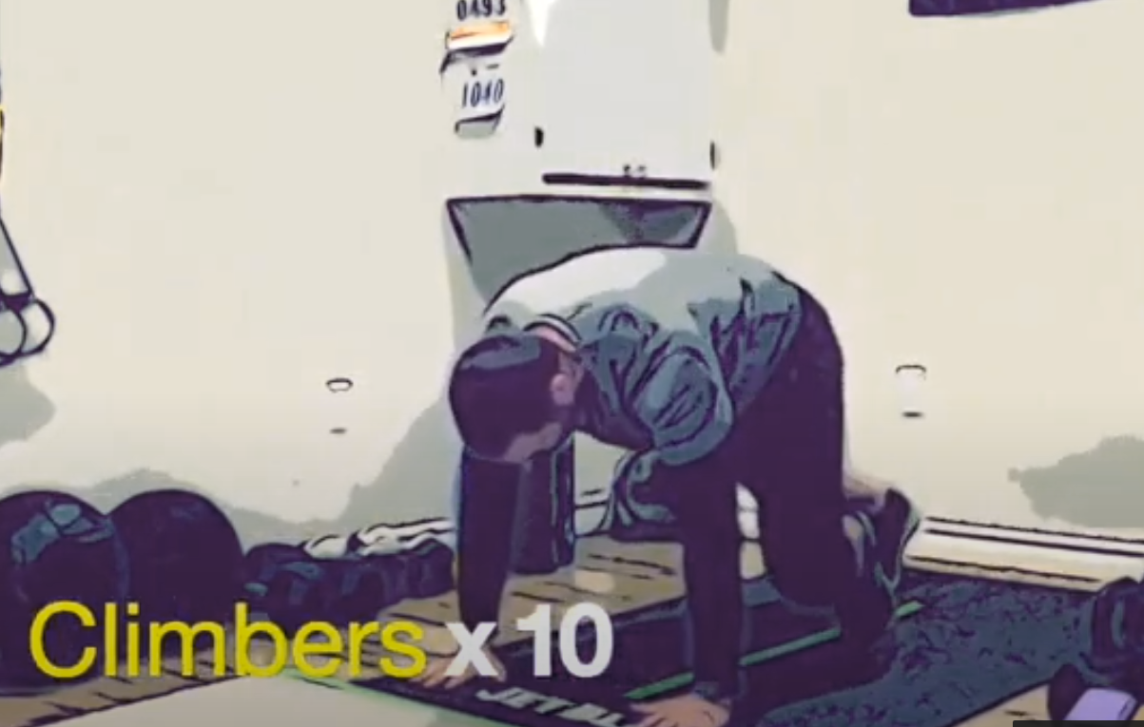
Mr. Verbeek Active @Home (and have students create)
Main site: https://youtube.com/channel/UCFIQCgADfLkcXvA0ymlo_5Q (six videos)
Samples: Blaze Workout

Slide 8
Mr. Verbeek Active @Home Target Games

Slide 9
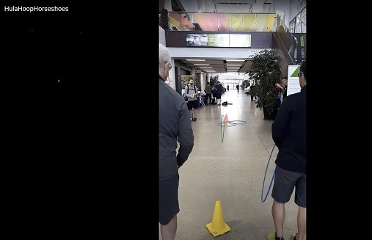
Target Activities Hula Hoop Horseshoe Race— https://youtu.be/D-lAsMyun3M https://www.canadago4sport.com/Target1/Hula-Hoop-Horseshoes-Race

Slide 10
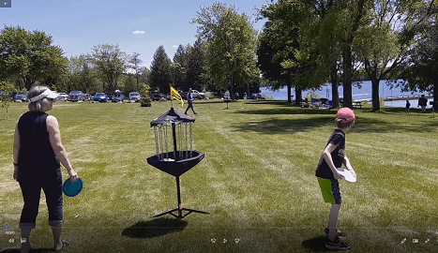
Disc Golf With Anova Targets https://www.canadago4sport.com/Target1/Disc-Golf-with-Mobile-Goals

Slide 11
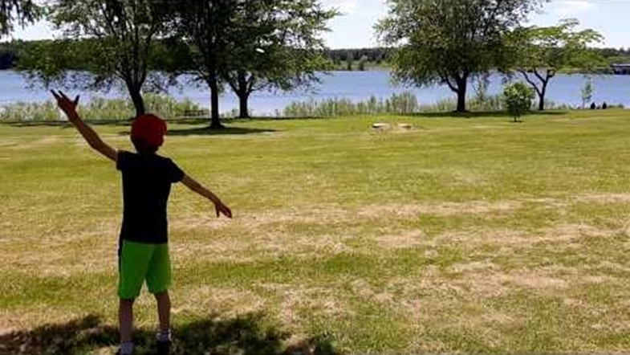
Disc Golf with Natural Targets https://www.canadago4sport.com/Target1/Disc-Golf-with-Natural-Goals

Slide 12
Kickpar https://www.canadago4sport.com/Target1/Kickpar

Slide 13
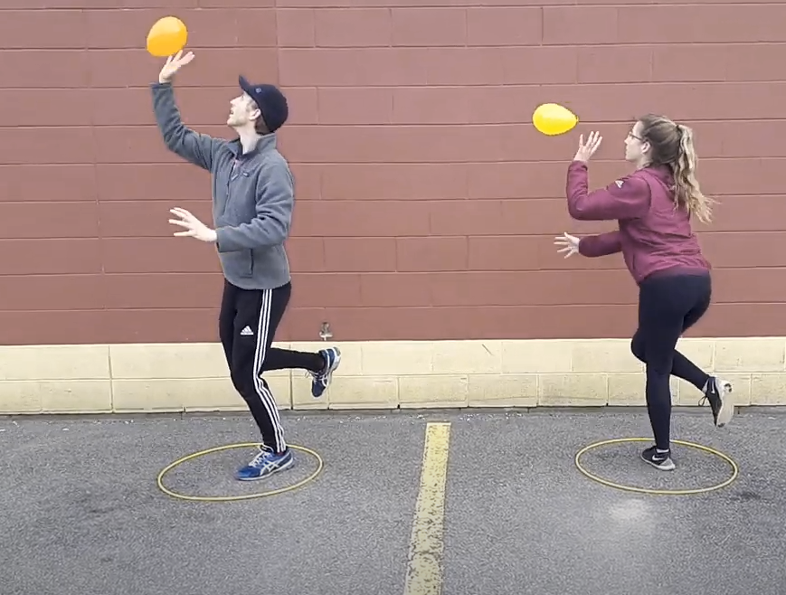
Manipulative Retain Stork Stand Balloon Keepup https://www.canadago4sport.com/Manipulative-Retain/Stork-Stand-Balloon-Keepup

Slide 14
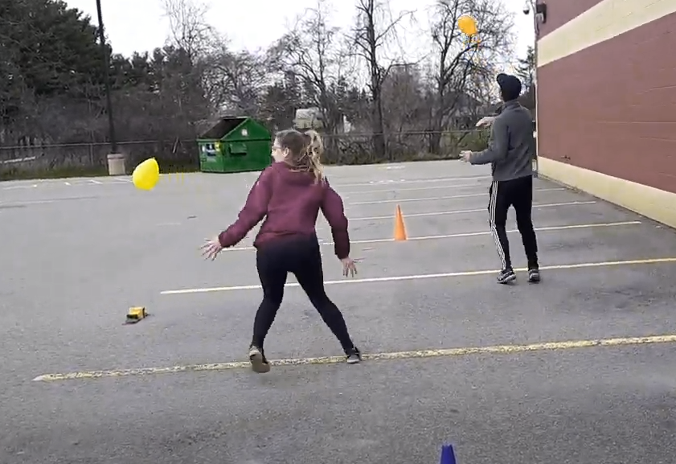
Balloon Dribble with Hands https://www.canadago4sport.com/Manipulative-Send/Balloon-Dribble-With-Hands

Slide 15
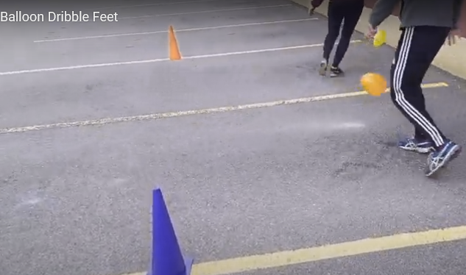
Balloon Dribble with Feet https://www.canadago4sport.com/Manipulative-Send/Balloon-Dribble-with-Feet

Slide 16
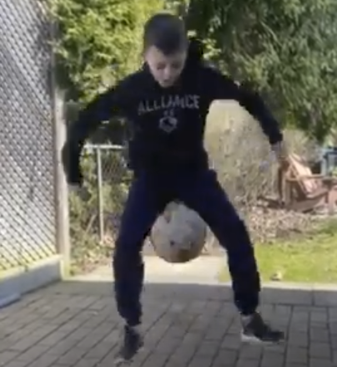
Balance a Ball https://www.canadago4sport.com/Manipulative-Retain/Balance-Two-Ball

Slide 17
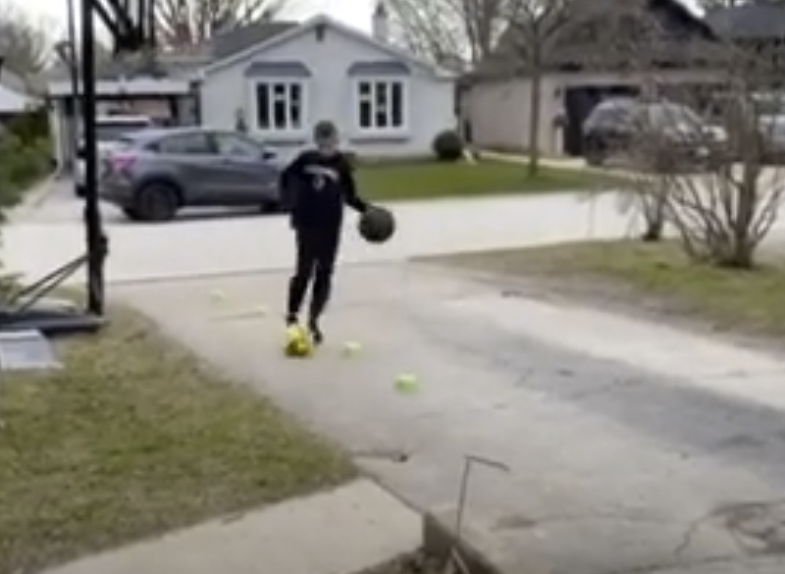
Double Dribble https://www.canadago4sport.com/Manipulative-Retain/Double-Dribble

Slide 18
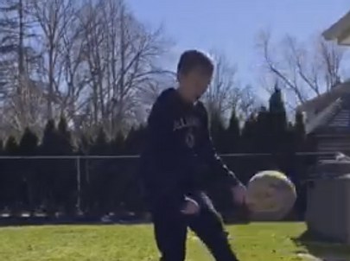
Soccer Juggle with 360 https://www.canadago4sport.com/Manipulative-Retain/Soccer-Juggle-with-360

Slide 19
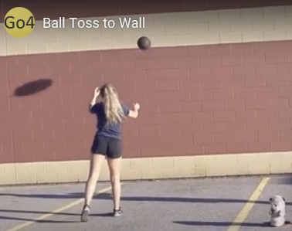
Throw to a Wall Timed Race https://www.canadago4sport.com/Manipulative-Send/Throw-to-a-Wall-Relay https://www.canadago4sport.com/Manipulative-Send/Toss-and-Catch-to-Wall
But make an individual or team (2-3 players) race of it.

Slide 20
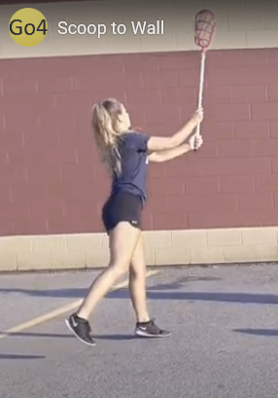
Scoops with a partner or solo against a wall https://www.canadago4sport.com/Manipulative-Send/Scoop-to-Wall

Slide 21
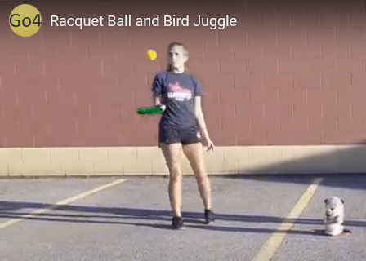
Bird/Ball Juggle https://www.canadago4sport.com/Manipulative-Send/-Bird%2FBall-Juggle

Slide 22
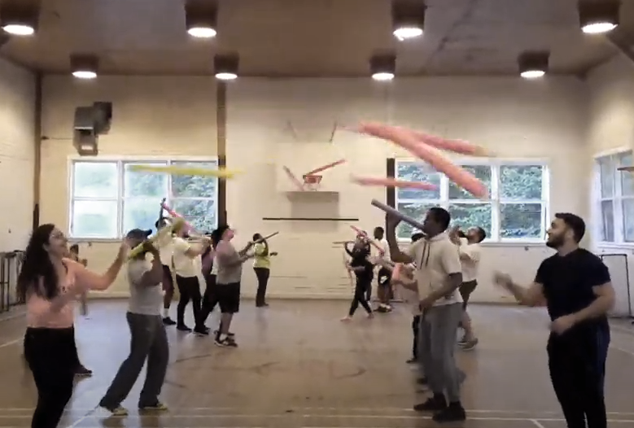
Manipulative Send and Receive Noodle Toss Pairs [at home] (but use Rubber Band Ball instead or scoops) https://www.canadago4sport.com/Manipulative-Send/Noodle-Toss-Pairs

Slide 23
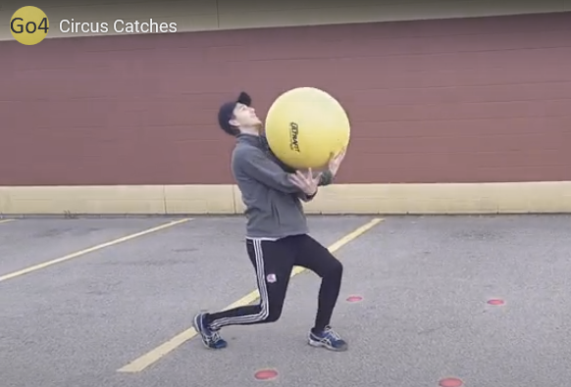
Circus Catches [at home—partner or tossed to self] https://www.canadago4sport.com/Stability-Ball1/Circus-Catches

Slide 24
Backwards Partner Bowling [at home] https://www.canadago4sport.com/Target1/Backwards-Partner-Bowling

Slide 25
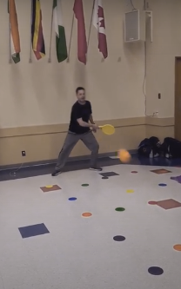
Net/Wall Activities Two Square With a Target https://www.canadago4sport.com/Target1/Ace-Chase-Two-Square

Slide 26
Pickleball—Other Racquet Sports
Identify a pickleball (or use pickleballs from two different companies).
Play solo against a wall
One player picks up a pickleball with his hands, and the other player picks up the other pickleball with his hands. Players can flip or kick opponent’s pickleball to their side and keep their pickleball out of play, when not serving, by rolling their ball to the wall behind them.

Slide 27
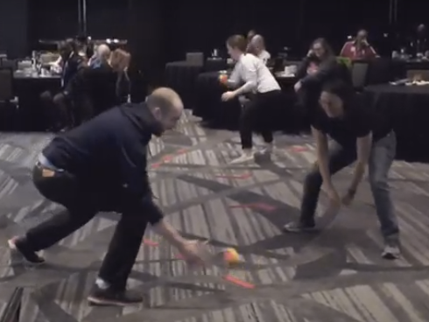
Width and Depth [at home] https://www.canadago4sport.com/Net/Width-and-Depth

Slide 28
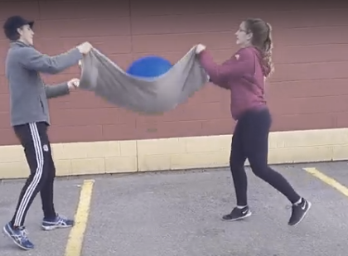
Toss in the Towel (use a soccer ball instead of stability ball) https://www.canadago4sport.com/Manipulative-Send/Toss-in-the-Towel

Slide 29
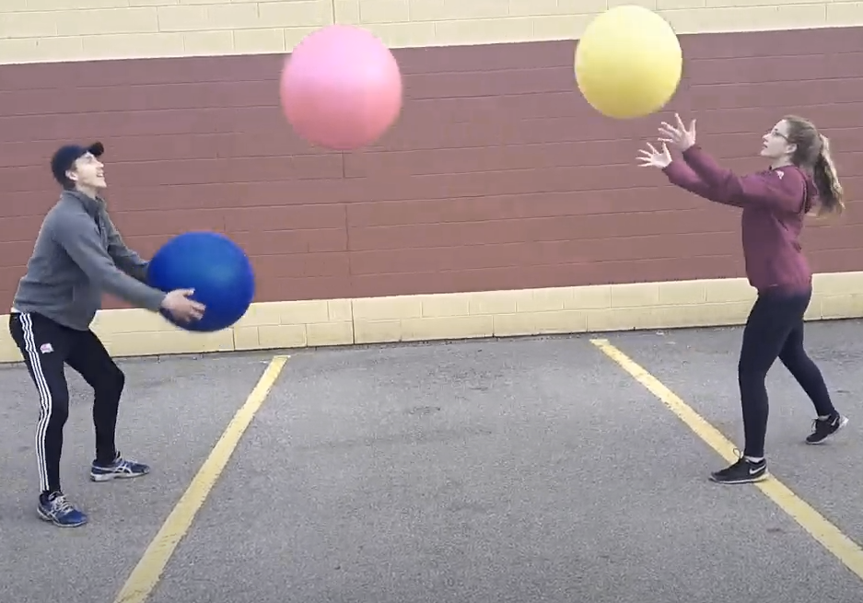
Two Player Juggle [at home] (use any three larger balls—soccer, basketball…) https://www.canadago4sport.com/Manipulative-Send/Two-Player-Juggle

Slide 30
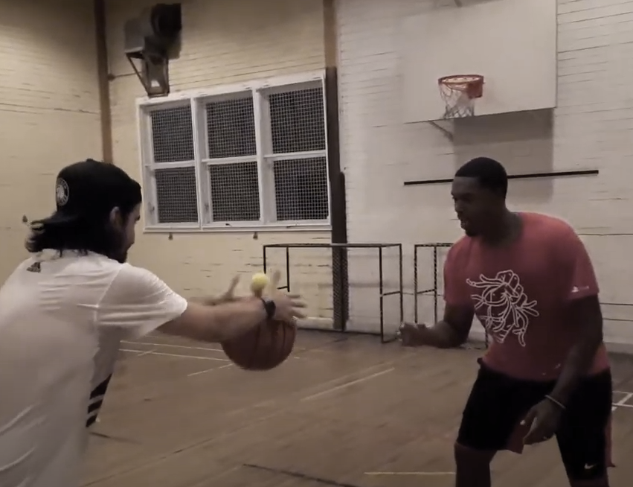
Kaboom (use a larger ball (basketball or soccer ball) and a smaller ball (tennis) or bean bag [do solo or with safe partner] https://www.canadago4sport.com/Manipulative-Receive/Kaboom

Slide 31
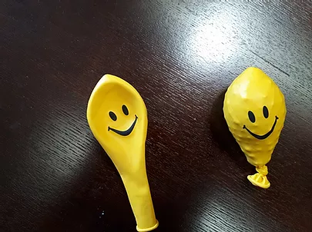
Wobbly Balloon [at home] https://www.canadago4sport.com/Manipulative-Receive/Woobly-Balloon

Slide 32
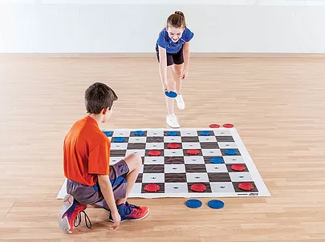
Active Brain Activities Active Checkers https://www.canadago4sport.com/Numeracy/Active-Checkers

Slide 33
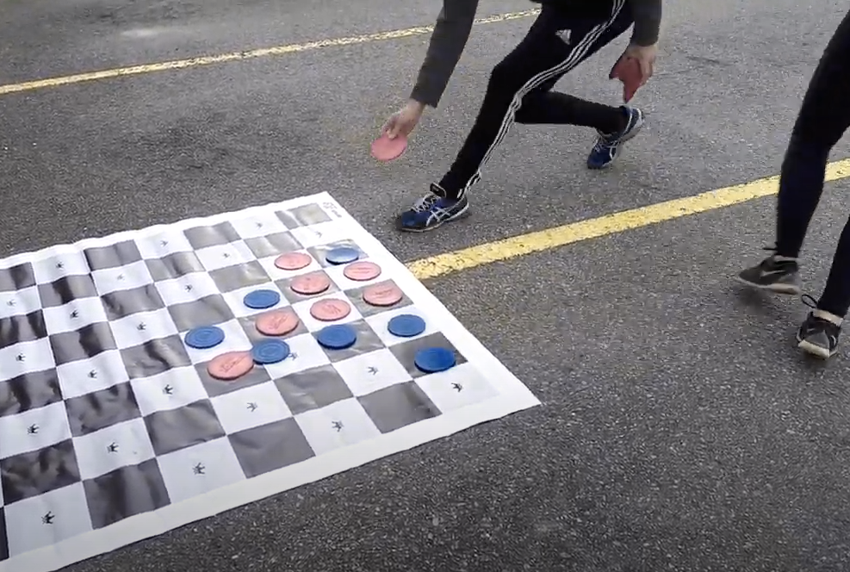
Connect Four Up (use checker board) https://www.canadago4sport.com/Numeracy/Connect-Four-Up

Slide 34
Fitness

Slide 35
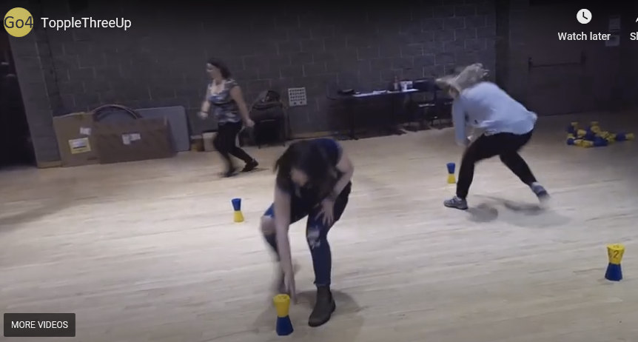
Topple Three Up (Use plastic cups—upside-down or right-side-up) https://www.canadago4sport.com/Locomotor/Topple-Three-Up

Slide 36
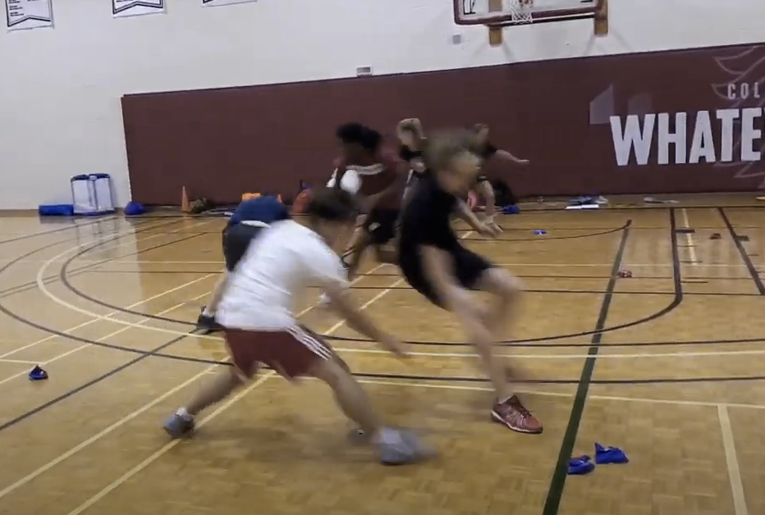
Anerobic Beanbag Race (could use any four objects like, handkerchiefs, pieces of foam, plastic cups…) https://www.canadago4sport.com/Locomotor/Anaerobic-Beanbag-Race

Slide 37
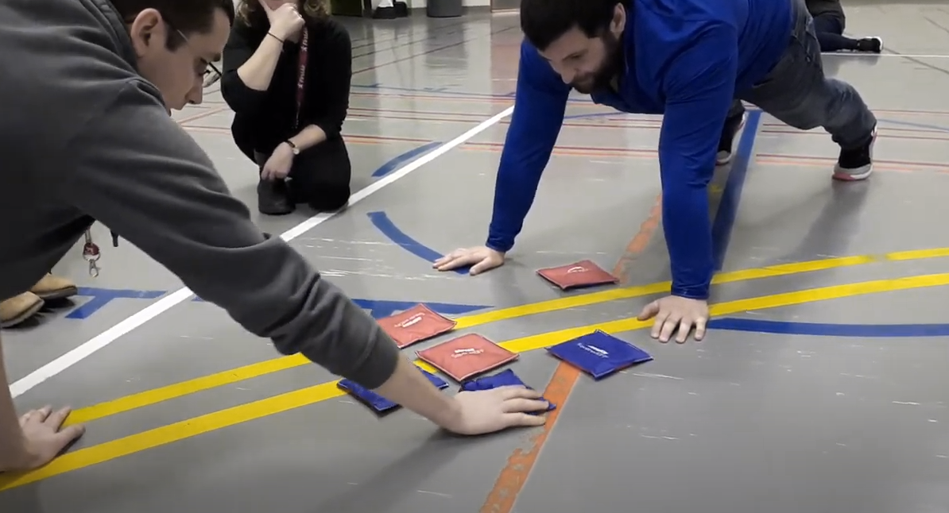
Tic Tac Toe No Grid in Push Up Position https://www.canadago4sport.com/Numeracy/Tic-Tac-Toe%E2%80%94No-Grid-With-Push-Up

Slide 38
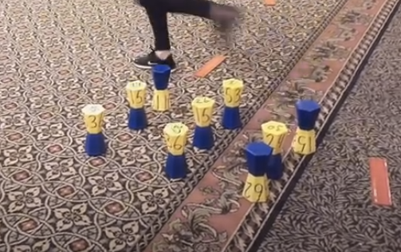
Tic-Tac-Toe Double Three in a Row (9 plastic cups) https://www.canadago4sport.com/Numeracy/Topple-Double-Tic-Tac

Slide 39
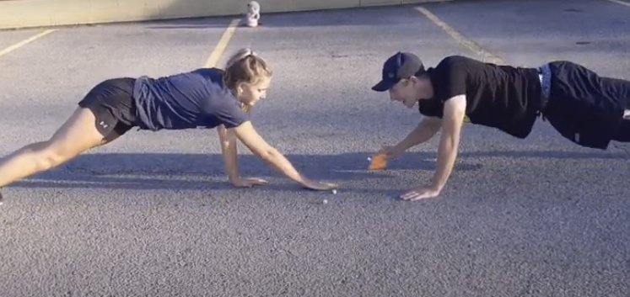
Planks till Odd Use own dice and beanbag https://www.canadago4sport.com/Numeracy/Planks-till-odd

Slide 40
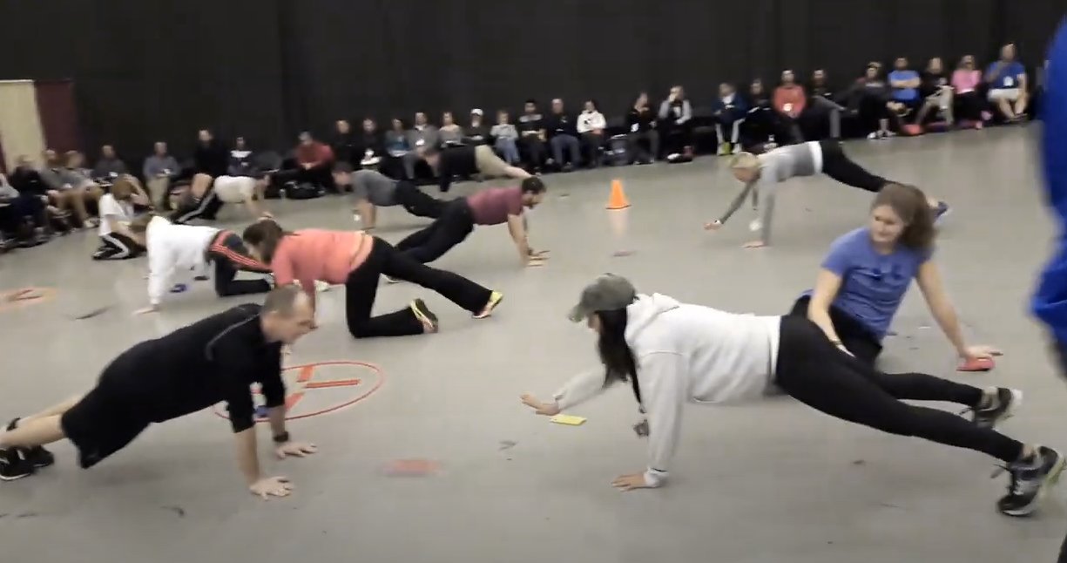
Push up Hockey in Pairs [at home] https://www.canadago4sport.com/Warmups/Push-Up-Hockey-in-Pairs

Slide 41
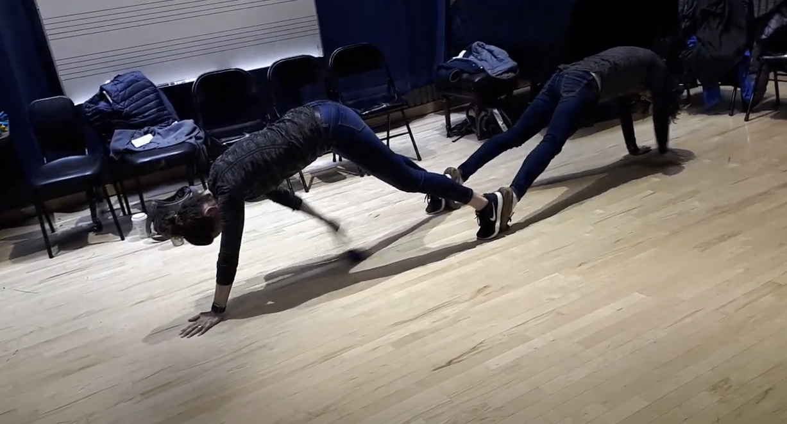
Feet to Feet Hockey [at home] (use any small ball (tennis) or bean bag) https://www.canadago4sport.com/Manipulative-Receive/Feet-to-Feet-Hockey

Slide 42
Seated Toss [at home or solo against a wall] https://www.canadago4sport.com/Stability-Ball1/Butt-Sit-Pass

Slide 43
Fitness Activities can be done well by using body weight for activities
Encourage students to design their own workout using 4-8 activities that develop balanced muscle development for strength and/or endurance.

Slide 44
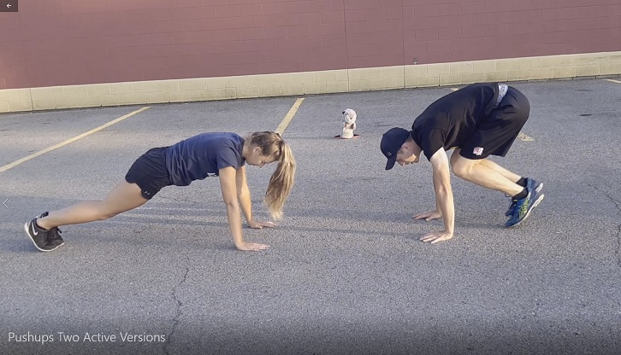
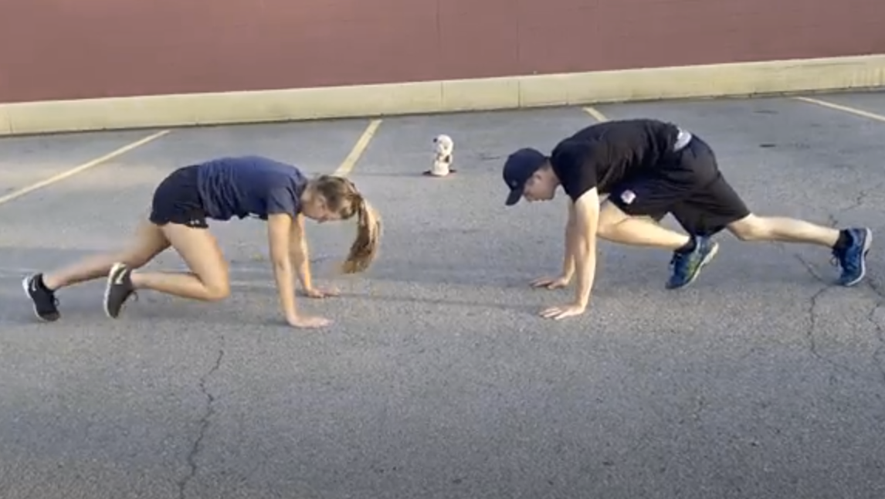
Abdominals, Deltoids, Pectoralis, and Tricep https://www.canadago4sport.com/Warmups/Push-Ups--Two-Active-Versions
Pushups off knees, off toes, toes on first, second… step on a staircase
https://greatist.com/move/sliders-workout#lower-body
High Plank Double Knee
High Plank Mountain Climber

Slide 45
Triceps, Pectoralis, and Trapezius Triceps Dips Can be done on the first rung of a staircase or a chair.

Slide 46
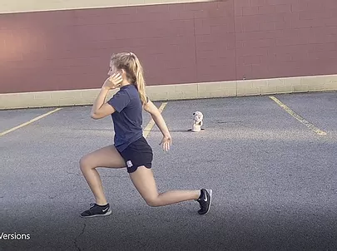
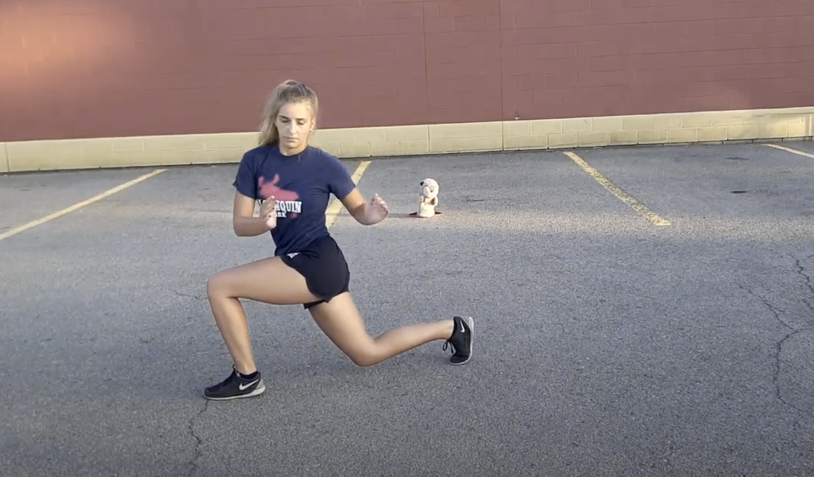
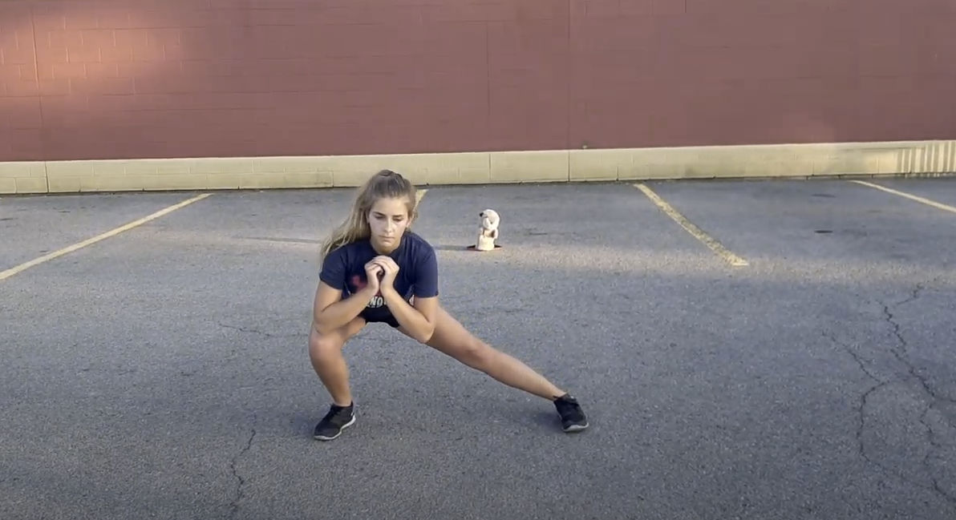
Quadriceps, Hamstrings, Glutes, and Calves Lunges https://www.canadago4sport.com/Warmups/Lunge-Three-Versions

Slide 47
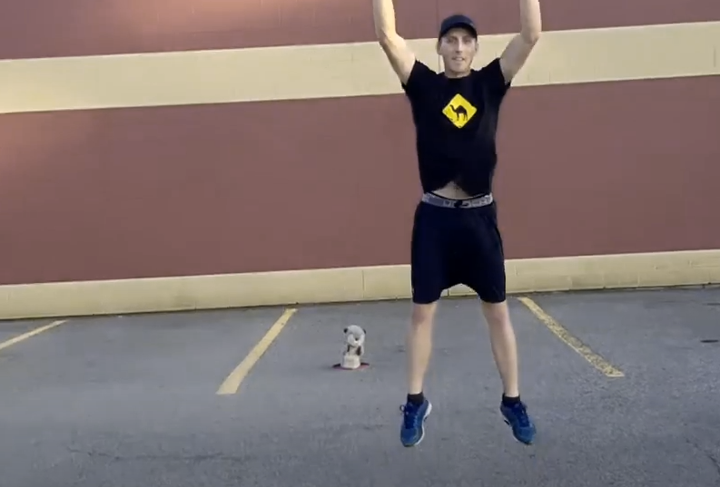
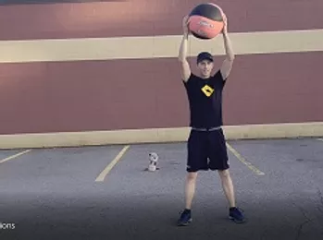
Squats https://www.canadago4sport.com/Warmups/Squats--Two-Versions

Slide 48
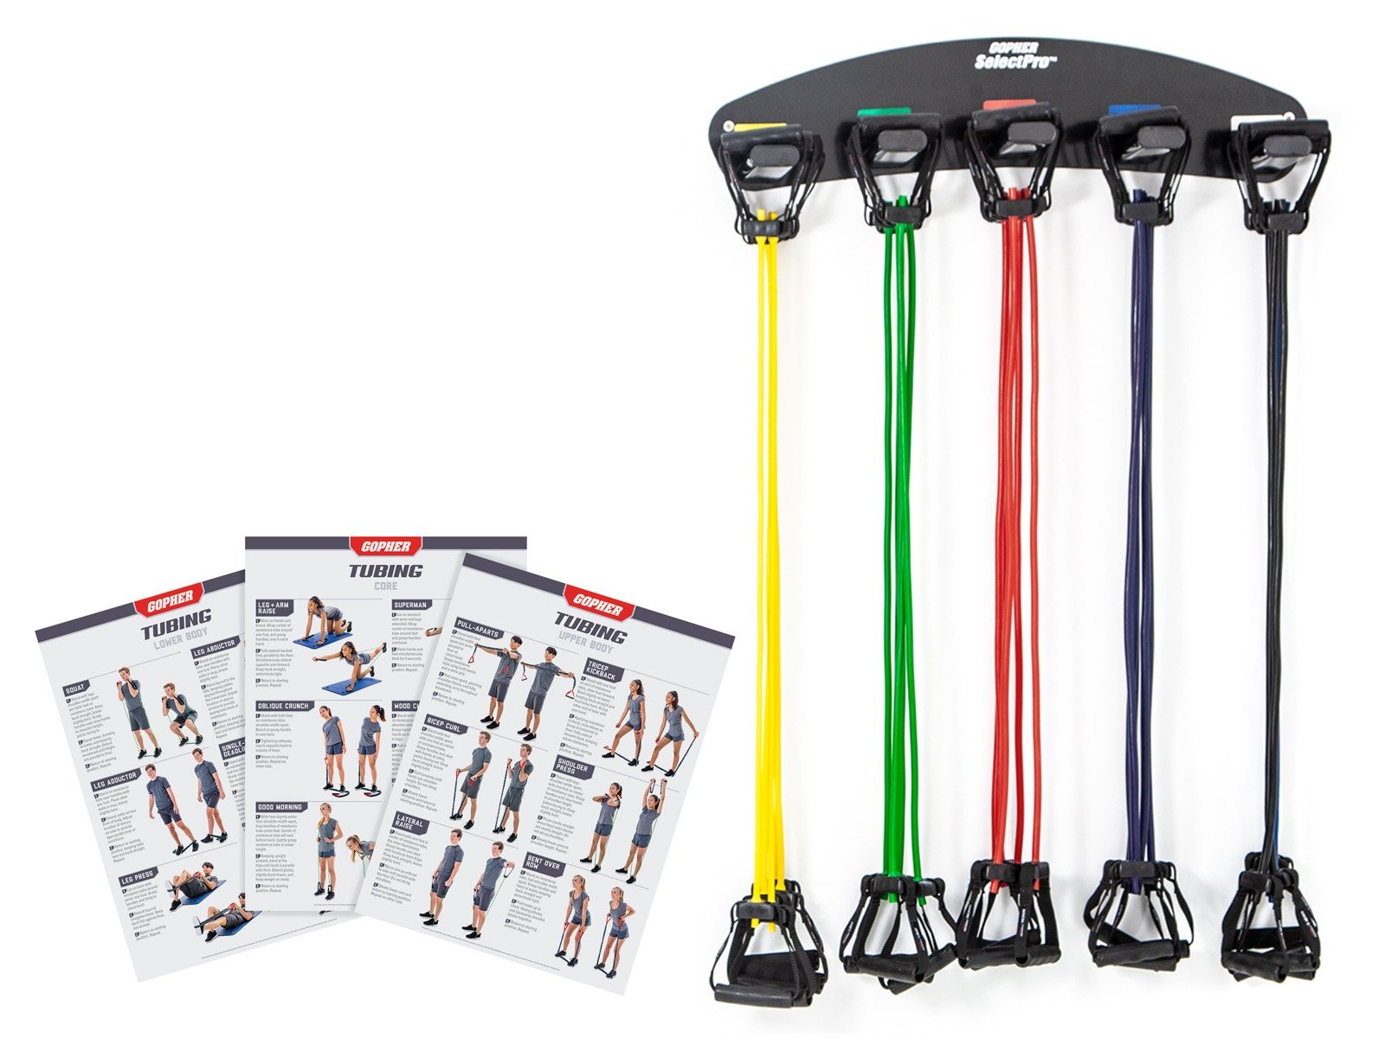
Biceps
Curls by being seated, placing one hand under opposite leg.
Simple version is to lift leg with no resistance.
Make curl more demanding by exerting downward pressure with the leg.
Empty plastic containers containing different amounts of water to change the amount of weight in each container or backpacks with some cans or books in them to change the weight.
Resistance Tubing
https://www.gophersport.com/fitness/resistance/prostretch-tube-plastic-handles?item=10440

Slide 49
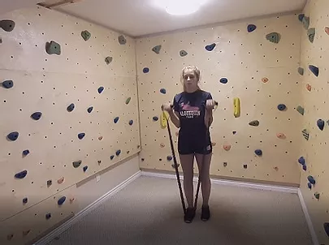
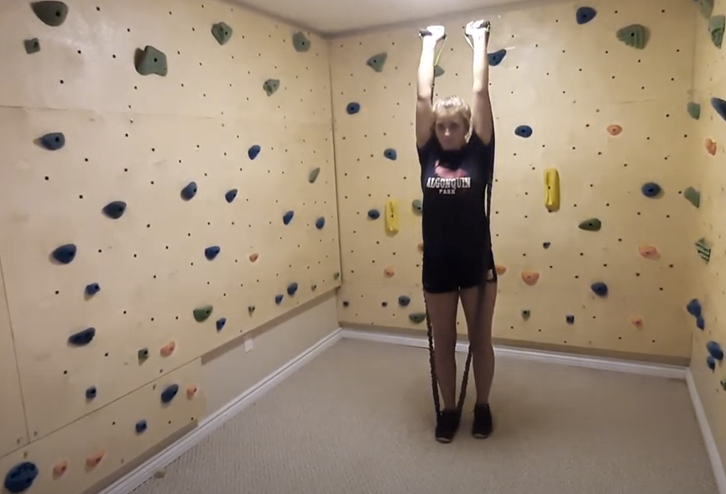
Biceps Con’t—Resistance Tubing https://www.canadago4sport.com/Warmups/Resistance-Tubing--Three-exercises

Slide 50
Ladder Activities
For about 50 different ways (use chalk to mark on pavement)
https://www.canadago4sport.com/agility-ladders
Ladder activities—for over 60 different activities, download the Ladder workshops at
https://www.canadago4sport.com/conferences-and-workshops

Slide 51
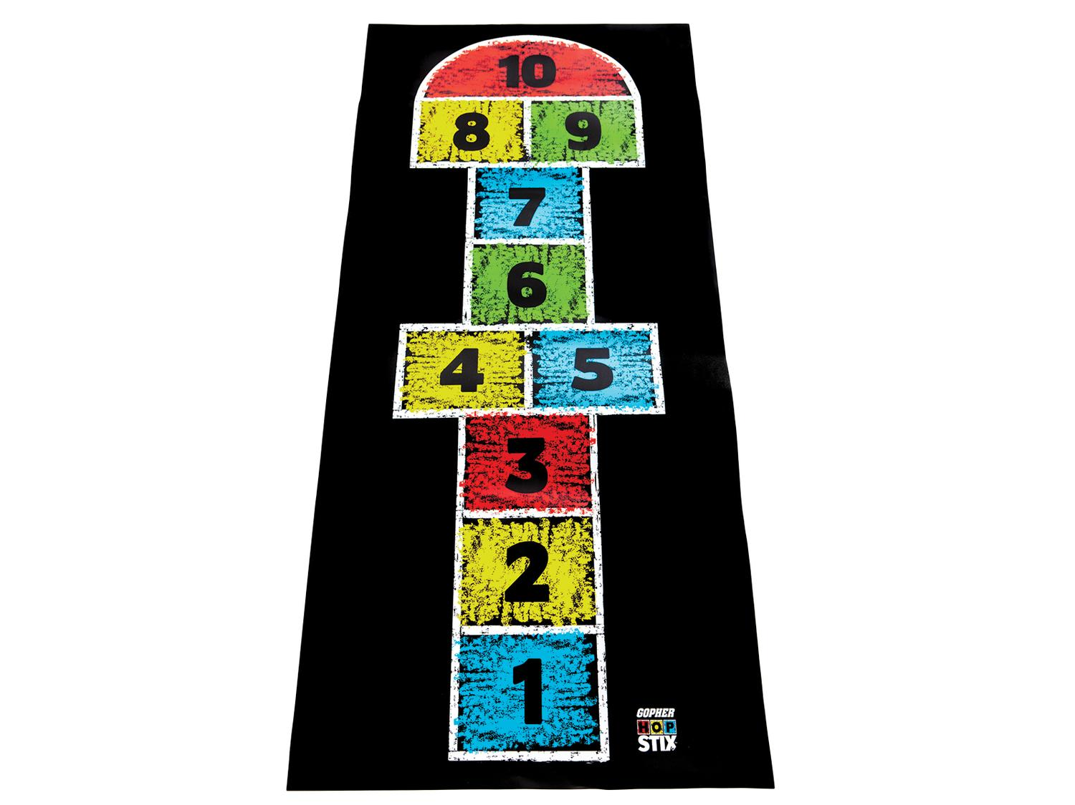
Hop Scotch
Need video still

Slide 52
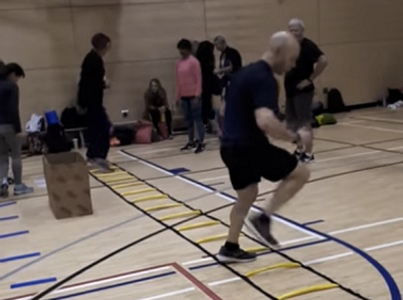
Ladder Activities Con`t Just with Feet
For example:

Slide 53
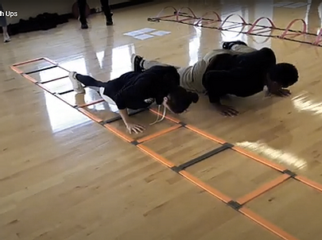
Ladder Activities Con`t With Feet and Hands
For example:

Slide 54
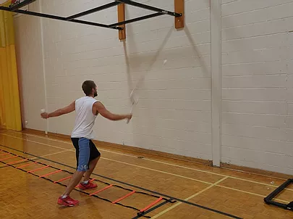
Ladder Activities Con`t With Additional Equipment
For example:

Slide 55
Dance
Resources https://www.gophersport.com/pe/dance?tg=1
Everybody Move https://www.gophersport.com/pe/movement/everybody-move?item=6202
Samples https://www.pinterest.ca/canadago4sport/dance/
Don`t Sit Still Swimming Groove

Slide 56
John’s Web Resources
Website
Agility Ladders
https://www.canadago4sport.com/agility-ladders
Target Games
https://www.canadago4sport.com/target-index
Combatives
https://www.canadago4sport.com/combative-index
Pinterest
https://www.pinterest.ca/canadago4sport/physical-education-at-home/

Slide 57
John’s Web Resources Con’t
Follow/Subscribe with John on Tuesdays+:
Twitter: https://twitter.com/canadago4sport
Instagram: @canadago4sport
Learn and follow/subscribe to many great ideas at his sites at:
Website (700+ activities; 400+ videos): www.canadago4sport.com
Pinterest (700+ pins; 23 boards): www.pinterest.ca/canadago4sport/
YouTube (400+ videos): www.youtube.com/c/canadago4sport

Slide 58
With thanks
To all of the wonderful people
who inspire each other
at conferences and other places!
To Gopher Sport
for their innovative products
and high quality equipment!

Slide 59
Download These Slides and Video Viewing at:
https://www.canadago4sport.com/confences-and-workshops
“Succeeding at Stay-at-Home PHE”

